Slide 1
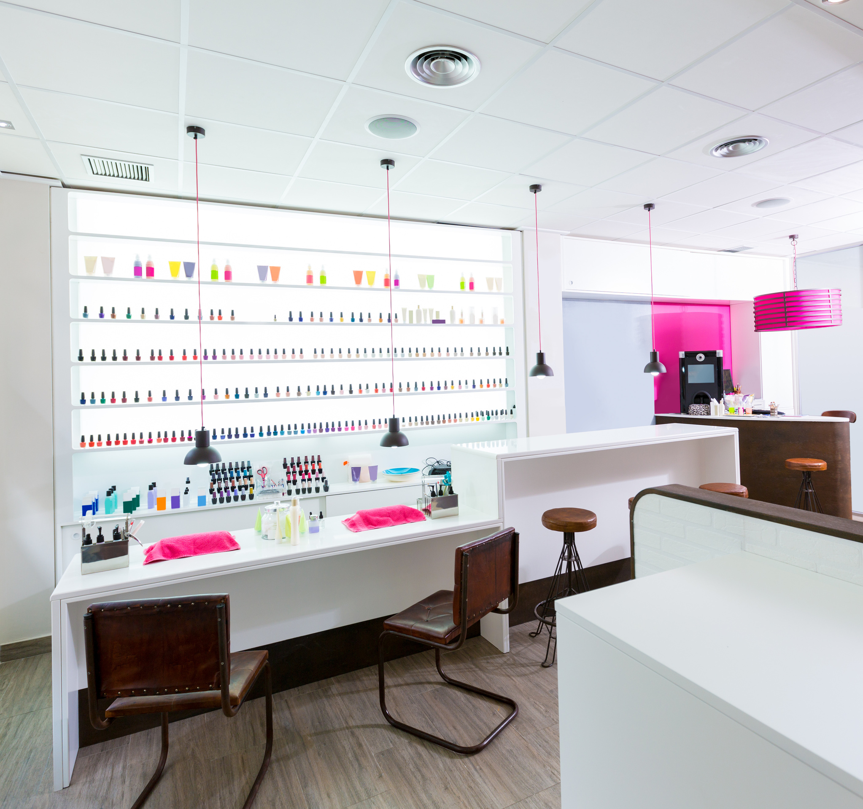
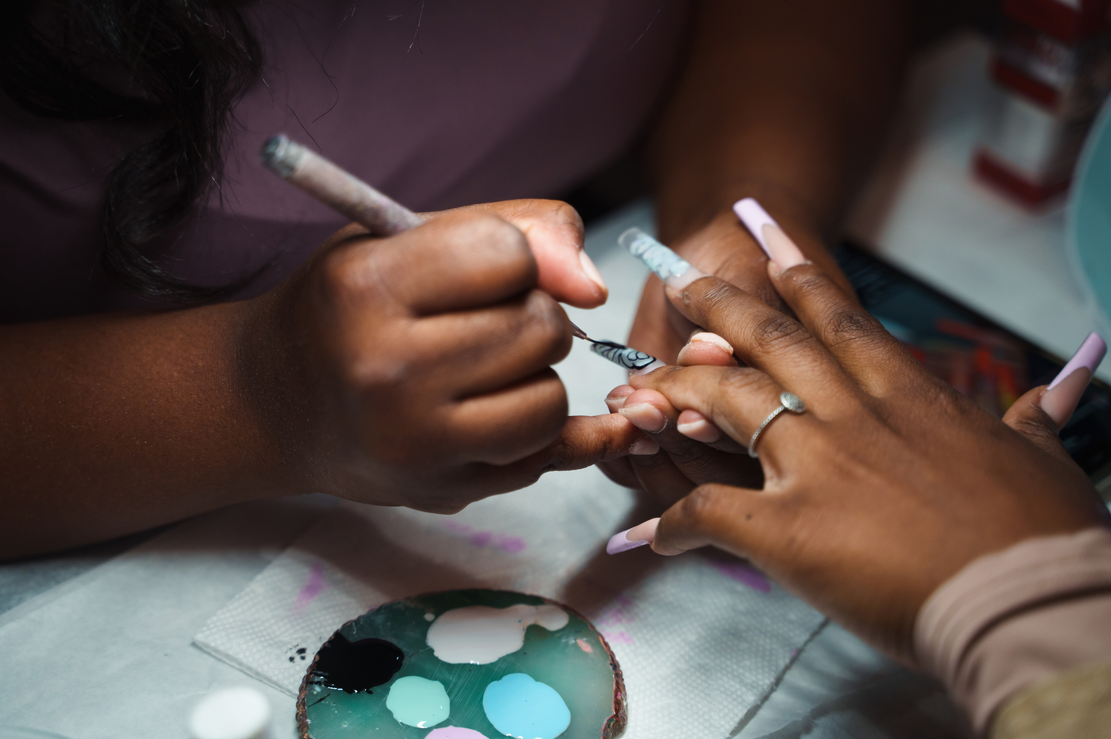


Trusted Nail Spa
Your Las Vegas
Nail Care Destination
Welcome to Trusted Nail Spa, your premier destination for all your nail care needs in Las Vegas. We're passionate about delivering the highest quality nail services, personalized to your unique style.

Slide 2

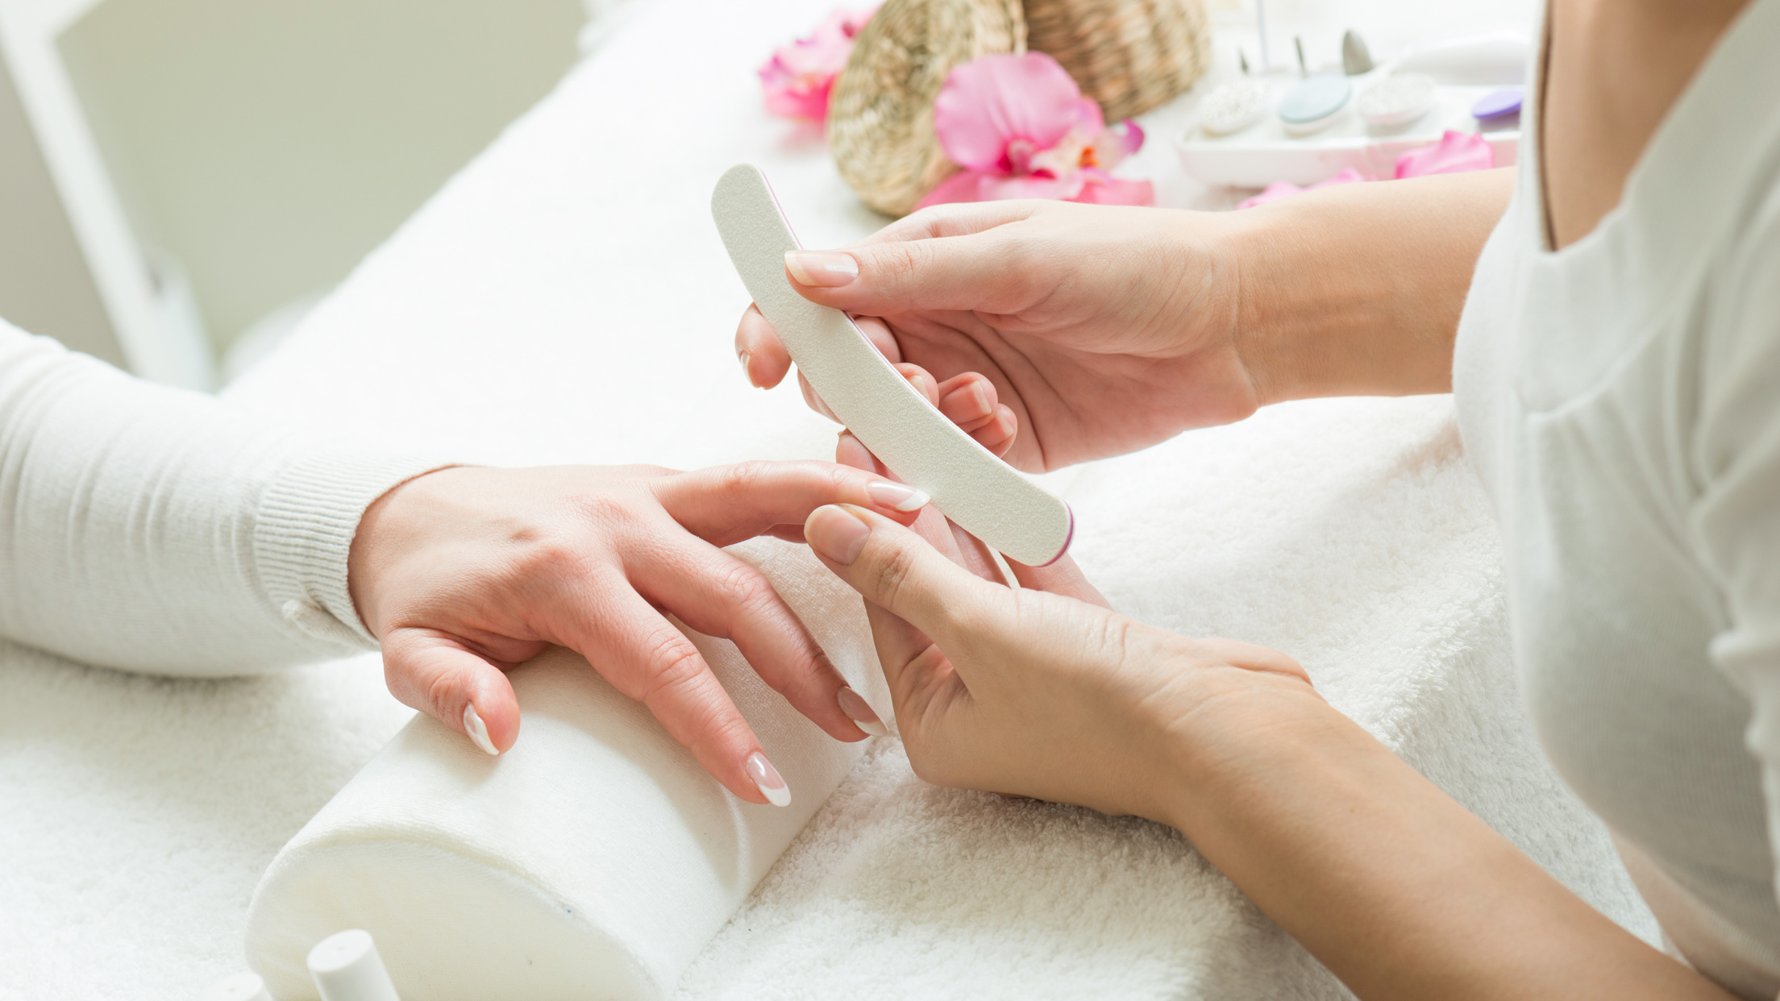
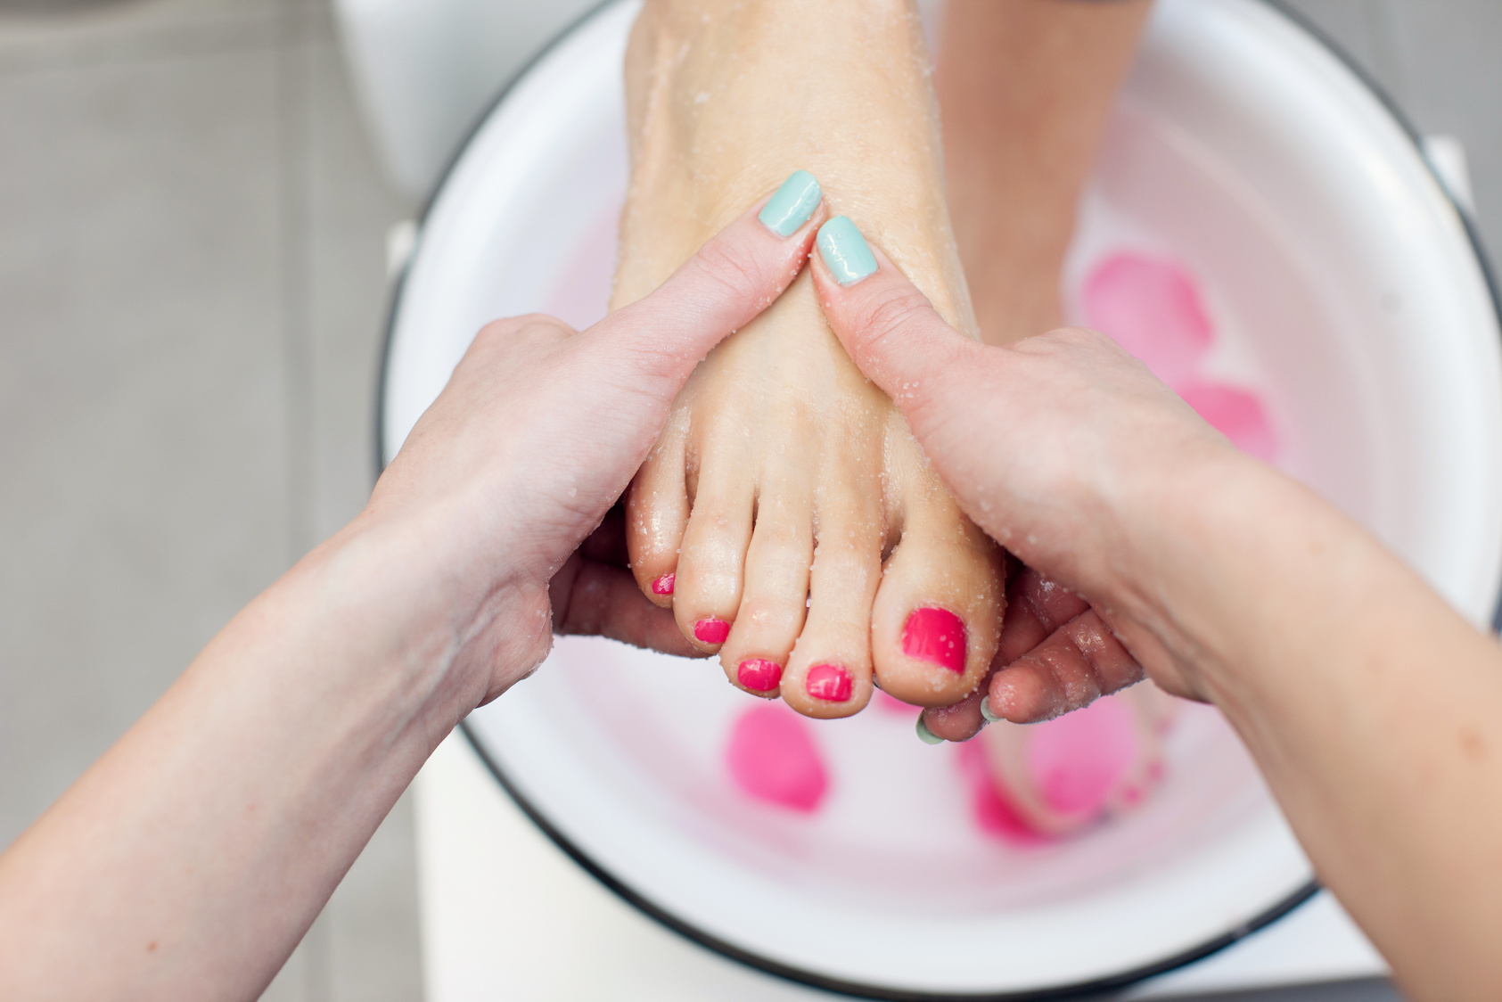
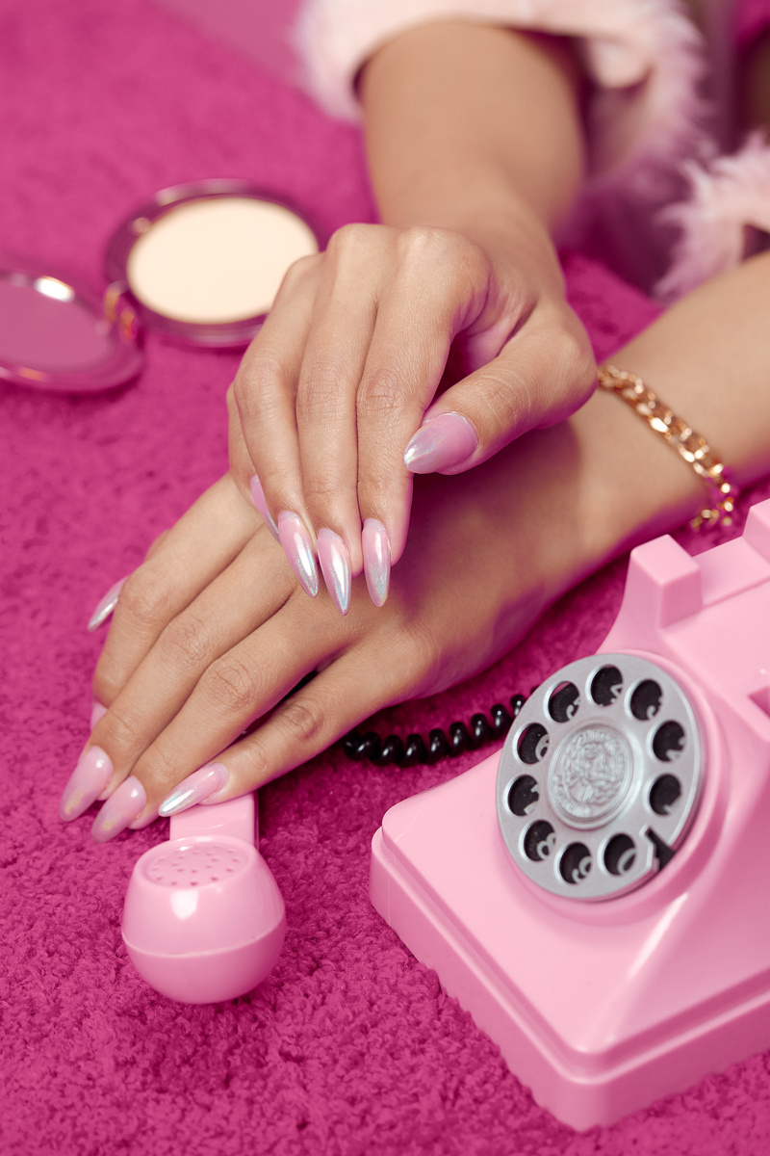
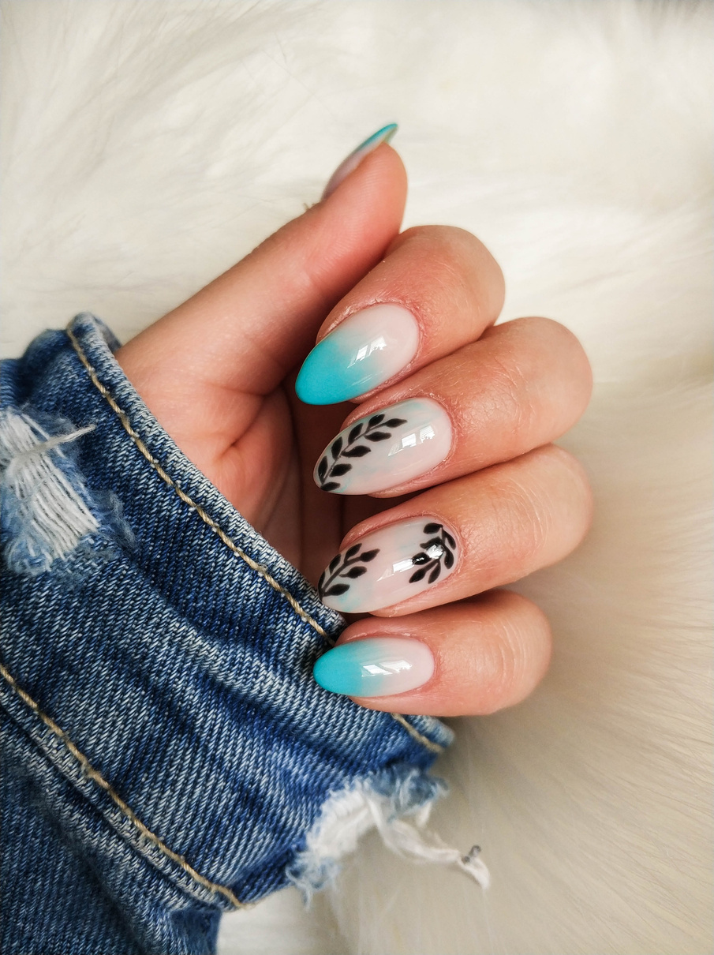
Unmatched Nail Services: From Classic to Creative
Manicures
Pedicures
Acrylic Nails
Nail Art
Our manicures are designed to pamper and nourish your nails, leaving them looking and feeling their best.
Experience the ultimate foot relaxation with our pedicures, featuring soothing treatments and expert nail care.
Get durable and long-lasting acrylic nails that enhance your natural beauty and offer endless styling possibilities.
Express your unique personality with our intricate nail art, crafted by our skilled technicians.

Slide 3
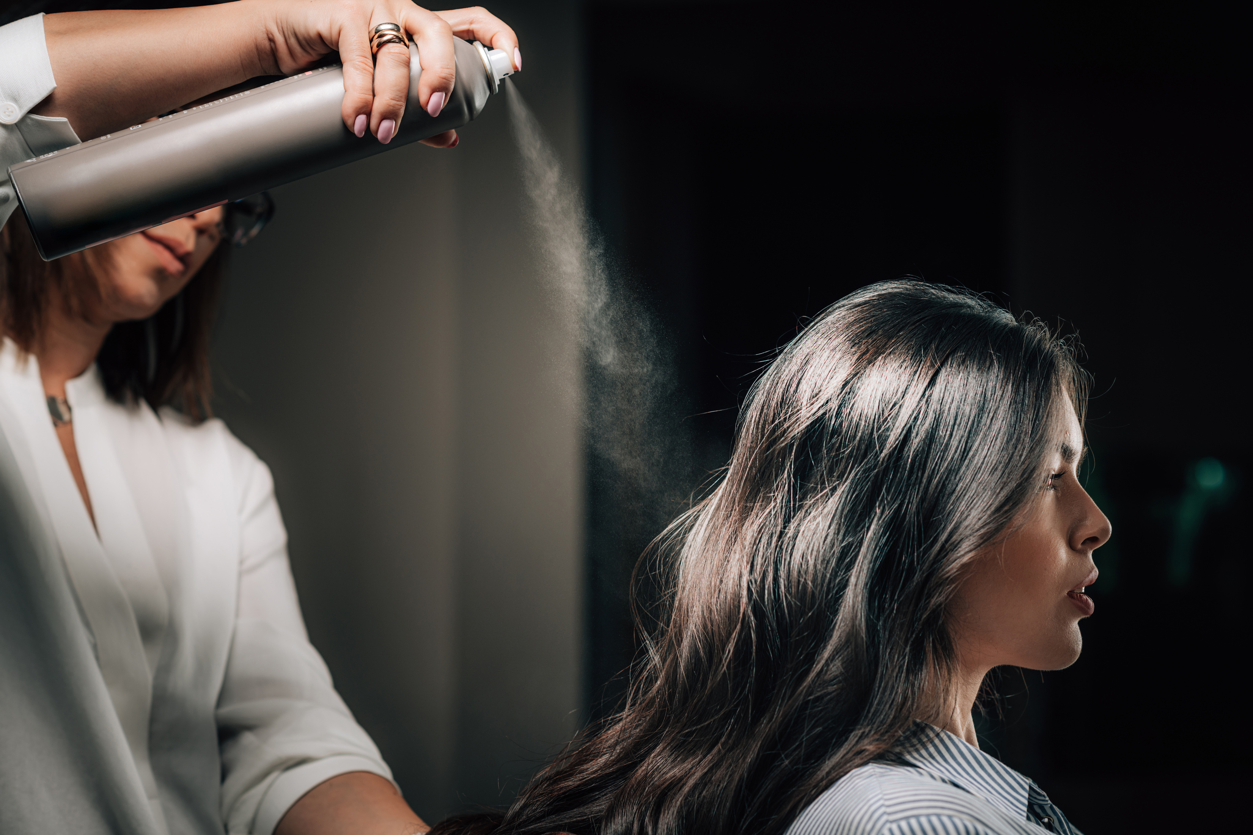
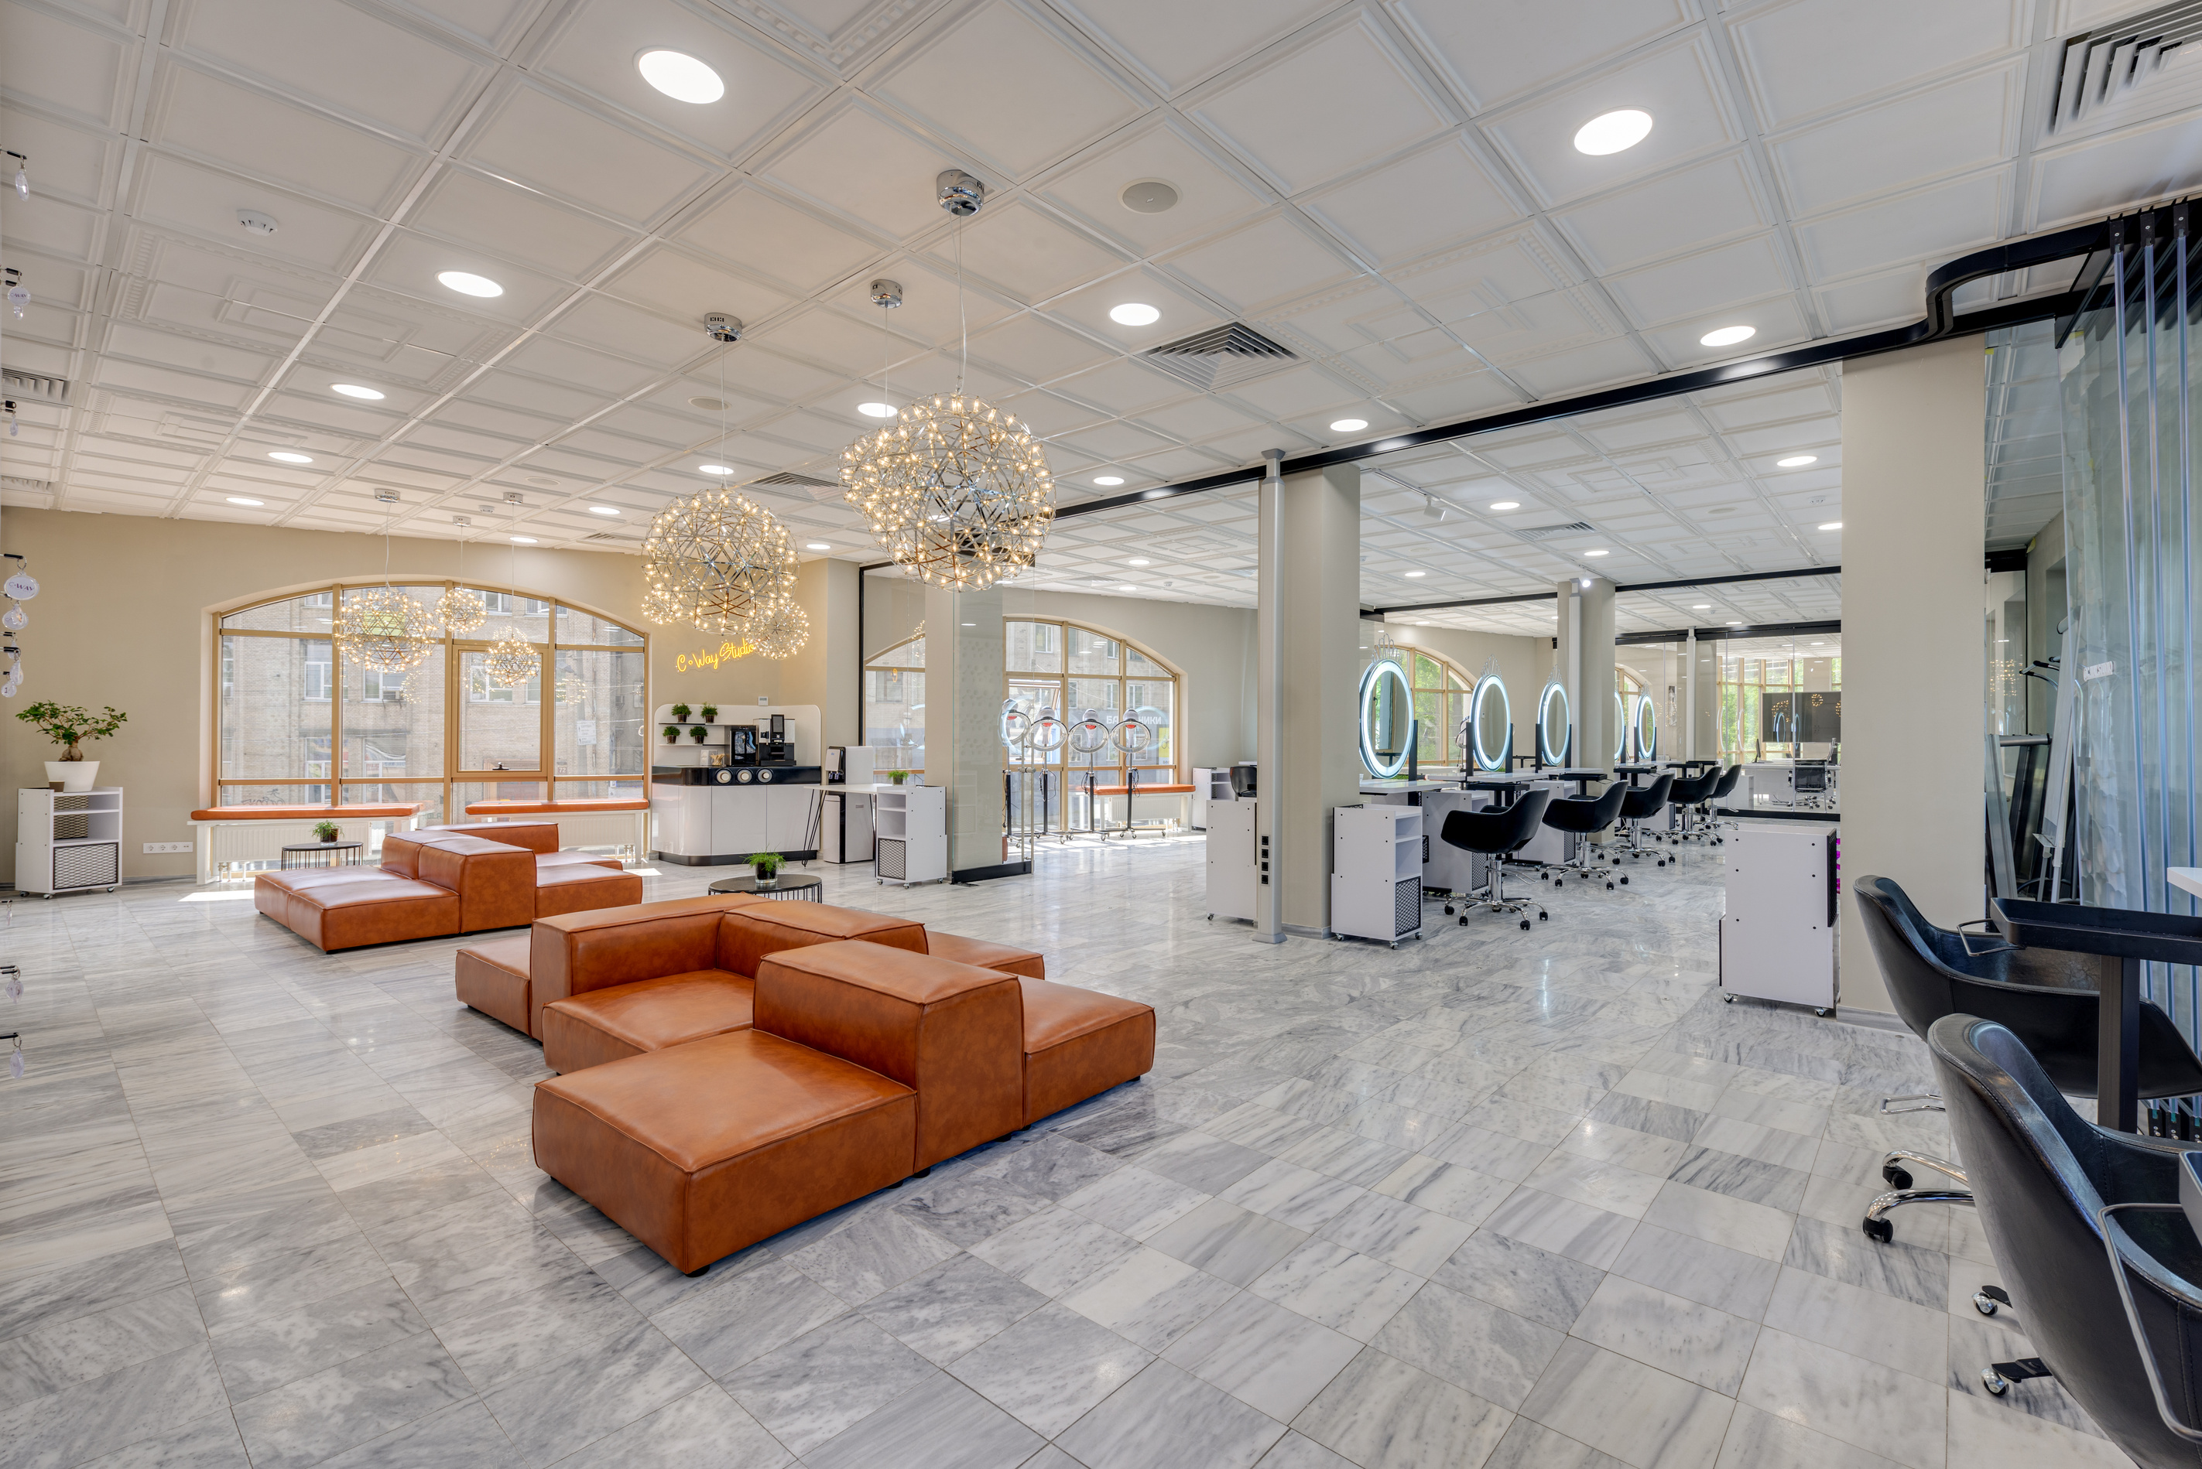

Skilled Technicians: The Heart of Our Success
Experienced
Creative
Our technicians have years of experience and a deep understanding of nail care.
They are talented artists who can bring your dream nail designs to life.
Passionate
Friendly
They are passionate about their craft and dedicated to providing the best service.
Our technicians are friendly and welcoming, making you feel comfortable and pampered.

Slide 4

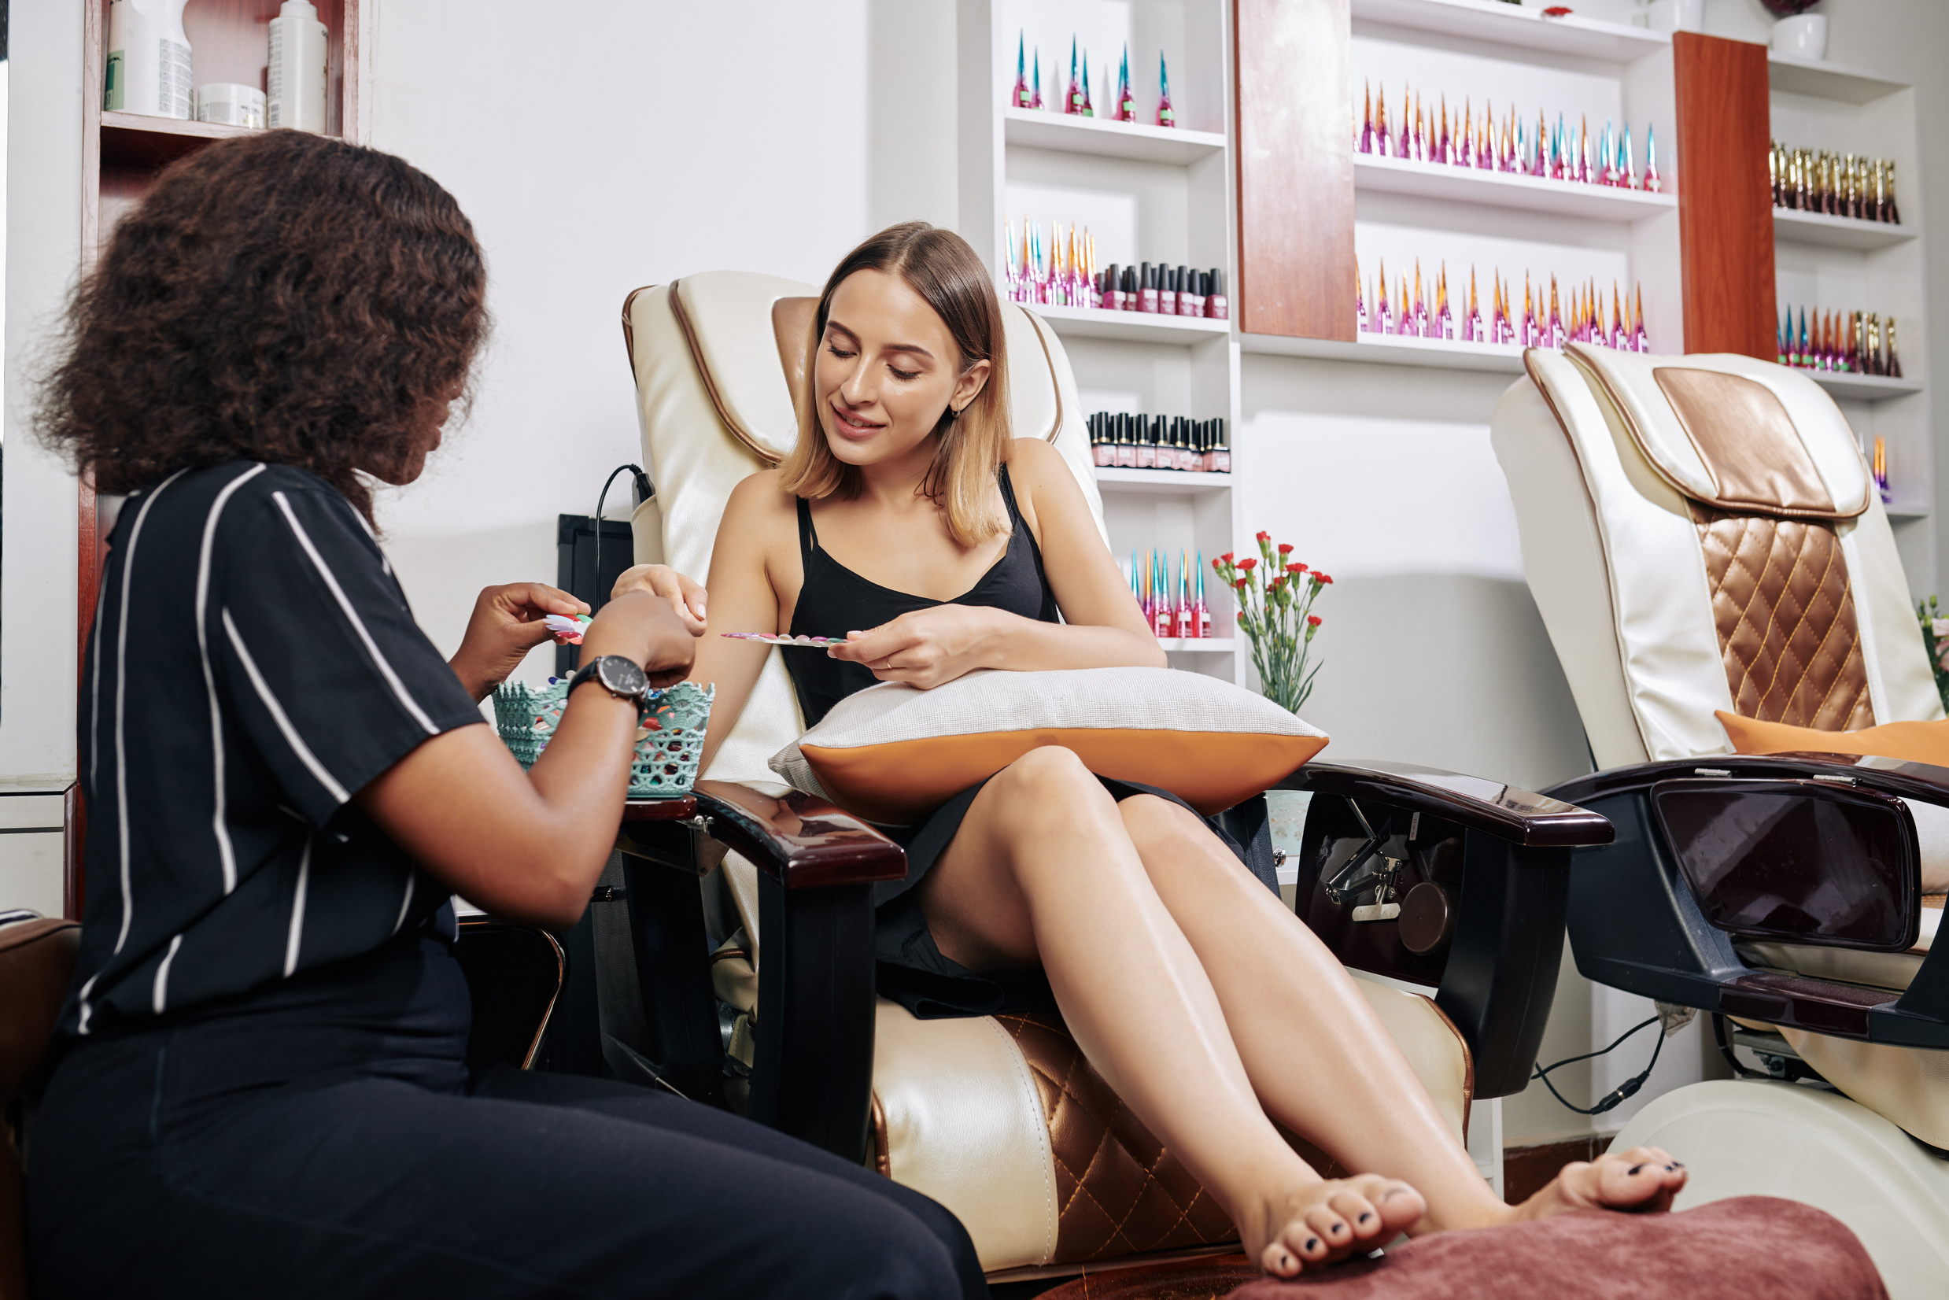

Relaxing Experience: A Sanctuary for Your Nails
  Comfort & Relaxation
We create a calming atmosphere where you can unwind and escape the stress of everyday life.
  Exceptional Hygiene
We maintain the highest standards of hygiene to ensure a clean and safe environment for our clients.
  Personalized Care
We cater to your individual needs and preferences, providing a personalized experience.

Slide 5

High-Quality Acrylic Nails: Durability and Style
Premium Products
1.
We use only the highest quality acrylic powder and liquid to ensure durability and long-lasting results.
Expert Application
2.
Our technicians are highly skilled in applying acrylic nails, creating a seamless and natural finish.
Endless Possibilities
3.
Acrylic nails offer endless possibilities for customizing shapes, lengths, and colors to match your style.

Slide 6
Soothing Manicures & Pedicures: Pamper Yourself
1.
Relaxation & Rejuvenation
Our manicures and pedicures are designed to pamper and rejuvenate your hands and feet.
Expert Techniques
2.
Our technicians use expert techniques to ensure your nails are perfectly shaped and polished.
Luxurious Products
3.
We use high-quality lotions and oils to nourish and moisturize your skin.

Slide 7
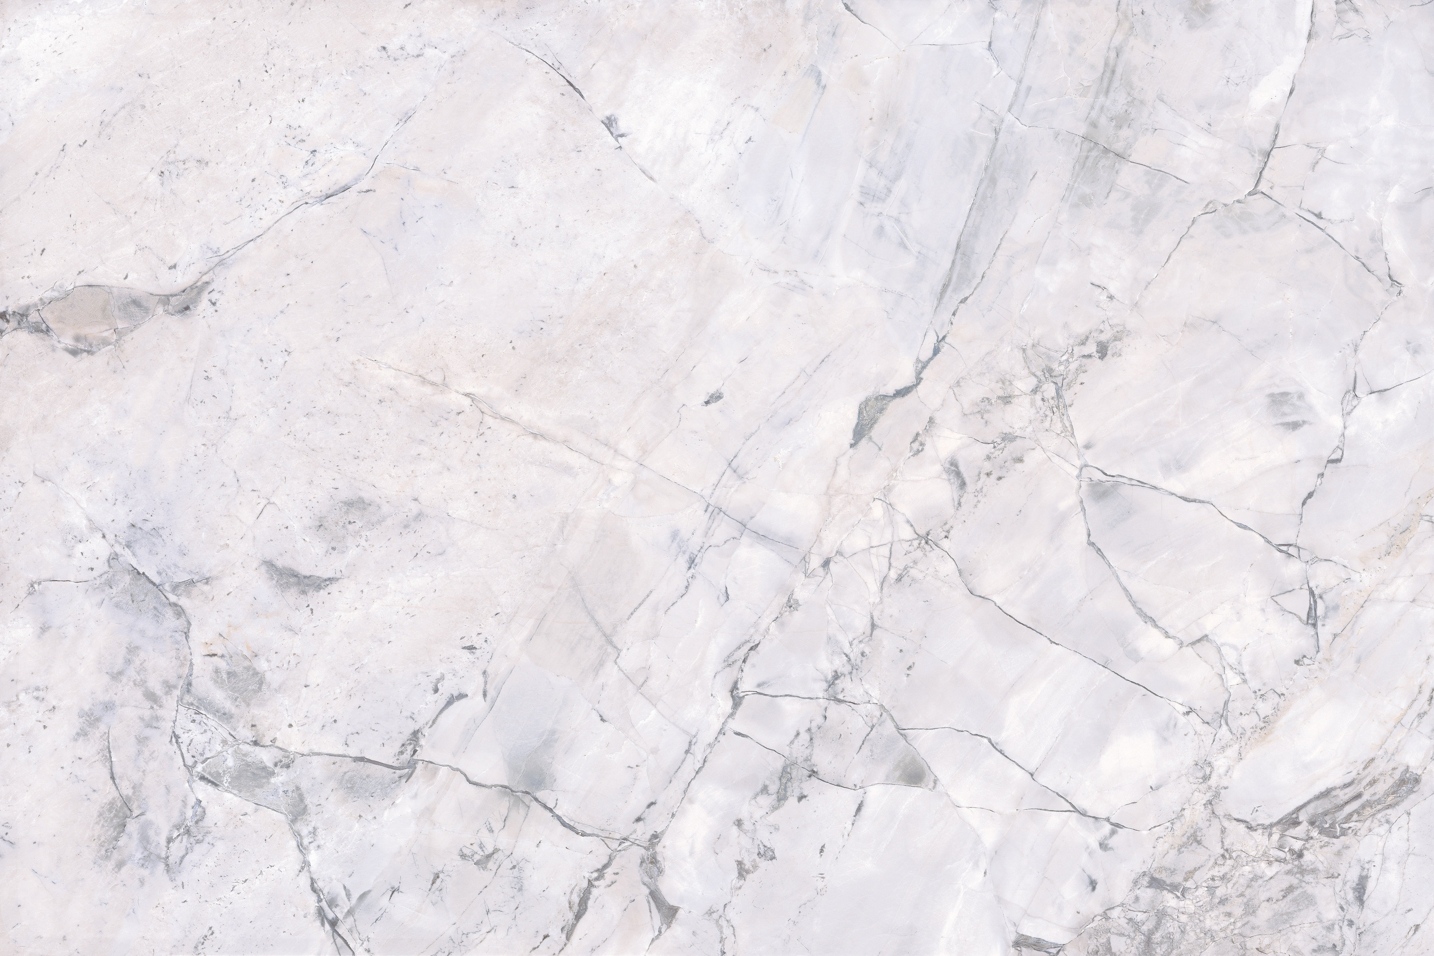
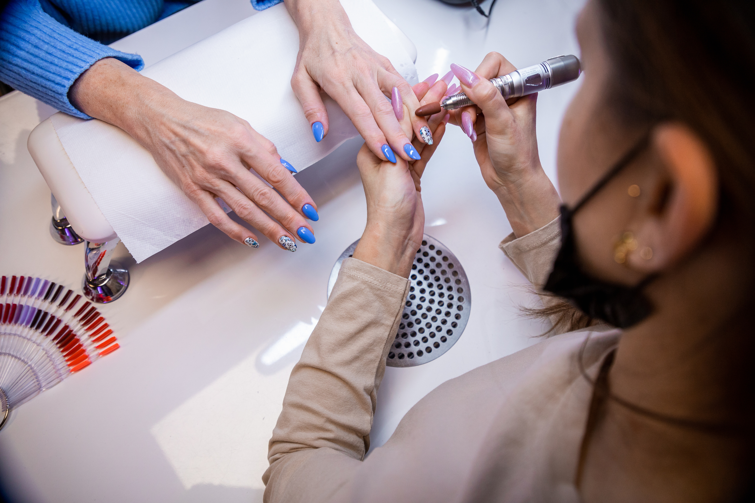

Committed to Customer Satisfaction: Your Nail Care Goals are Our Priority
Personalized Consultations
We take the time to understand your needs and preferences, ensuring your satisfaction.
Personalized Consultations
We take the time to understand your needs and preferences, ensuring your satisfaction.
Attentive Service
Our technicians are attentive and responsive, making you feel valued and cared for.

Slide 8
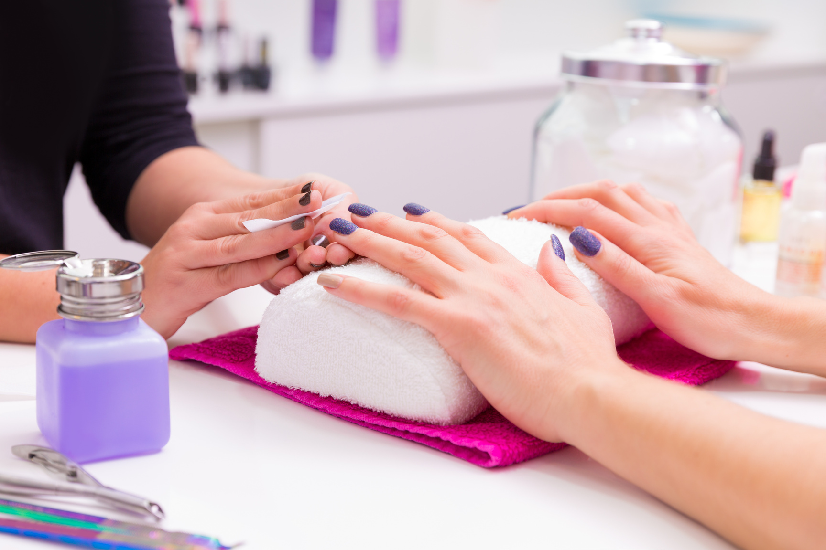
Convenient Scheduling
& Flexible Appointments
24/7
Multiple
Fast
Online Booking
Appointment Options
Response Time
Book your appointments online at your convenience, anytime, anywhere.
We offer flexible appointment times to fit your busy schedule.
We respond quickly to your inquiries and confirm your appointments promptly.

Slide 9
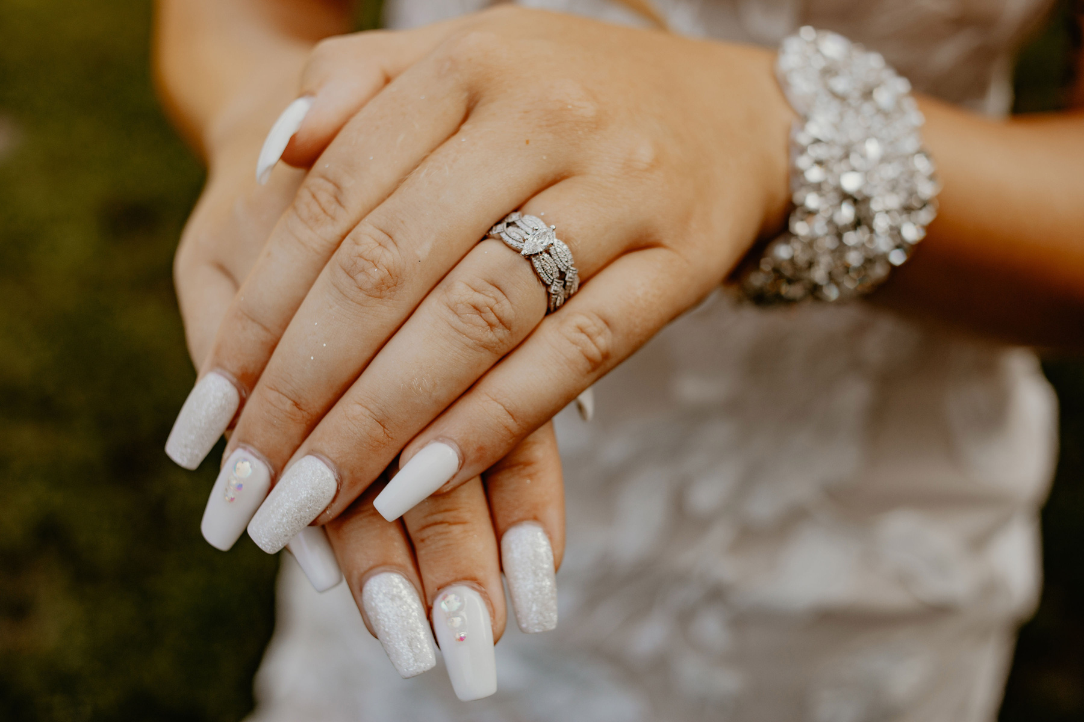

Trusted Nail Spa is more than just a nail salon; it's a haven for your nail care needs. We offer a unique combination of expertise, quality, and convenience, making us the absolute nail care authority in Las Vegas. Visit us today and experience the difference!
Contact
Phone us
(702) 998-9500
Email Us
trustednailspa@gmail.com
Address
9827 W Tropicana Ave #130, Las Vegas, NV

