Slide 1


How Self Service ATM Machines Support Scalable Operations

Slide 2


Start with a Clear Objective
Self-service ATM machines help create that structure. They reduce the need for manual handling. They also cut down on delays. Instead of waiting for end of day processes, transactions happen in real time. Think about it. A store manager should not spend hours counting cash. That time is better spent running the business. These machines shift the workload in a smart way.

Slide 3

A Day in the Life of a Growing Business
Let’s make it real. A retail chain opens five new locations. Sales increase. Cash volume grows. But the process stays the same. Manual counting. Delayed deposits. Long closing hours. Now add self-service ATM machines into the mix. Staff deposit cash during the day. The system records everything. Reports are ready without extra effort.

Slide 4
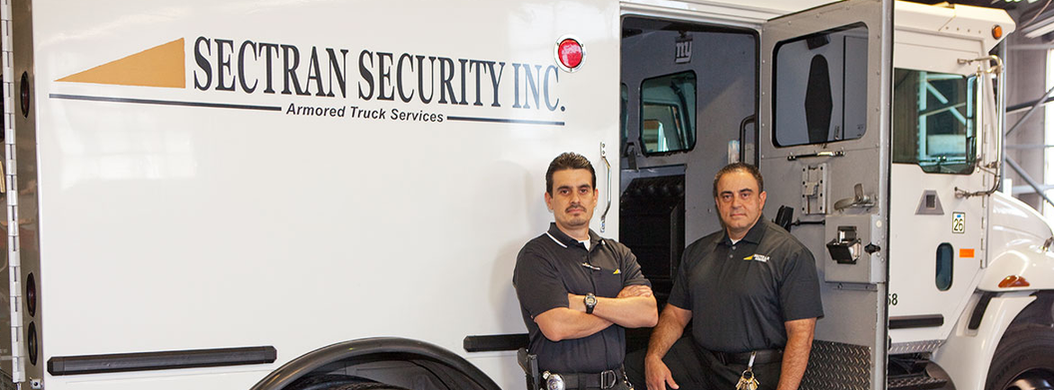
Why Accuracy and Speed Go Hand in Hand
Speed without accuracy creates problems. Accuracy without speed slows things down. Businesses need both. Self-service machines handle this balance well. They count fast and record every detail. That means fewer mistakes and faster reporting.

Slide 5
Is It Worth the Investment
These systems reduce risk. They save time. They improve accuracy. Over time, they pay for themselves through better efficiency. It is not just about cost. It is about value. Ask any growing business what matters most. They will say consistency. These machines help build that consistency. Sectran Security offers solutions that align with real business needs. Their approach focuses on secure cash handling, fast processing, and clear reporting.

Slide 6


CONTACT US
www.sectransecurity.com
P.O.Box 227267 Los Angeles, CA 90022
(562)-(948)-(1446)

