Slide 1



Quora Web Solution
Website Design and
Development
Company
Web Design & Web Development
Company in Bangalore, India
www.quorawebsolution.com
+91 9986 056 909
info@quorawebsolutions.com
24A, 1st Main Rd, Chandra Reddy
Layout, Koramangala 4th Block,
Koramangala, Bengaluru,
Karnataka 560034

Slide 2

Comprehensive Web Development Services: Your Digital Partner for Success
A website design and development company is a team of experts specializing in creating and maintaining online platforms. They offer a variety of services, including:
www.quorawebsolution.com

Slide 3

  Website Design: They craft visually stunning and user-friendly websites that accurately represent your brand's identity and message.
www.quorawebsolution.com

Slide 4

  Website Development: They construct the technical foundation of your website using cutting-edge programming languages and frameworks.
www.quorawebsolution.com

Slide 5
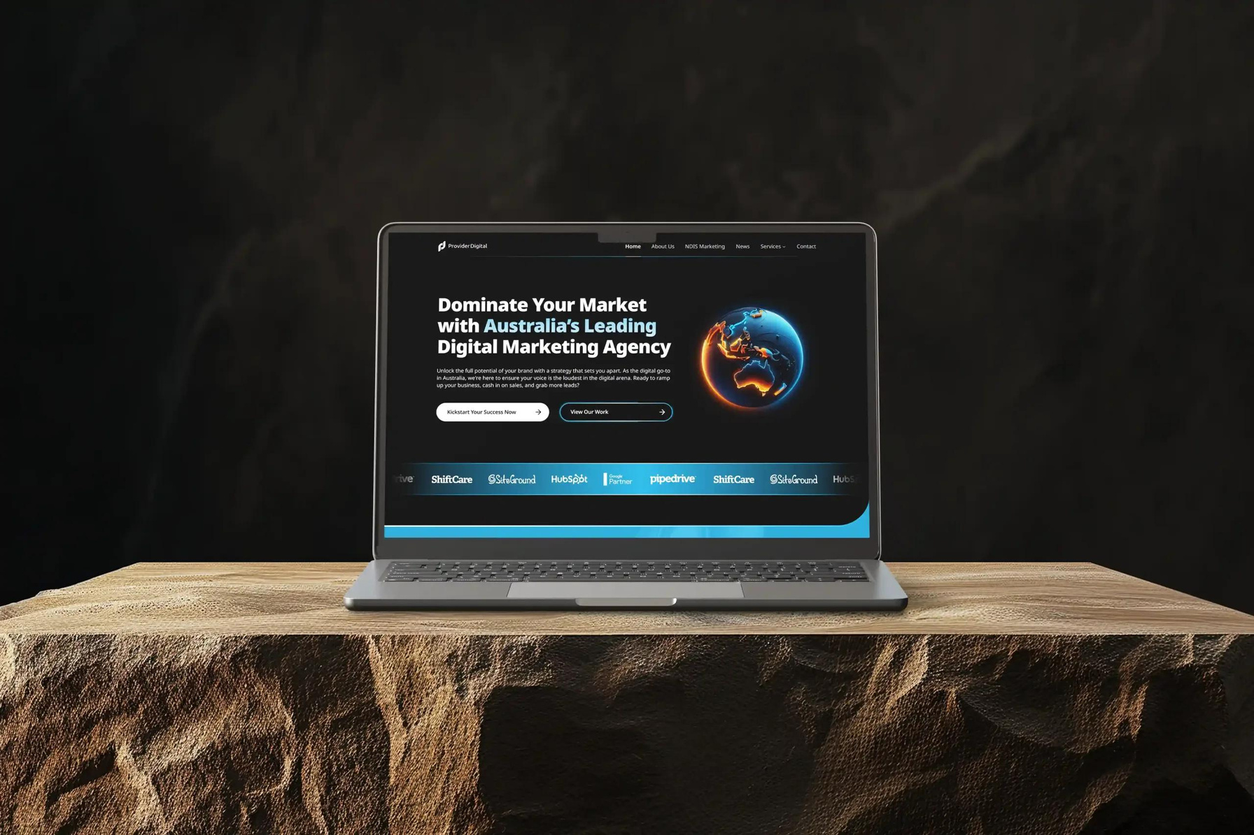
E-commerce Development: They build robust online stores that enable you to sell your products and services seamlessly online.
www.quorawebsolution.com

Slide 6
  Content Management Systems (CMS): They implement powerful CMS platforms that empower you to easily update and manage your website content.
  Search Engine Optimization (SEO): They optimize your website to enhance its visibility in search engine results, driving organic traffic to your site.
  Digital Marketing: They provide comprehensive digital marketing services, including social media marketing, email marketing, and pay-per-click advertising, to help you reach your target audience effectively.*
  ***When selecting a website design and development company, it's crucial to consider several key factors. First, evaluate their experience in the industry. Look for a company with a proven track record of delivering successful projects that align with your specific business objectives. A company with a strong portfolio of past work will provide you with a good sense of their capabilities and expertise.
www.quorawebsolution.com

Slide 7
Additionally, assess their pricing structure. While cost is a significant factor, it's essential to avoid compromising quality for the sake of saving money. Ensure that the pricing is transparent and aligns with the scope of work and your budget.
Effective communication is another crucial aspect to consider. A reputable website design and development company will maintain open and transparent communication throughout the project. They should also be willing to listen to your feedback and make adjustments as needed. This will help ensure that the final product meets your expectations and aligns with your vision.
Furthermore, don't hesitate to ask for references. A company with satisfied clients will be happy to provide you with testimonials or case studies. Speaking with previous clients can give you valuable insights into their experience working with the company, including factors such as project timelines, quality of work, and overall satisfaction.
www.quorawebsolution.com

Slide 8
Consider asking about the company's responsiveness to their needs, their ability to meet deadlines, and the level of support provided after the project was completed.
Finally, it's important to assess the company's cultural fit. Does their approach to work align with your values and preferences? Do they have a collaborative and supportive team? A company that shares your values and work ethic is more likely to deliver a successful project and a positive working experience.
To further evaluate a website design and development company, consider the following additional factors:
Technical expertise: Ensure that the company has the necessary technical skills and expertise to handle your specific project requirements. This may include knowledge of programming languages, content management systems, and e-commerce platforms.
www.quorawebsolution.com

Slide 9
  Project management capabilities: A well-organized and efficient project management team can help ensure that your project stays on track and meets deadlines. Look for a company with a proven track record of successful project management.
  Scalability: If your business is growing or you anticipate future expansion, consider a company that can accommodate your evolving needs. A scalable website design and development solution can help you avoid costly redesigns or re-platforming in the future.
  Creativity and innovation: A company that is creative and innovative can help you stand out from your competitors. Look for a company that can offer fresh ideas and unique solutions to your website design and development challenges.
After-sales support: A reputable company will provide ongoing support and maintenance services after your website is launched. This may include updates, troubleshooting, and security patches.
www.quorawebsolution.com

Slide 10
When evaluating a website design and development company, it's also important to consider their approach to user experience (UX) design. A well-designed website should be intuitive, easy to navigate, and visually appealing. Look for a company that understands the importance of UX and can create a website that is not only functional but also engaging for your users.
Additionally, assess the company's portfolio of past work. This will give you a sense of their capabilities and the types of projects they have experience with. Look for examples of websites that are similar to your project and evaluate the quality of the design, functionality, and user experience.
Furthermore, consider the company's approach to mobile optimization. In today's mobile-first world, it's essential that your website is accessible and user-friendly on all devices. Look for a company that specializes in creating responsive or adaptive websites that provide a seamless experience across different screen sizes.
www.quorawebsolution.com

Slide 11
Finally, don't be afraid to ask questions. A reputable website design and development company will be happy to answer your questions and provide you with more information about their services. By carefully considering these factors, you can select a company that is the right fit for your business and can help you achieve your online goals.
In addition to the factors mentioned above, it's also important to consider the company's approach to security and data privacy. In today's digital age, protecting your website and your customers' data is essential. Look for a company that has a strong commitment to security and can implement measures to safeguard your website from vulnerabilities and attacks.
Finally, don't be afraid to negotiate. While cost is a factor, it's important to get the best value for your money. Don't hesitate to negotiate on pricing, project scope, and timelines to ensure that you're getting a fair deal.
www.quorawebsolution.com

Slide 12
By carefully considering these factors, you can select a website design and development company that can help you create a successful online presence. Remember, a well-designed and developed website is not just a digital brochure; it's a powerful tool that can help you attract new customers, generate leads, and grow your business.***
**Your Digital Ally: A Website Design and Development Company
In the ever-evolving digital landscape, a website has become an indispensable tool for businesses and individuals alike. It serves as a virtual storefront, a platform for showcasing products and services, and a means of connecting with customers and clients.
www.quorawebsolution.com

Slide 13
However, creating a website that effectively achieves these goals requires the expertise of a skilled and experienced team. That's where a website design and development company comes in.
A website design and development company specializes in crafting custom websites that are not only visually stunning but also highly functional, user-friendly, and optimized for search engines. They work closely with clients to understand their unique needs and objectives, and then leverage their technical skills and creative talents to create websites that exceed expectations.
From the initial concept to the final launch, a website design and development company provides comprehensive services that cover every aspect of the website creation process. This includes:
Website Design: Creating visually stunning websites that align with the client's brand identity and target audience.
www.quorawebsolution.com

Slide 14
  Web Development: Building functional and efficient websites using the latest technologies and programming languages.
  E-commerce Development: Developing online stores that enable businesses to sell products and services online.
  Content Management Systems (CMS):: Implementing CMS platforms like WordPress, Drupal, or Joomla to make website management easier.
  Search Engine Optimization (SEO): Optimizing websites to improve their visibility in search engine results by employing various techniques such as keyword research, on-page optimization, link building, and content marketing.
  Mobile App Development: Creating mobile applications for iOS and Android platforms.
By partnering with a reputable website design and development company, businesses and individuals can benefit from the following advantages:
www.quorawebsolution.com

Slide 15
  Expertise and Experience: A website design and development company has the expertise and experience to create websites that are both visually appealing and functionally effective.
  Customized Solutions: They can tailor their services to meet the specific needs and objectives of each client.
  Time and Cost Savings: By outsourcing website development, businesses and individuals can save time and money.
  Improved Online Presence: A well-designed and optimized website can help businesses and individuals improve their online presence and attract more customers.
If you're looking for a website design and development company to help you create a website that stands out from the competition, be sure to consider the following factors:
www.quorawebsolution.com

Slide 16
  Portfolio: Explore the company's portfolio to discover their design expertise, technical proficiency, and ability to deliver projects that align with your vision. Immerse yourself in their past work to assess their design aesthetics, functionality, and overall quality.
  Experience: Look for a company with experience in your industry or with similar projects.
  Client Testimonials: Read reviews from previous clients to get an idea of their satisfaction.
  Communication: Ensure that the company has good communication skills and is responsive to your needs.
  Pricing: Compare pricing options and ensure that the cost aligns with your budget and requirements.
www.quorawebsolution.com

Slide 17
By choosing the right website design and development company, you can create a website that effectively represents your brand, engages your audience, and drives your business forward.
A website design and development company is a team of experts who specialize in creating, designing, and maintaining websites for businesses and individuals. They offer a comprehensive suite of services tailored to meet your unique needs and goals, including:
  Website Design: Crafting visually stunning and user-friendly websites that align with your brand's identity and goals.
  Web Development: Building robust and efficient websites using the latest technologies and programming languages.
  E-commerce Development: Creating seamless online shopping experiences that drive sales and conversions.
  Content Management Systems (CMS): Implementing user-friendly platforms that empower you to easily manage and update your website's content.
www.quorawebsolution.com

Slide 18
  Search Engine Optimization (SEO): Optimizing your website to improve its visibility in search engine results and attract organic traffic.
  Mobile App Development: Creating custom mobile apps that enhance your brand's reach and engagement.
When choosing a website design and development company, consider the following key factors:
  Portfolio: Examine the company's portfolio to assess their design capabilities, technical proficiency, and ability to deliver projects that align with your vision.
  Experience: Seek a company with a proven track record in your industry or with similar projects, demonstrating their expertise and understanding of your specific needs.
  Client Testimonials: Read reviews from previous clients to gain insights into their satisfaction with the company's services, communication, and project outcomes.
  Communication: Ensure the company has strong communication skills and is responsive to your inquiries, ensuring a collaborative and transparent working relationship.
www.quorawebsolution.com

Slide 19
  Pricing: Compare pricing options and ensure that the cost aligns with your budget and the scope of the project, while considering the value and quality of the services offered.
By partnering with a skilled website design and development company, you can create a website that not only looks great but also effectively serves your business objectives.
www.quorawebsolution.com

Slide 20
Quora Web Solution: Quora Web Solution is a trusted website development company based in Bangalore, India, offering a wide array of services to not only domestic but global clientele. Be it Website Design and Development, SEO services, Digital Marketing, Branding, App Development, Ecommerce Solution, and Logo Creation . Quora Web Solution has the best website developers offering top quality services and that is the reason why we are well known as one of the best Website Development Companies in Bangalore, India.
Visit Us - www.quorawebsolution.com
Call Us - +91 9986 056 909
Mail Us - info@quorawebsolutions.com
www.quorawebsolution.com

Slide 21




Services
WORDPRESS DEVELOPMENT
ECOMMERCE DEVELOPMENT
PHP DEVELOPMENT
CMS DEVELOPMENT
DRUPAL DEVELOPMENT
WEBSITE SERVICES
WEBPORTAL DEVELOPMENT
MAGENTO DEVELOPMENT
WEBSITE DEVELOPMENT
JOOMLA DEVELOPMENT
SMALL BUSINESS DEVELOPMENT
CHEAP WEBSITE DEVELOPMENT
STATIC WEBSITE DEVELOPMENT
DYNAMIC WEBSITE DEVELOPMENT
WEBSITE DESIGN COMPANY
TOUR AND TRAVEL WEBSITE DEVELOPMENT

