Slide 1

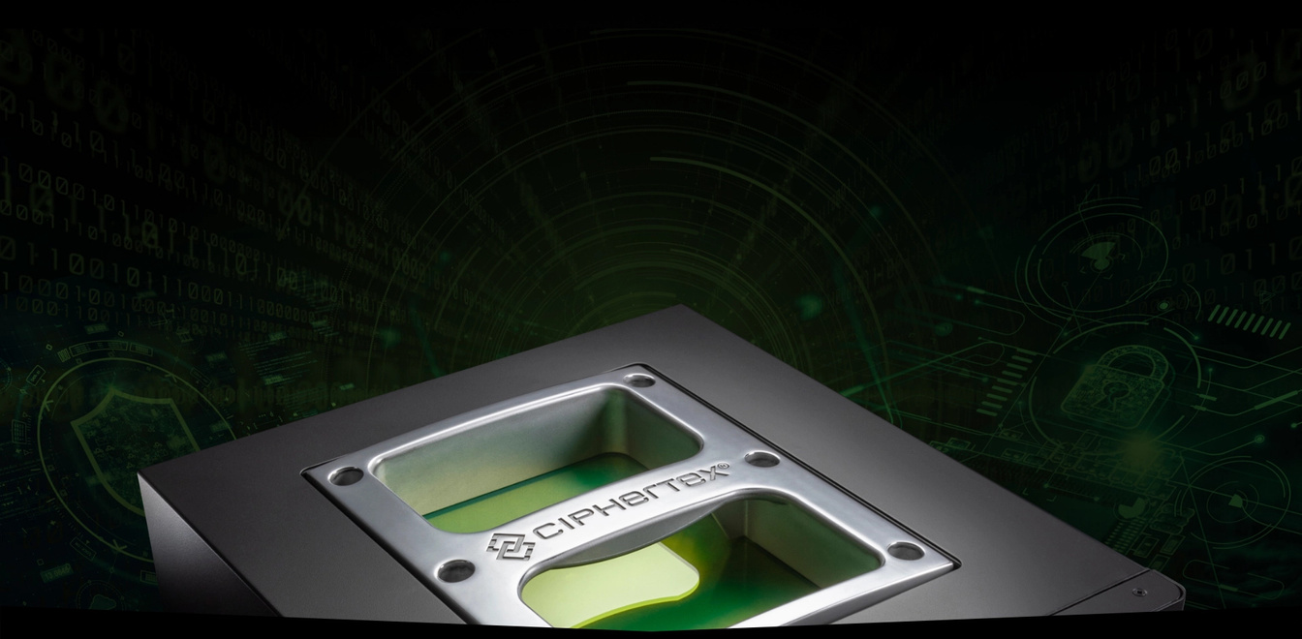
Ciphertex
www.ciphertex.com

Slide 2

Introduction
Ciphertex Data Security is a leading provider of secure data storage and transportation solutions. Specializing in rugged, portable NAS devices and advanced data protection technologies, Ciphertex serves industries like healthcare, finance, forensics, and more.

Slide 3

Features of Portable Network Storage
  High-Capacity Storage: From terabytes to petabytes, we’ve got you covered.
  High-Speed Connectivity: Supports ultra-fast data transfers with options like 100GbE and Wi-Fi integration.

Slide 4
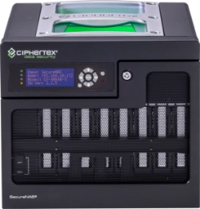
Applications of Ciphertex Portable Network Storage
  Healthcare: Secure patient data storage and HIPAA compliance.
  Media & Entertainment: Effortlessly handle large video and audio files.
  Defense & Government: Portable solutions tailored for sensitive missions.

Slide 5
THANK YOU VERY MUCH!
Visit us: www.ciphertex.com
Contact us: 1 (877) 977-8878

