Slide 1
How Custom Home Builders Cape Coral FL Cater To Smart Living Trends

Slide 2
Once we purchase our dream house, it is imperative to provide a personal touch to it. This can be done by hiring custom home builders who will allow you to stay in the house according to your liking. There are also other benefits of hiring custom home builders Cape Coral FL that we have explained in this article.

Slide 3
Flexibility
As already mentioned, a custom home builder will enable you to tweak your house according to your personal taste. You can inform the homebuilder regarding which materials will be used for constructing the house. Moreover, if you do not like a particular aspect of the house, you can instruct them to modify it. In this way, it’ll be possible for you to enjoy your stay in the residence in a pleasurable manner.

Slide 4
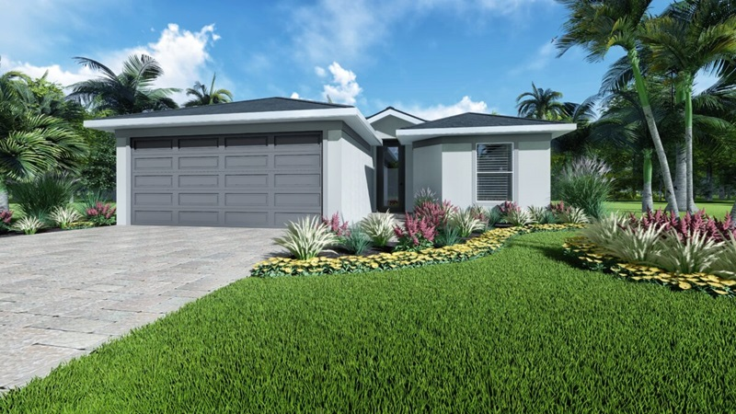
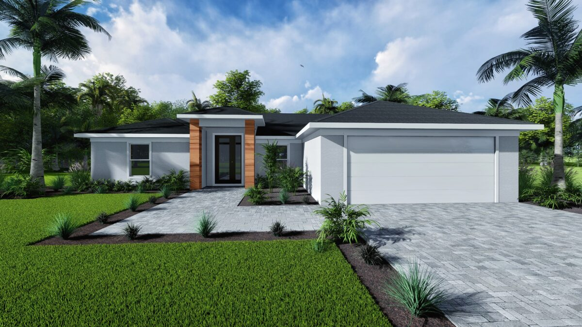
Some Homes Design In Cape Coral

Slide 5
Save Your Time
Custom builders take on the task of building your home right from the start, thus ensuring a flawless construction process. This will help to free up your time for other activities while they will guarantee timely completion of the project.

Slide 6
Save Cash
One beneficial aspect of hiring custom home builders Cape Coral FL is that they will help you to save your cash. They will make sure that the house is constructed within your budget which will be beneficial for you in the long run. While supervising the construction process, they will purchase materials for building the house at an inexpensive rate. They might also have connections with local suppliers who will provide them with discounts and bonuses.

Slide 7
Expertise
It is imperative to construct your house in accordance with the local rules and regulations. Moreover, it has to be constructed in a flawless manner so that it can last for quite some time. Custom home builders will make it possible for you to do so. They have already worked with many customers in the past, which will help them to build your house in the best possible way.

Slide 8
Reduced Maintenance Charges
Custom home builders will also help you to lower your house’s maintenance charges. Although they might end up asking for a significant upfront payment, its value will become depreciated over time. There will not be any need for you to update your house for quite some time after the completion is over. In this way, you can enjoy staying in your house in a cost-effective manner.

Slide 9
Will Stick to a Streamlined Process
There is no doubt that the process of building a house is rather complicated. However, Cape Coral Custom Home Builders have plenty of experience under their belt, which will make the process streamlined without fail. They will make everything easy for you so that you can recommend these builders to your near and dear ones.

Slide 10
CONTACT US
Company Name- Sposen Signature Homes
Address- 2311 Santa Barbara Blvd, Suite 112, 33991 Cape Coral, Florida, USA
Toll-Free –239-244-8886
Email ID- hello@sposenhomes.com
Website : https://sposenhomes.com

Slide 11
THANKS FOR WATHCHING

