Slide 1

Pure Precision: Micro Thermics Aseptic Processing Equipment
Aseptic Processing Equipment

Slide 2
About us
Microthermics provides an extensive array of HTST/UHT processors and homogenizers tailored for liquid processing needs. Engineered for precision, reliability, and adaptability, our products ensure optimal product quality and safety throughout your production process. Ideal for dairy, beverage, and other liquid processing applications, our HTST/UHT processors consistently deliver reliable results. Their modular design facilitates seamless customization and expansion to accommodate evolving needs.

Slide 3
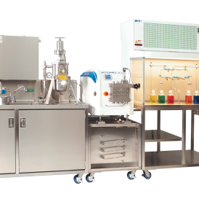
Pure Precision: Micro Thermics Aseptic Processing Equipment
Elevate your production standards with Microthermics' Aseptic Processing Equipment. Engineered with precision and purity in mind, our advanced systems ensure sterile processing for beverages, dairy, and pharmaceuticals. Featuring cutting-edge technology and decades of expertise, Microthermics delivers unparalleled reliability and efficiency in aseptic packaging. From filling machines to sterilizers, our equipment seamlessly integrates to uphold the highest hygiene standards while extending product shelf life.

Slide 4
Sterile Solutions: Micro Thermics Aseptic Processing Equipment
Discover unparalleled precision and reliability with Microthermics' Aseptic Processing Equipment. Our cutting-edge systems are meticulously designed to ensure sterile processing for beverages, dairy, and pharmaceuticals. From filling machines to sterilizers, each component is engineered with advanced technology and decades of expertise, guaranteeing the highest standards of product safety and integrity. With seamless integration into your production line, our equipment upholds stringent hygiene standards while extending product shelf life.

Slide 5

Innovative Thermal Processing Solutions: Microthermics
Explore cutting-edge thermal processing solutions with Microthermics. As industry leaders in precision engineering, we specialize in delivering state-of-the-art equipment and services for a wide range of applications, including food, beverage, pharmaceuticals, and cosmetics. Our expertise spans from HTST/UHT processors and aseptic filling machines to homogenizers and thermal process development services.

Slide 6
Contact Us
3216–102 Wellington Ct. Raleigh, NC 27615 USA
Phone: 9198788045
Email: info@microthermics.com
https://www.linkedin.com/company/microthermics-inc
https://microthermics.com/

