Slide 1
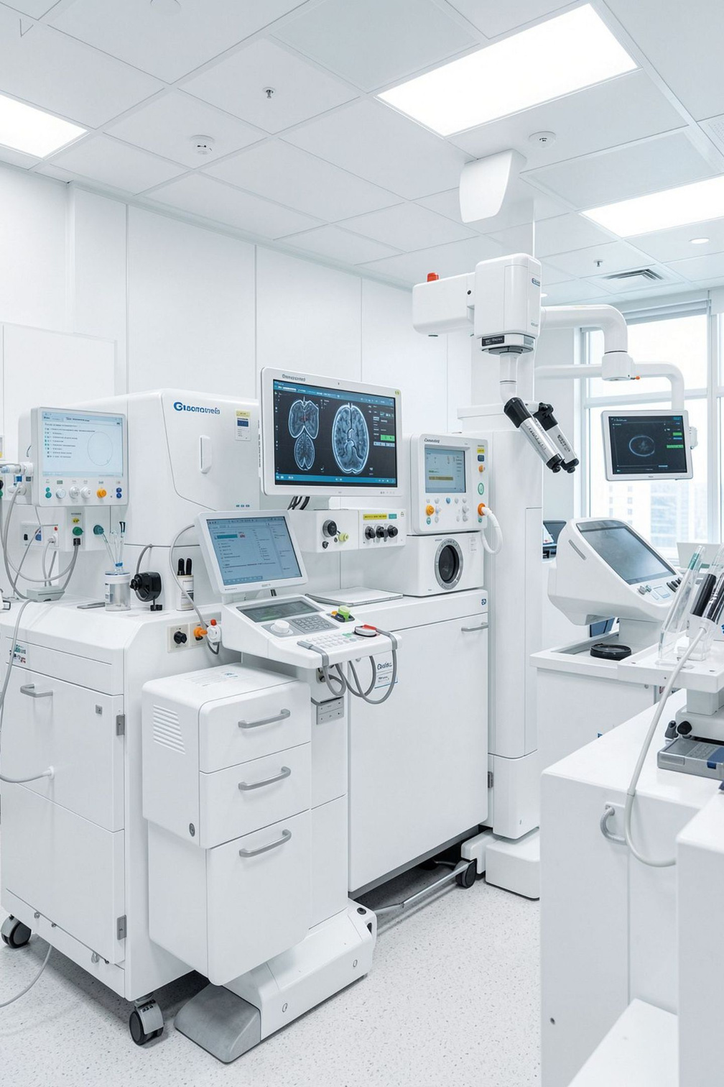


WellCare Labs
Advanced Diagnostic & Health Checkup Services
Reliable Testing. Better Health Decisions.
Diagnostic and pathology services in Pune & PCMC — health checkup packages for different healthcare needs, convenient home sample collection, and online booking with digital report access.
PIMPLE SAUDAGAR, PUNE
PIMPRI-CHINCHWAD, MAHARASHTRA

Slide 2





Your Partner in Preventive Healthcare
WellCare Labs provides diagnostic testing and health screening services designed to make healthcare more accessible and convenient. We combine modern diagnostic technology with experienced professionals to support better healthcare decisions.
Reliable Testing
Preventive Screening
Quality-focused diagnostic processes with timely reporting
Patient-friendly health screening for all healthcare needs
Home Collection
Convenient home sample collection in selected areas

Slide 3




Comprehensive Testing Under One Roof
WellCare Labs offers a wide range of laboratory investigations and health screening options. Patients can choose individual tests or suitable health packages according to their healthcare requirements.
Blood & Sugar
Organ Function
Complete Blood Count (CBC), diabetes and blood sugar testing, lipid profile
Thyroid testing, Liver Function Tests (LFT), Kidney Profile
Vitamins & Hormones
Specialized Profiles
Vitamin testing, hormonal testing, urine investigations
Fever-related profiles and preventive health checkups

Slide 4
Smart Health Checkup Packages
Regular health screening can help people monitor important health parameters and discuss abnormal results with their healthcare professional. These packages combine multiple investigations into convenient screening options.
Full Body Packages
Specialized Packages
  WellCare Master Full Body Checkup
  WellCare Master Male Full Body Checkup
  WellCare Master Female Full Body Checkup
  WellCare Smart Full Body Checkup Plan
  WellCare Male Special Health Checkup
  WellCare Female Special Health Checkup
  WellCare Complete Health Checkup
  Complete Health Checkup with Vitamin Screening

Slide 5






Targeted Screening for Different Needs
WellCare Labs also provides specialized packages designed around specific health and lifestyle requirements. Package contents vary according to the specific health screening objective.
Fever Profiles
Chronic Health
Advanced Fever Profile, Smart Fever Profile
Essential Diabetes Panel, Essential Vitamin Profile
Fitness Panels
Specialty Care
Smart Gym Panel, Advance Gym Panel
Smart & Advance Arthritis Package, Essential & Advance ANC Profile, Cancer Detection Profile Male

Slide 6

Monitor Your Overall Health
A full body health checkup brings several important laboratory investigations together in one screening plan. Regular preventive screening can help identify health parameters that may require further medical evaluation. Choose a package based on your age, health needs and doctor's advice.
🩸 Blood Health
Blood health, blood sugar, iron and vitamin status
🫀 Organ Health
Liver health, kidney health, thyroid function
❤️ Cardiac
Cholesterol, lipid levels, cardiac-related parameters
📋 Routine Markers
Other routine health markers for comprehensive assessment

Slide 7

Quality. Convenience. Patient-Focused Care.
WellCare Labs emphasizes accuracy, timely reporting and patient-friendly service. Here's why patients trust us for their diagnostic needs.
8+
ISO
Years of Experience
Certified Quality
Over 8 years of diagnostic experience serving Pune & PCMC
ISO-certified quality-focused processes for reliable results
Advanced Technology
Experienced Professionals
Modern diagnostic equipment for accurate testing
Skilled technicians and pathologists
Home Sample Collection
Online Reports
Convenient collection in selected areas
Access your diagnostic reports digitally

Slide 8


Healthcare at Your Doorstep
Visiting a laboratory isn't always convenient. WellCare Labs provides home sample collection in selected areas of Pune and Pimpri-Chinchwad — saving travel time and making routine health testing easier for elderly and busy individuals.
Convenient & Time-Saving
Sample collection at home — no travel required. Useful for routine health testing.
Easy Booking & Digital Access
Book tests online and access reports digitally from anywhere.
Wide Service Coverage
Pimple Saudagar • Wakad • Baner • Balewadi • Hinjawadi • Ravet • Punawale • Kharadi • Aundh • Kothrud • Bavdhan • Lohegaon and nearby areas

Slide 9
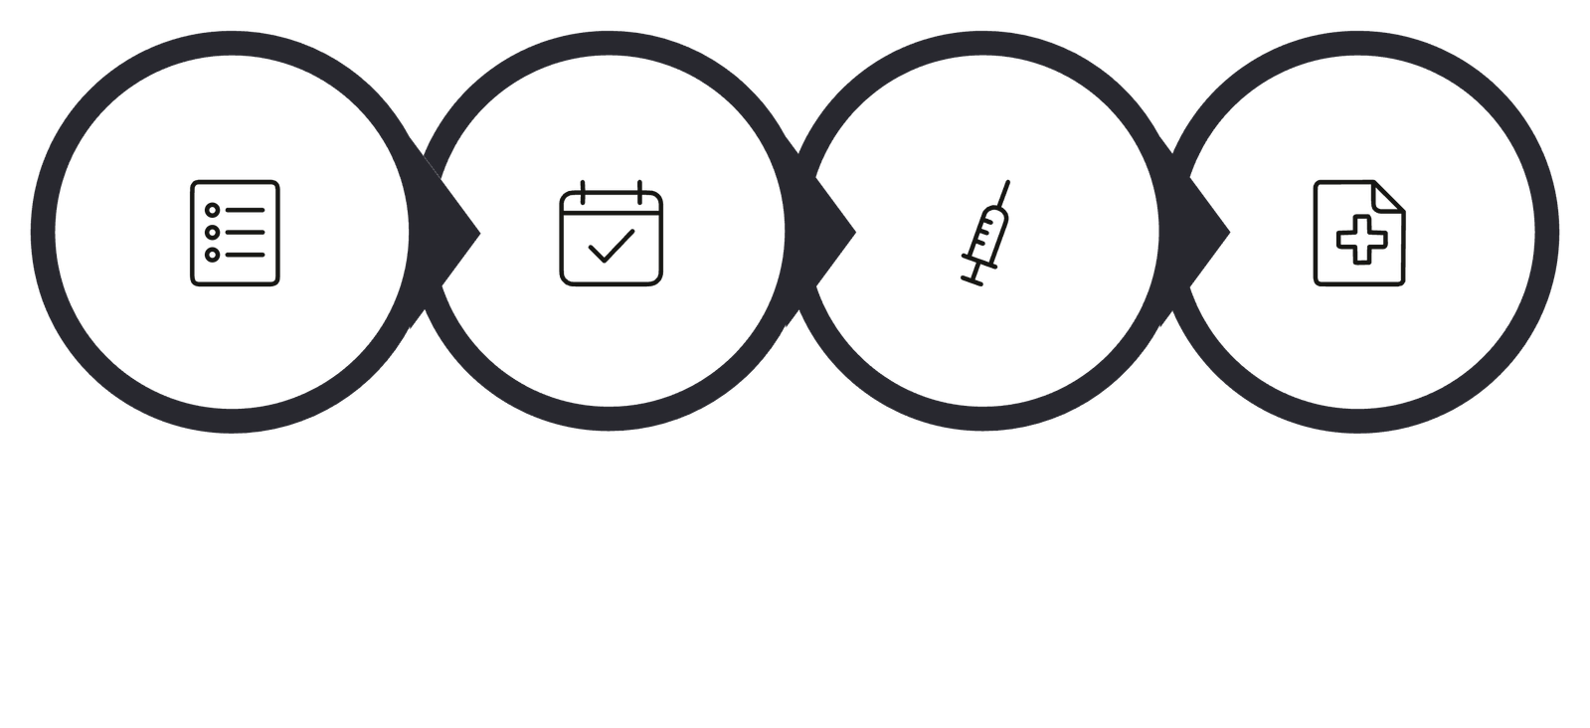
Simple Healthcare. Easy Booking.
Book Appointment
Sample Collection
Select Test
Get Report
📍 Address
📞 Contact Us
Shop 113, First Floor, A-Wing, Sai Vision Mall, Pimple Saudagar, Pimpri-Chinchwad, Pune, Maharashtra – 411027
Phone: +91 915 898 0898
Email: info@wellcarelabs.in
Website: wellcarelabs.in

Slide 10


Your Health Deserves Regular Attention
Preventive health screening can help you stay informed about important health parameters and seek medical guidance when needed. Take a proactive step toward better health today.
✓ Comprehensive Testing
✓ Modern Technology
Full diagnostic and health checkup packages
Advanced lab equipment and experienced professionals
✓ Home Collection
Convenient sample collection and online reports
Test Today. Know Your Health. Take Better Care Tomorrow.

