Slide 1

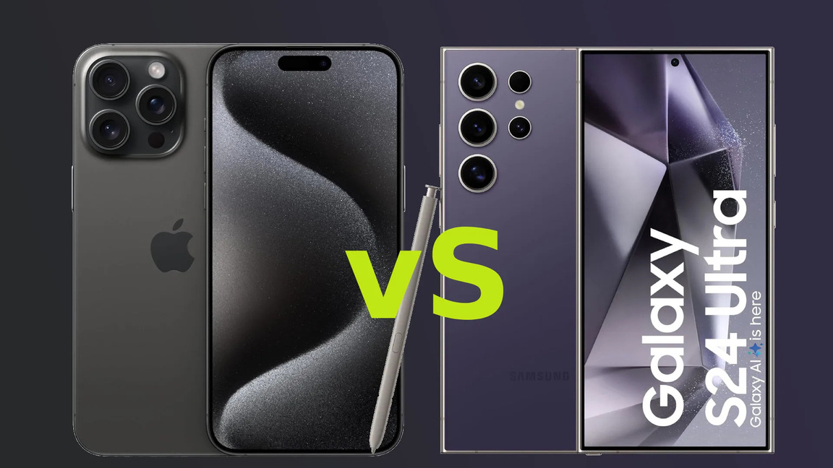

Presentation by Devicefixes
IPHONE VS SAMSUNG
WHICH SMARTPHONE IS BETTER FOR YOU
A Complete Smartphone Comparison
STEP BY STEP GUIDE

Slide 2

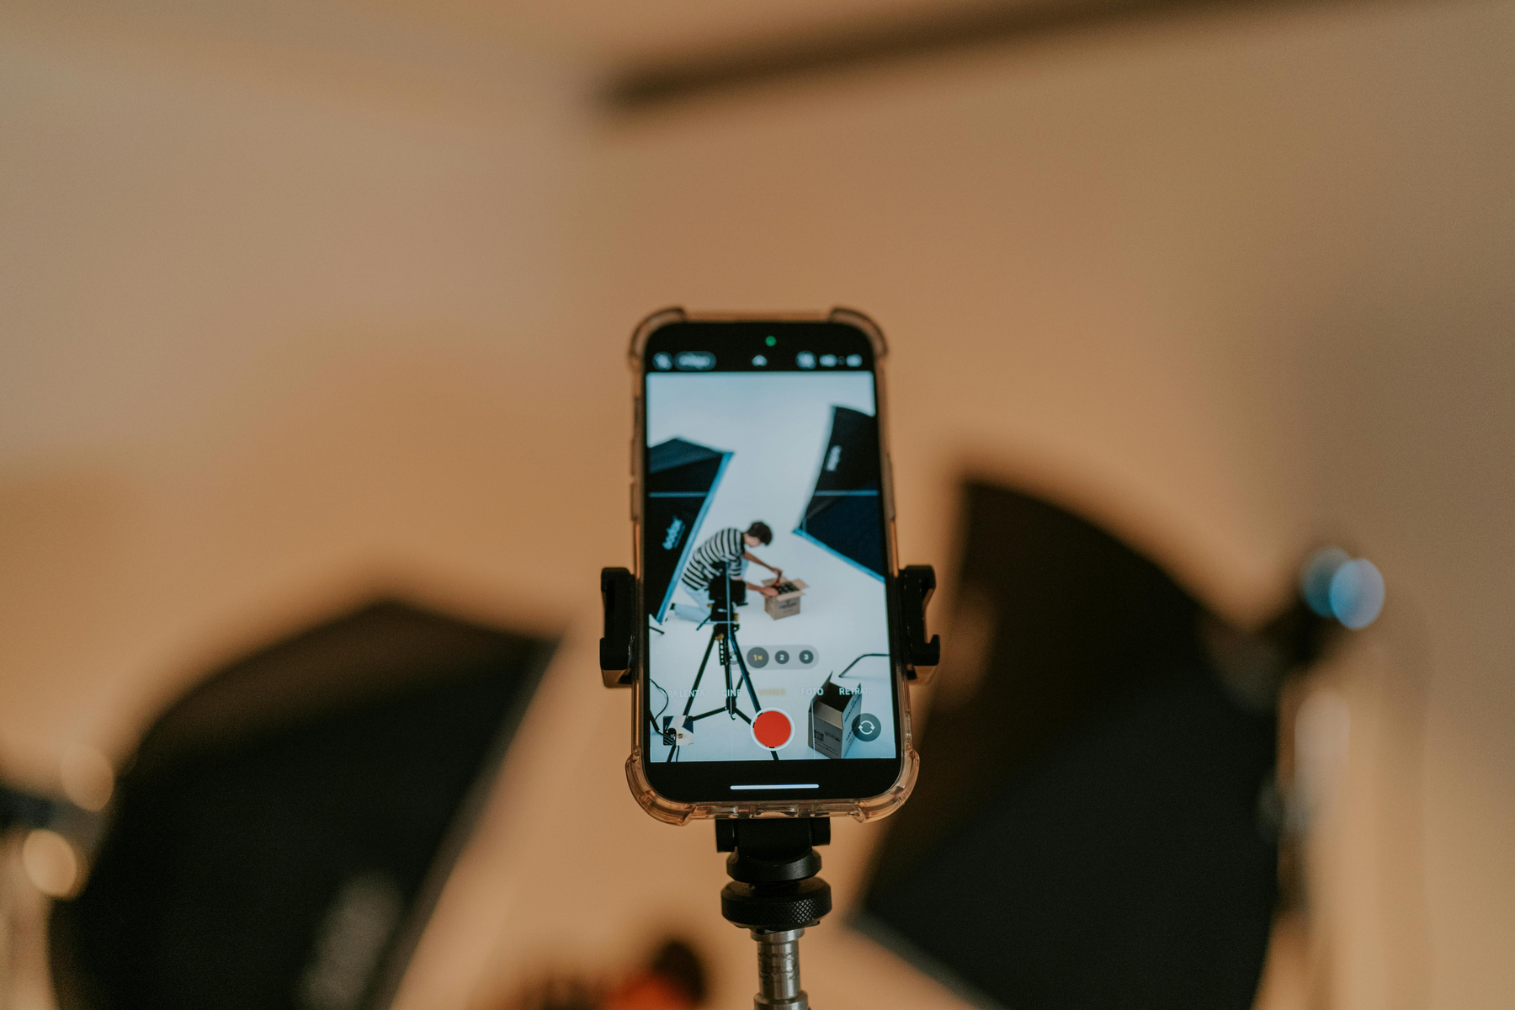
Introduction
  The smartphone market is dominated by Apple (iPhone) and Samsung (Galaxy series)
  Both brands offer high-quality devices across multiple price ranges
  iPhone focuses on simplicity and ecosystem
  Samsung focuses on variety and innovation
  This comparison helps users choose the best device based on their needs

Slide 3


Product range & Pricing
iPhone:
  Limited lineup (e.g., standard, Plus, Pro, Pro Max)
  Premium pricing strategy
  Older models sold at reduced prices
Samsung:
  Wide range (Galaxy A – budget, Galaxy S – flagship, Galaxy Z – foldables)
  Options for every budget
  Frequent discounts and offers

Slide 4


Design & Build Quality
iPhone:
  Sleek, minimal, and consistent design
  Premium materials like aluminum and ceramic shield
  Familiar look across generations
Samsung:
  Modern and diverse designs
  Innovative foldable phones (Flip & Fold series)
  Slim bezels and curved displays

Slide 5
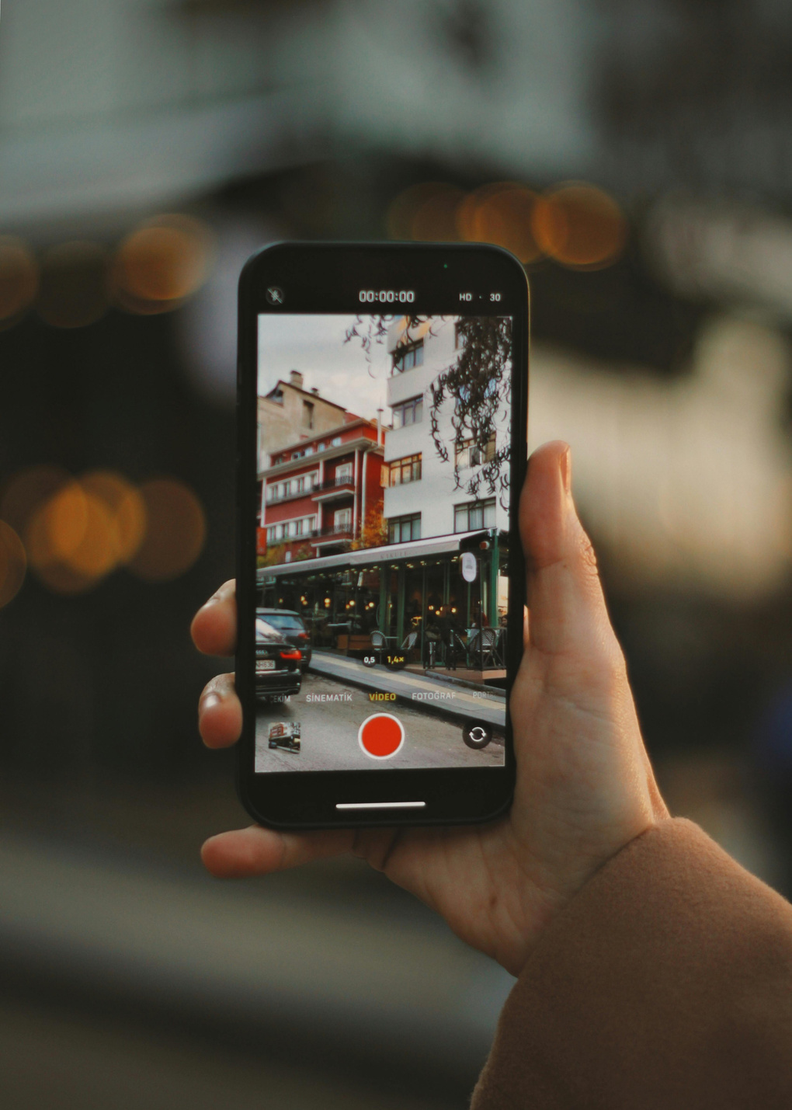
Operating System (iOS vs Android)
iPhone (iOS):
  Clean, simple, and user-friendly interface
  Strong privacy and security features
  Limited customization
Samsung (Android – One UI):
  Highly customizable interface
  More control over apps and settings
  Slightly more complex but flexible

Slide 6

Performance & Speed
  The smartphone market is dominated by Apple (iPhone) and Samsung (Galaxy series)
  Both brands offer high-quality devices across multiple price ranges
  iPhone focuses on simplicity and ecosystem
  Samsung focuses on variety and innovation
  This comparison helps users choose the best device based on their needs

Slide 7

Camera Comparison
iPhone:
  Natural color accuracy
  Best-in-class video recording
  Consistent results across all lenses
Samsung:
  Higher megapixel cameras
  Better zoom capabilities (Space Zoom)
  More shooting modes and features
  Both brands offer excellent low-light photography

Slide 8

Battery & Charging
iPhone:
  Optimized battery life with software efficiency
  Slower charging compared to Samsung
  MagSafe wireless charging support.
Samsung:
  Larger battery capacities
  Faster charging speeds
  Reverse wireless charging (charge other devices)

Slide 9

Ecosystem & Extra Features
iPhone Ecosystem:
  Seamless connection with Mac, iPad, Apple Watch
  Features like AirDrop, iMessage, FaceTime
Samsung Ecosystem:
  Works with Android, Windows, and Samsung devices
  Features like DeX (desktop experience), split-screen multitasking
  More flexibility with third-party apps

Slide 10

Which One Should You Choose?
Choose iPhone if you want:
  Smooth performance
  Strong security & privacy
  Seamless ecosystem
Choose Samsung if you want:
  More choices & price flexibility
  Customization and advanced features
  Innovative designs (foldables, high zoom cameras)
Your preferences matter:
  Both are excellent smartphones
  The best choice depends on your personal preference, budget, and usage style
For more insights go through this site: https://devicefixes.com/blog/iphone-vs-samsung/

