Slide 1

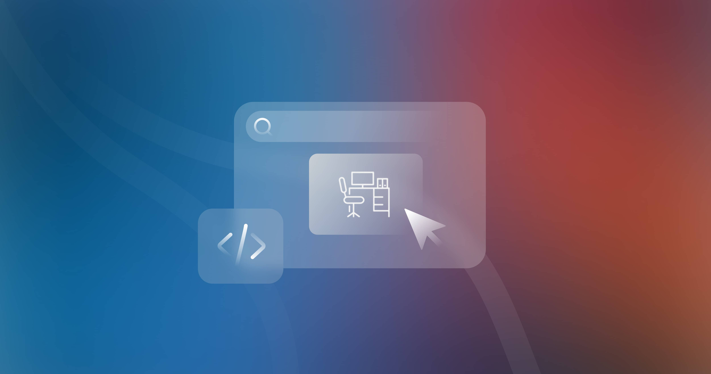

Quora Web Solution
Website Design and
Development
Company
Web Design & Web Development
Company in Bangalore, India
www.quorawebsolution.com
+91 9986 056 909
info@quorawebsolutions.com
24A, 1st Main Rd, Chandra Reddy
Layout, Koramangala 4th Block,
Koramangala, Bengaluru,
Karnataka 560034

Slide 2

The Power of a Well-Designed Website: A Comprehensive Guide to Selecting the Ideal Company
www.quorawebsolution.com

Slide 3
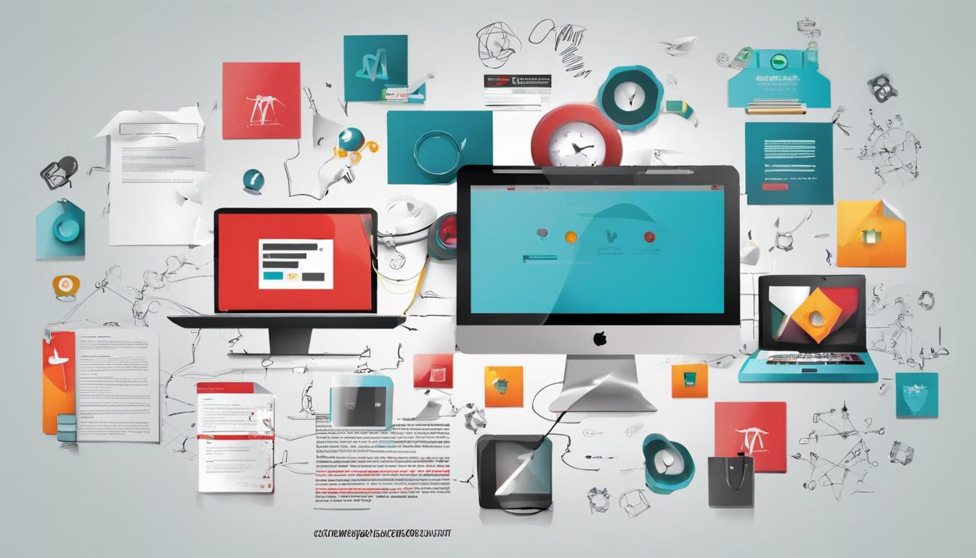
In today's digital landscape, a website is more than just an online brochure; it's a powerful tool that can help businesses connect with their target audience, build brand recognition, and drive revenue.
www.quorawebsolution.com

Slide 4
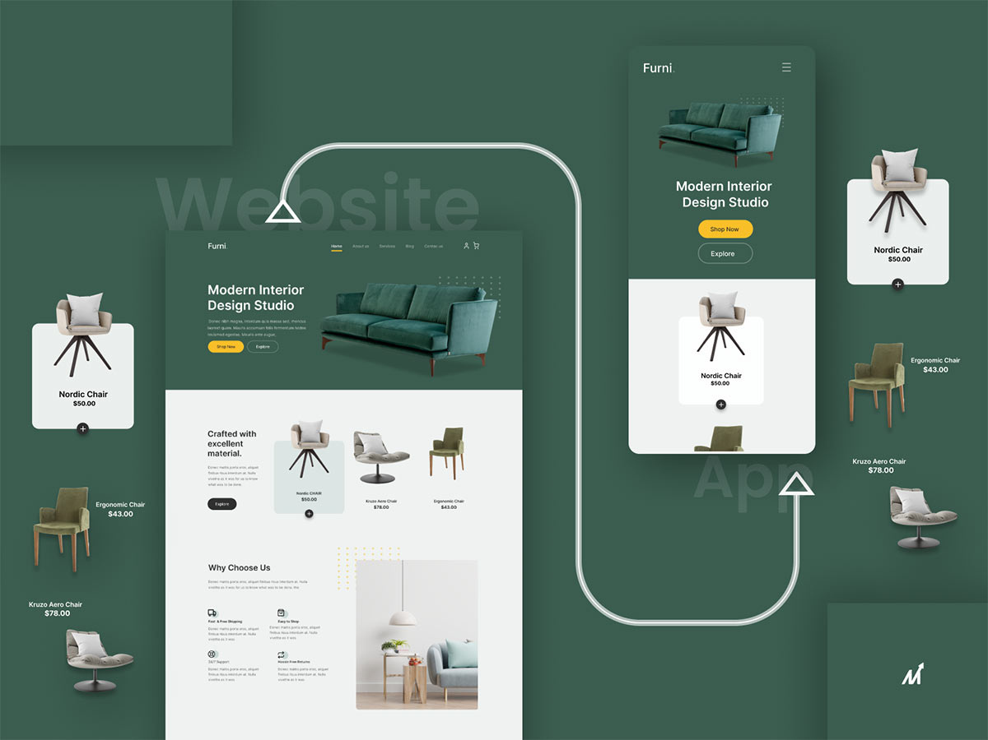
A well-designed and developed website serves as the digital storefront of your business, showcasing your products or services, providing valuable information, and fostering customer engagement.
www.quorawebsolution.com

Slide 5

A website design and development company can craft a digital masterpiece that not only captivates your audience but also drives tangible results.
www.quorawebsolution.com

Slide 6
They possess the expertise to create a website that is visually stunning, user-friendly, and optimized for search engines, ensuring your online presence stands out from the crowd.
Here are some of the comprehensive services that a website design and development company can offer:
  Comprehensive website design: They can craft a visually stunning website that aligns with your brand identity, leaving a lasting impression on your visitors. They will meticulously design every element of your website, from the layout and typography to the color palette and imagery, ensuring a cohesive and visually appealing experience.
Advanced website development: They can build a website that is not only visually appealing but also intuitive to navigate, ensuring a seamless user experience. They will utilize the latest technologies and frameworks to create a website that is fast, responsive, and compatible with all devices.
www.quorawebsolution.com

Slide 7
  Search engine optimization (SEO): They can optimize your website for search engines, ensuring it ranks higher in search results and attracts more organic traffic. They will conduct thorough keyword research, optimize your website's content and structure, and build high-quality backlinks to improve your website's visibility.
  Ongoing website maintenance: They can keep your website up-to-date, secure, and running smoothly, ensuring a positive user experience and preventing downtime. They will regularly update your website's content, monitor its performance, and address any technical issues that may arise.
When selecting a website design and development company, it's crucial to consider a wide range of factors to ensure you find the perfect partner for your project. Here are some key considerations:
www.quorawebsolution.com

Slide 8
Experience: Look for a company with a proven track record and a long history of success in website design and development. A company that has been in business for many years is more likely to have the experience and expertise to deliver high-quality results.
Portfolio: Review the company's portfolio of previous work to get a sense of their design aesthetic, technical capabilities, and ability to create websites that meet specific business objectives. Pay attention to the variety and complexity of their projects, as well as the client testimonials that accompany them.
Pricing: While cost is an important factor, it's essential to consider the overall value that a company offers. Don't solely focus on the cheapest option, as it may lead to compromises in quality or service. Instead, compare the pricing of different companies based on the scope of work, features, and level of customization they provide.
www.quorawebsolution.com

Slide 9
Communication: Effective communication is crucial for a successful website development project. Look for a company that is responsive, proactive, and transparent in their communication. They should be able to clearly understand your vision, provide regular updates on the project's progress, and address any concerns or questions you may have.
Technical expertise: Ensure the company has a strong technical foundation and stays up-to-date with the latest trends and technologies in website design and development. They should be able to leverage modern tools and frameworks to create websites that are fast, responsive, and optimized for search engines.
Customization: Consider the level of customization you require for your website. Some companies may offer pre-designed templates or themes, while others specialize in creating fully bespoke websites. Choose a company that can deliver the level of customization that aligns with your unique brand and business needs.
www.quorawebsolution.com

Slide 10
By partnering with a reputable website design and development company, you can unlock the full potential of your online presence. They will craft a website that not only captivates your audience but also drives tangible results, helping you achieve your business goals.
A well-designed website can serve as a powerful marketing tool, attracting new customers and generating leads. It can also enhance your brand reputation and establish you as a trusted authority in your industry. By investing in a professional website design and development company, you are investing in the future of your business.
Here are some of the specific benefits you can expect from partnering with a reputable website design and development company:
  Increased website traffic: A well-designed and optimized website will attract more visitors to your site, increasing your chances of converting those visitors into customers.
www.quorawebsolution.com

Slide 11
  Improved user experience: A user-friendly website will make it easier for visitors to navigate your site and find the information they need. This can lead to increased engagement and conversions.
  Enhanced brand reputation: A visually appealing and professional website can help to improve your brand's reputation and credibility.
  Increased sales: A website that is designed to convert visitors into customers can help you to increase your sales and revenue.
  Improved SEO rankings: A website that is optimized for search engines will appear higher in search results, making it easier for potential customers to find you.
  Better customer engagement: A website that is engaging and interactive can help you to build stronger relationships with your customers.
www.quorawebsolution.com

Slide 12
  Increased ROI: A well-designed and developed website can provide a significant return on investment (ROI) by driving sales and generating leads.
Ultimately, a website is an essential tool for any business that wants to succeed in today's digital world. By partnering with a reputable website design and development company, you can create a website that is both visually stunning and effective at driving results.
www.quorawebsolution.com

Slide 13
Website Design and Development Company: Your Digital Foundation for Success
In today's digital landscape, a well-crafted and functional website is no longer a luxury but a necessity for businesses of all sizes. Whether you're a small startup or a large enterprise, a professional website can serve as your digital storefront, attracting new customers, building brand credibility, and driving sales. That's where a reputable website design and development company comes into play.
A website design and development company is your trusted partner in crafting a digital presence that resonates with your audience. Their team of skilled professionals, including web designers, developers, and content writers, collaborate to create a website that is not only visually stunning but also provides a seamless user experience.
www.quorawebsolution.com

Slide 14
From the initial concept to the final launch, these companies oversee every aspect of the website development process, ensuring that your online platform aligns with your business objectives and exceeds your expectations.
Here are some of the core services offered by website design and development companies:
  Website design: They craft visually captivating and responsive websites that are optimized for different devices, such as desktops, tablets, and smartphones, ensuring a seamless user experience across all platforms.
  Web development: They build the technical foundation of your website, ensuring it functions smoothly and loads quickly, while also implementing robust security measures to protect your data and prevent unauthorized access.
www.quorawebsolution.com

Slide 15
  Content creation: They help you develop high-quality content that engages your target audience and improves your website's search engine ranking, using strategic keyword placement and compelling storytelling techniques.
  E-commerce development: If you sell products or services online, they can create a user-friendly e-commerce platform that simplifies the buying process for your customers, integrates with popular payment gateways, and provides secure checkout options.
  Search engine optimization (SEO): They optimize your website to improve its visibility in search engine results, driving more organic traffic to your site through techniques such as keyword research, on-page optimization, and backlink building.
www.quorawebsolution.com

Slide 16
  Digital marketing: They offer a range of digital marketing services, including social media marketing, email marketing, and pay-per-click advertising, to help you reach your target audience and achieve your marketing goals effectively.
When selecting a website design and development company, consider the following key factors:
  Portfolio: Assess their previous work to evaluate their design skills and expertise.
  Experience: Choose a company that has a proven track record of success in your industry, demonstrating their ability to understand your unique needs and deliver tailored solutions.
www.quorawebsolution.com

Slide 17
  Communication: Ensure they have excellent communication skills and are responsive to your needs.
  Technical expertise: Verify that they possess the necessary technical skills and knowledge to build a high-quality website.
  Pricing: Compare their pricing with other companies in the market, but remember that quality should be prioritized over cost.
By partnering with a reputable website design and development company, you can unlock the full potential of your online presence. They will help you create a website that not only looks great but also effectively communicates your brand message, engages your target audience, and drives tangible results for your business.
www.quorawebsolution.com

Slide 18
Quora Web Solution: Quora Web Solution is a trusted website development company based in Bangalore, India, offering a wide array of services to not only domestic but global clientele. Be it Website Design and Development, SEO services, Digital Marketing, Branding, App Development, Ecommerce Solution, and Logo Creation . Quora Web Solution has the best website developers offering top quality services and that is the reason why we are well known as one of the best Website Development Companies in Bangalore, India.
Visit Us - www.quorawebsolution.com
Call Us - +91 9986 056 909
Mail Us - info@quorawebsolutions.com
www.quorawebsolution.com

Slide 19




Services
WORDPRESS DEVELOPMENT
ECOMMERCE DEVELOPMENT
PHP DEVELOPMENT
CMS DEVELOPMENT
DRUPAL DEVELOPMENT
WEBSITE SERVICES
WEBPORTAL DEVELOPMENT
MAGENTO DEVELOPMENT
WEBSITE DEVELOPMENT
JOOMLA DEVELOPMENT
SMALL BUSINESS DEVELOPMENT
CHEAP WEBSITE DEVELOPMENT
STATIC WEBSITE DEVELOPMENT
DYNAMIC WEBSITE DEVELOPMENT
WEBSITE DESIGN COMPANY
TOUR AND TRAVEL WEBSITE DEVELOPMENT

