Slide 1

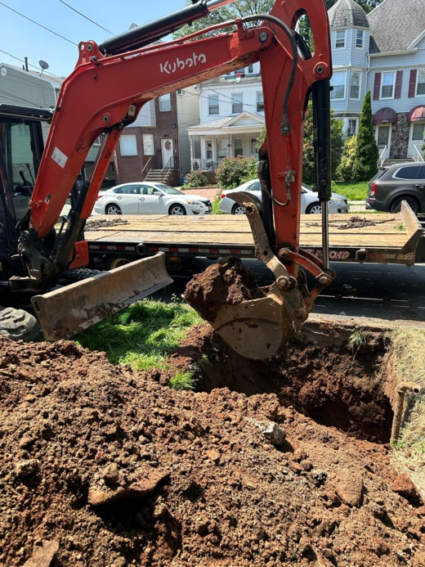
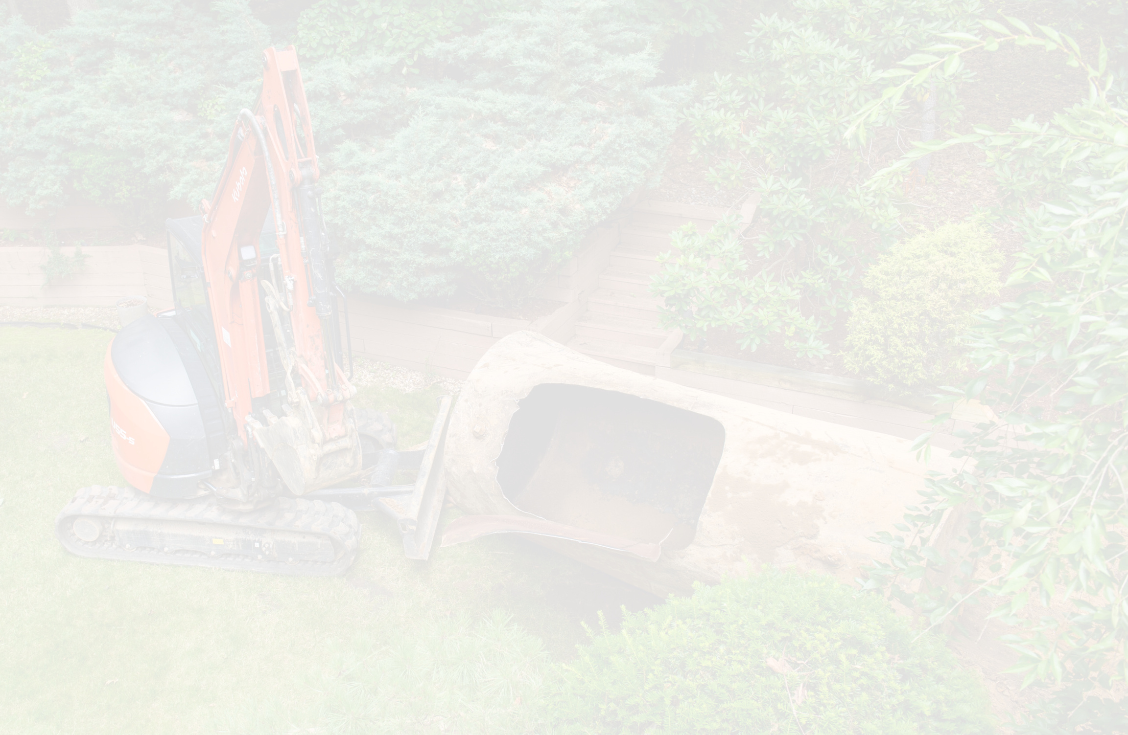
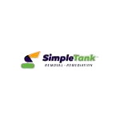

What Is the Oil Tank Removal Process and What Should You Expect?
If you have an old or unused oil tank on your property, you may wonder what happens during removal. The oil tank removal process typically involves an initial inspection, obtaining required local approvals, safely removing the tank, checking the excavation for signs of contamination, collecting soil samples when required, and completing the necessary closure documentation. The exact steps can vary based on the property, tank type, and whether contamination is discovered.

Slide 2

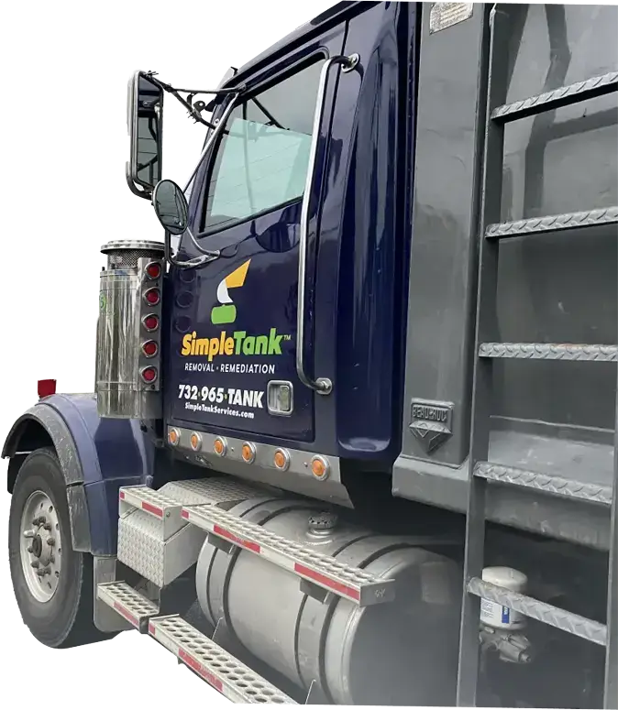
What Is the Oil Tank Removal Process?
Oil tank removal is more than simply digging up a tank and hauling it away. A professional removal project involves several steps designed to safely close the tank, evaluate the surrounding area, and address potential environmental concerns.For underground heating oil tanks in New Jersey, NJDEP guidance requires underground tank closure to be performed by an appropriately certified contractor.

Slide 3
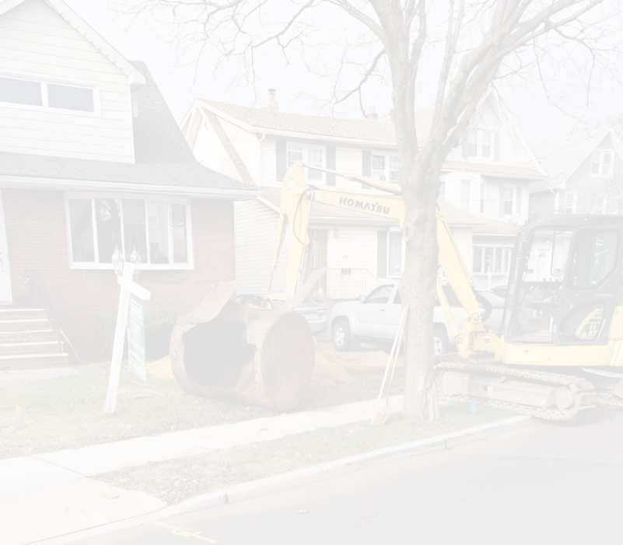
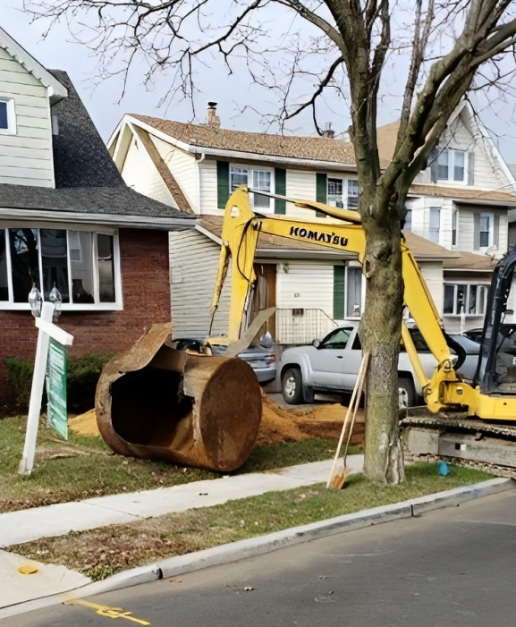
What Are the Main Oil Tank Removal Steps?
  Initial Tank Assessment: The process begins with evaluating the tank and the surrounding property. The contractor may determine the tank’s location, size, accessibility, condition, and whether it is underground or above ground.
  Permits and Preparation: Before removal begins, the required municipal permits or approvals should be addressed. New Jersey’s requirements can depend on the type of tank and property.
  Excavating Around the Tank: For an underground oil tank, soil around the tank is carefully excavated to expose the tank and associated piping.

Slide 4
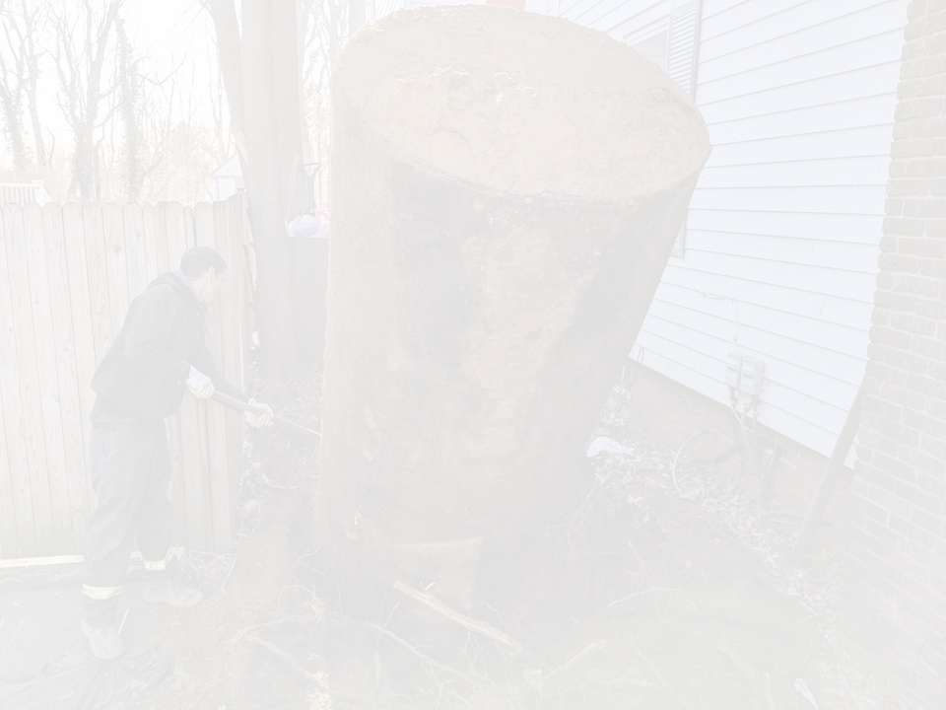
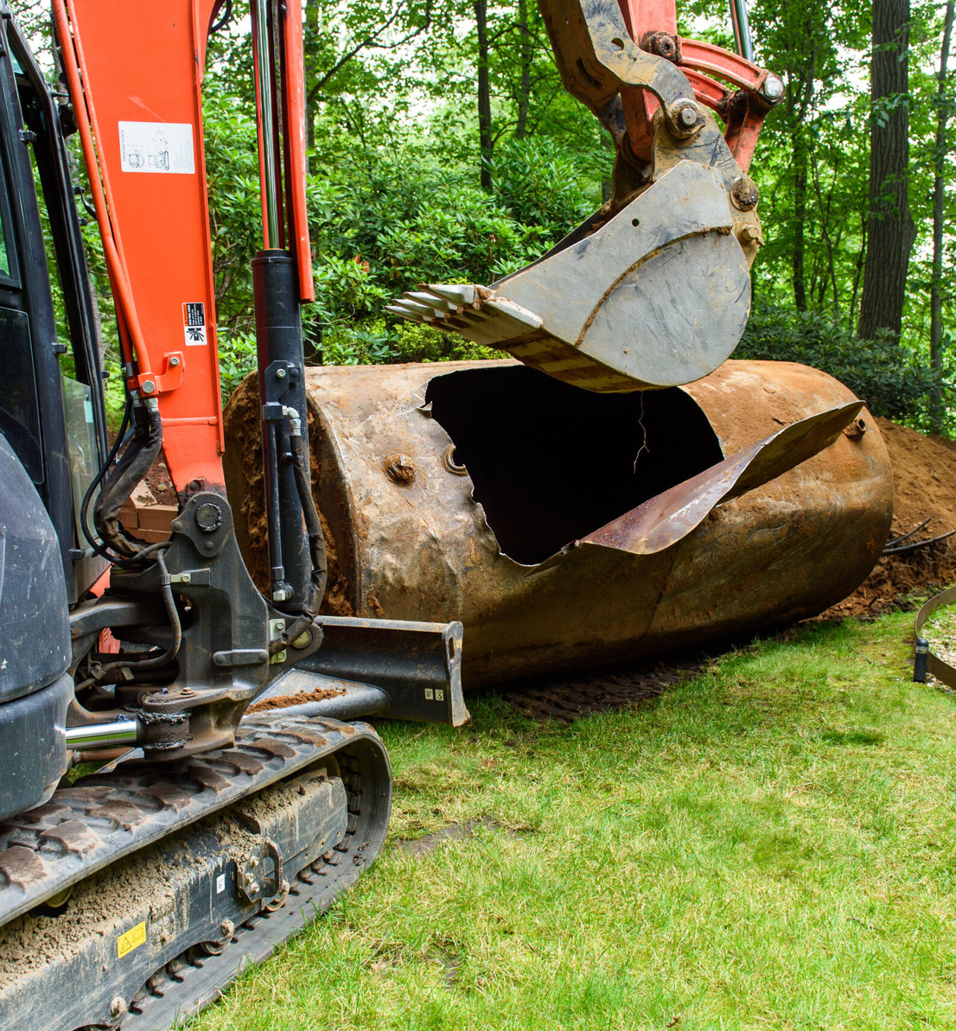
What Happens If Contamination Is Found?
Finding contamination does not necessarily mean the entire property needs extensive cleanup. The appropriate response depends on the location, amount, and characteristics of the contamination
When a discharge is identified, NJDEP requires the discharge to be reported and the property owner to have the site investigated and, when necessary, remediated by appropriately qualified environmental professionals.

Slide 5
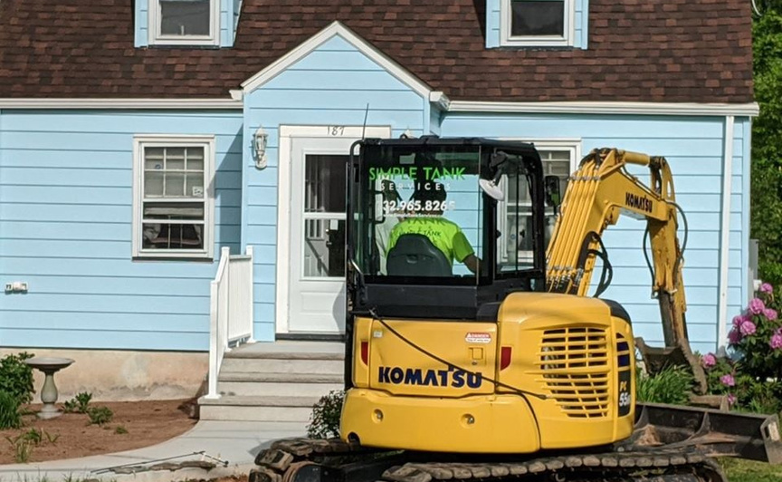
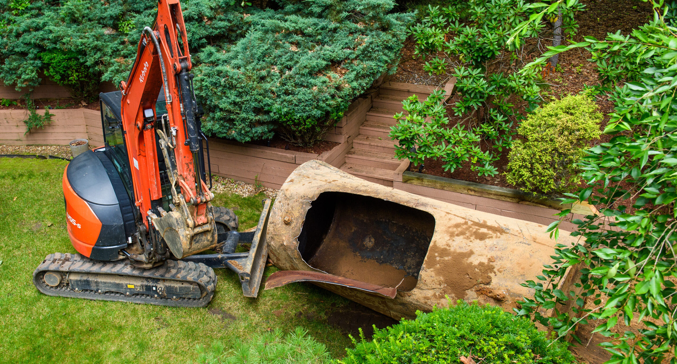
Backfilling and Restoring the Area
After the tank has been removed and required sampling or remediation activities are completed, the excavation can be prepared for backfilling.
The restoration process depends on the property and the scope of work. The area may need suitable fill material and surface restoration so that the property can safely return to normal use

Slide 6
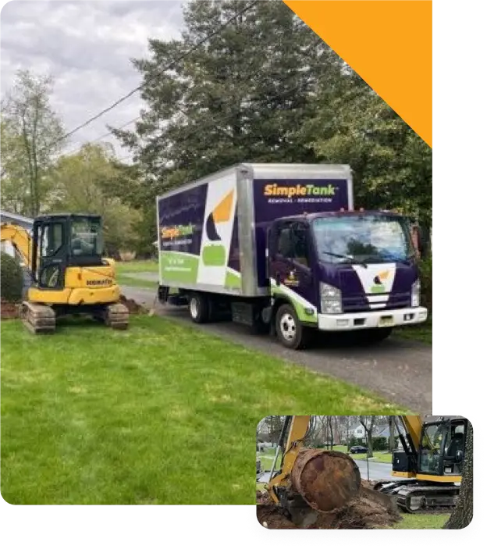
Final Documentation and Closure
The final stage involves completing the appropriate closure documentation and inspection requirements.
If no discharge is found and the required municipal inspection is successfully completed, the tank closure process may be completed without environmental remediation. If a discharge is identified, additional investigation and remediation documentation may be required.

Slide 7





CONTACT US
732-965-8265
matt@simpletankservices.com
www.simpletankservices.com
717 North AvePlainfield, NJ 07062, USA

