Slide 1

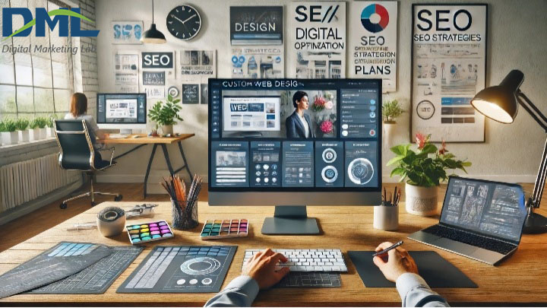

Quora Web Solution
Website Design and
Development
Company
Web Design & Web Development
Company in Bangalore, India
www.quorawebsolution.com
+91 9986 056 909
info@quorawebsolutions.com
24A, 1st Main Rd, Chandra Reddy
Layout, Koramangala 4th Block,
Koramangala, Bengaluru,
Karnataka 560034

Slide 2

Website Design and Development Company: Your Trusted Partner for Digital Success
A website design and development company is a specialized team that crafts bespoke websites tailored to the unique needs of businesses and individuals.
www.quorawebsolution.com

Slide 3
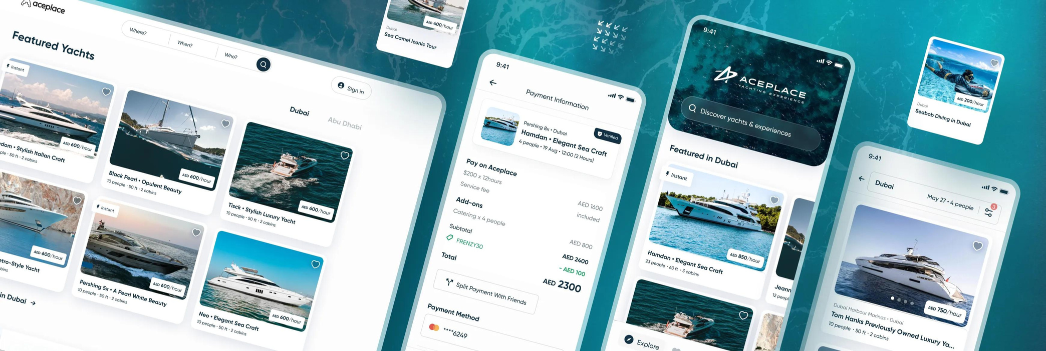
They offer a comprehensive range of services, including:
  Website Design: Crafting visually stunning and user-friendly website layouts that leave a lasting impression.
www.quorawebsolution.com

Slide 4
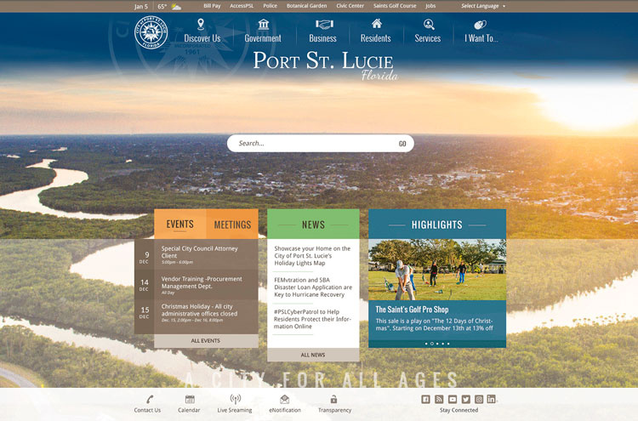
  Website Development: Building functional and responsive websites using cutting-edge programming languages and technologies.
www.quorawebsolution.com

Slide 5

  E-commerce Development: Creating seamless online shopping experiences with features like intuitive product catalogs, secure payment gateways, and personalized recommendations.
www.quorawebsolution.com

Slide 6
  Content Management Systems (CMS): Empowering clients with user-friendly CMS platforms like WordPress or Drupal, enabling them to effortlessly manage and update their website content.
  Search Engine Optimization (SEO): Optimizing websites to improve their visibility in search engine results, driving organic traffic and increasing brand awareness.
  Digital Marketing: Providing comprehensive digital marketing solutions, including social media marketing, email marketing, and pay-per-click advertising, to help businesses reach their target audience and achieve their marketing goals.*
These companies often collaborate closely with clients to fully grasp their specific needs and objectives, and then customize their services accordingly.
www.quorawebsolution.com

Slide 7
They may also provide ongoing maintenance and support for websites after their launch, ensuring optimal performance and security.
When working with a website design and development company, clients can expect a personalized experience tailored to their unique requirements. The company will typically conduct a thorough analysis of the client's business, industry, and target audience to identify their specific needs and goals. They will then create a customized website design and development plan that addresses these needs and helps the client achieve their desired outcomes.
Throughout the project, the company will maintain open communication with the client, providing regular updates and seeking feedback to ensure that the website meets their expectations. Once the website is launched, the company will continue to provide ongoing maintenance and support, including updates, security patches, and technical assistance.
www.quorawebsolution.com

Slide 8
By partnering with a reputable website design and development company, clients can rest assured that their website will be built to the highest standards, optimized for both user experience and search engine visibility, and serve as a valuable digital asset that helps them achieve their business objectives. The company's expertise and dedication to customer satisfaction ensure that the client's website is a powerful tool for attracting new customers, building brand awareness, and driving online sales.
Website Development Services
www.quorawebsolution.com

Slide 9
A website design and development company is a team of skilled professionals who specialize in crafting custom websites tailored to the unique needs of businesses and individuals. They work collaboratively to create visually appealing, user-friendly, and functional websites that achieve specific goals and objectives.
Core Services Offered:
  Website Design: Crafting visually stunning websites that align with your brand identity, using elements such as layouts, color schemes, and typography.
  Website Development: Building the technical foundation of your website using programming languages like HTML, CSS, JavaScript, and others, ensuring it functions seamlessly and is optimized for performance.
www.quorawebsolution.com

Slide 10
  Content Management Systems (CMS): Implementing user-friendly platforms like WordPress, Drupal, or Joomla, empowering you to easily manage and update your website content without requiring technical expertise.
  E-commerce Development: Creating robust online stores equipped with features such as product catalogs, shopping carts, and secure payment gateways, enabling you to sell your products or services online.
  Search Engine Optimization (SEO): Optimizing your website to improve its visibility in search engine results, attracting organic traffic and driving potential customers to your site.
www.quorawebsolution.com

Slide 11
  Responsive Design: Ensuring your website adapts seamlessly to different devices, such as desktops, tablets, and smartphones, providing a consistent and enjoyable user experience across all platforms.
  Website Maintenance: Providing ongoing support, updates, and security measures to keep your website running smoothly and up-to-date, safeguarding your online presence.
Advantages of Partnering with a Website Design and Development Company:
  Expertise and Efficiency: Benefit from the in-depth knowledge and experience of professionals who can deliver high-quality websites efficiently.
www.quorawebsolution.com

Slide 12
  Tailored Solutions: Get custom-built websites that perfectly align with your unique business requirements and objectives.
  Enhanced User Experience: Create websites that are not only visually appealing but also user-friendly, leading to increased engagement and conversions.
  Strengthened Brand Image: Showcase your brand in the best possible light with a visually stunning and well-functioning website that reflects your professionalism and credibility.
  Time and Cost Savings: Outsource website development to save valuable time and resources, allowing you to focus on other core aspects of your business.
www.quorawebsolution.com

Slide 13
When selecting a website design and development company, consider the following factors:
  Portfolio: Examine the company's previous work to assess their design and development skills.
  Experience: Seek companies with a proven track record and expertise in your industry.
  Client Testimonials: Read feedback from satisfied clients to gauge their satisfaction.
  Communication: Ensure effective communication and collaboration throughout the project.
  Pricing and Timeline: Discuss project costs, timelines, and payment terms.
By collaborating with a reputable website design and development company, businesses can establish a strong online presence that drives growth and success.
www.quorawebsolution.com

Slide 14
Quora Web Solution: Quora Web Solution is a trusted website development company based in Bangalore, India, offering a wide array of services to not only domestic but global clientele. Be it Website Design and Development, SEO services, Digital Marketing, Branding, App Development, Ecommerce Solution, and Logo Creation . Quora Web Solution has the best website developers offering top quality services and that is the reason why we are well known as one of the best Website Development Companies in Bangalore, India.
Visit Us - www.quorawebsolution.com
Call Us - +91 9986 056 909
Mail Us - info@quorawebsolutions.com
www.quorawebsolution.com

Slide 15




Services
WORDPRESS DEVELOPMENT
ECOMMERCE DEVELOPMENT
PHP DEVELOPMENT
CMS DEVELOPMENT
DRUPAL DEVELOPMENT
WEBSITE SERVICES
WEBPORTAL DEVELOPMENT
MAGENTO DEVELOPMENT
WEBSITE DEVELOPMENT
JOOMLA DEVELOPMENT
SMALL BUSINESS DEVELOPMENT
CHEAP WEBSITE DEVELOPMENT
STATIC WEBSITE DEVELOPMENT
DYNAMIC WEBSITE DEVELOPMENT
WEBSITE DESIGN COMPANY
TOUR AND TRAVEL WEBSITE DEVELOPMENT

