Slide 1









Slide 2






If you want an effective internet solution to quickly connect your
gadgets and smart devices, then the Piso Wifi can offer you fair deals
when you are looking for a reliable
private internet connection for your home and office. Piso Wifi is
available in the popular metro areas of the Philippines.

Slide 3


The Piso Wifi was originally started as Pisonet which was like an old arcade style internet cafe back in the days and the people were charged in Pisos. But now they transformed their internet cafes into Piso 10.0.0.1 vending machines.

Slide 4





If you want to stay connected while traveling then it is an effective solution for you.
It offers a perfect medium to connect to the internet with zero data allowance.
If you want to reduce your phone bill you want to save some money then it serves as a great option for you.

Slide 5



When users buy their time, they don't want to use all of it at once.
10.0.0.1 Piso Wifi pause time feature is what makes Piso Wifi different from other internet providers. In this feature, users can prevent themselves from over using their data

Slide 6

HOW TO ACCESS 10.0.0.1 PISO WIFI PAUSE TIME?
First of all, type the URL of the Piso Wifi in the search field of your browser.
Then at the router admin login page, enter your login credentials.
Then you will see a dashboard on your screen after the successful login. Then click on the general settings on the top left corner.
Then click on the pause time and then click “Auto pause time on boot” to enable it.
Then again go to the admin page and click on the pause time option. From there you can manage the pause time of your Wifi.

Slide 7



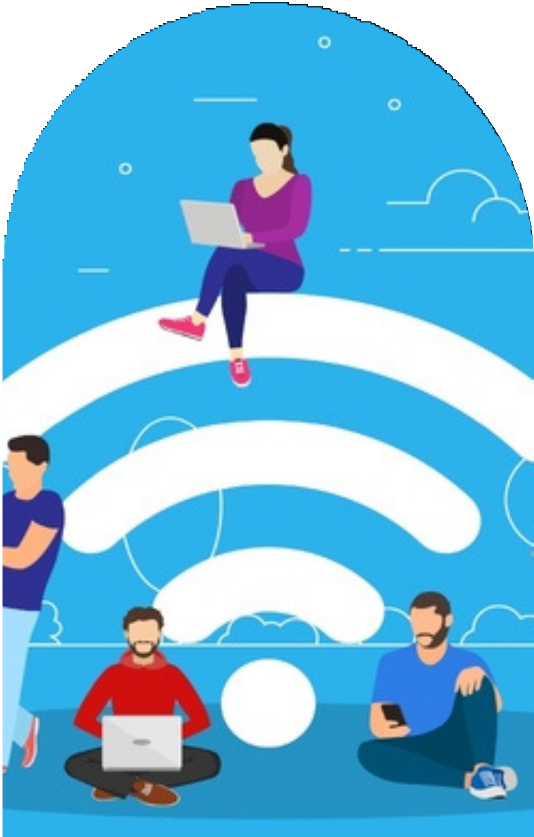


Thank's For Watching
Must Visit:-
https://www.printeralign.com/

