Slide 1



Quora Web Solution
Website Design and
Development
Company
Web Design & Web Development
Company in Bangalore, India
www.quorawebsolution.com
+91 9986 056 909
info@quorawebsolutions.com
24A, 1st Main Rd, Chandra Reddy
Layout, Koramangala 4th Block,
Koramangala, Bengaluru,
Karnataka 560034

Slide 2

Crafting Your Digital Identity: A Comprehensive Guide to Website Design and Development Companies
www.quorawebsolution.com

Slide 3
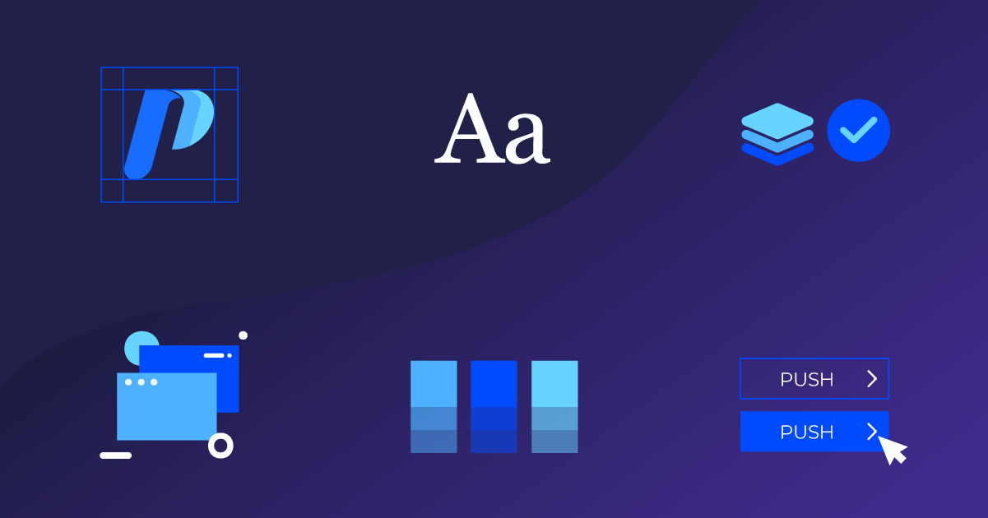
In today's digital age, a well-designed website is essential for business success.
www.quorawebsolution.com

Slide 4
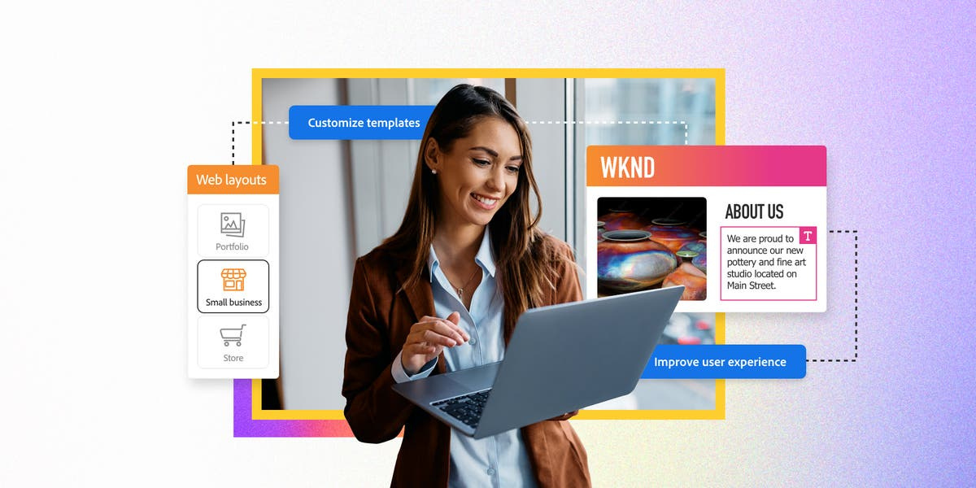
A professional website can significantly impact your online visibility, brand reputation, and overall business success.
www.quorawebsolution.com

Slide 5

Whether you're a budding entrepreneur or a seasoned corporation, a well-crafted website can help you:
  Attract new customers: A visually appealing and user-friendly website can capture the attention of potential customers and encourage them to learn more about your business.
www.quorawebsolution.com

Slide 6
  Build brand awareness: A consistent brand image across your website can help you build recognition and trust with your target audience.
  Generate leads and sales: A website with clear calls to action can drive conversions and help you grow your business.
  Improve customer satisfaction: A website that is easy to navigate and provides valuable information can improve customer satisfaction and loyalty.
  Stay ahead of the competition: A well-maintained website can help you stay ahead of the competition and attract new customers.
Understanding the Role of Website Design and Development Companies
Website design and development companies are experts in creating and managing websites. They offer a wide range of services, including web design, web development, e-commerce development, CMS, SEO, and digital marketing.
www.quorawebsolution.com

Slide 7
Key Factors to Consider:
  Proven track record
  Technical expertise
  Communication and collaboration
  Pricing and value
  Customer support
  SEO and digital marketing expertise
  Security and maintenance
The Benefits of Partnering with a Website Design and Development Company
By partnering with a reputable company, you can reap numerous benefits, including:
www.quorawebsolution.com

Slide 8
  Professional Website Design: A visually appealing website that reflects your brand identity.
  Enhanced Online Visibility: Improved search engine rankings and increased website traffic.
  Stronger Brand Presence: A professional website can significantly boost your brand reputation.
  Increased Sales and Conversions: A well-designed website can drive more leads and sales.
  Time and Cost Savings: Outsourcing website development can save you time and resources.
Conclusion
A well-crafted website is your digital storefront, welcoming visitors and leaving a lasting impression. By partnering with a skilled website design and development company, you can create a powerful online presence that drives business growth and success.
Remember: Your website is often the first impression you make on potential customers. Make it count. Invest in its design and development to ensure it represents your brand effectively and delivers a positive user experience.
www.quorawebsolution.com

Slide 9
Transforming Your Digital Presence: Partnering with a Website Design and Development Company
Your website is your online storefront. It's your 24/7 marketing tool, and your customer service channel. A well-designed and functional website can significantly impact your brand's visibility, customer engagement, and ultimately, your bottom line. This is where the expertise of a website design and development company comes into play.
What Services Do Website Design and Development Companies Offer?
Website design and development companies provide a wide range of services to help businesses establish and maintain a strong online presence. These services typically include:
  Website Design: A skilled designer can craft a visually stunning and user-friendly website that reflects your brand identity. They will consider factors such as layout, color scheme, typography, and overall aesthetics to create a site that is both pleasing to the eye and easy to navigate.
www.quorawebsolution.com

Slide 10
  Website Development: Developers bring your website to life by handling the technical aspects of building it. This includes coding, programming, and database management to ensure your site functions smoothly, loads quickly, and is compatible with various devices and browsers.
  E-commerce Development: If you want to sell products or services online, an e-commerce development company can create a secure and user-friendly online store. They can handle features like product catalogs, shopping carts, payment gateways, and inventory management to streamline your sales process.
Content Management Systems (CMS): Many companies use CMS platforms like WordPress or Drupal to manage their website content. A development company can help you set up and customize a CMS to suit your specific needs, making it easy to update and maintain your website.
www.quorawebsolution.com

Slide 11
  Search Engine Optimization (SEO): A good website design and development company can implement SEO best practices to improve your website's visibility and attract organic traffic. This includes optimizing your website's content, structure, and technical aspects to rank higher in search engine results. They can also help you build high-quality backlinks to your website, which can further boost your search engine rankings.
  Web Hosting: A reliable web hosting service is essential for keeping your website online and accessible to visitors. Many website design and development companies offer web hosting services as part of their packages.
  Website Maintenance: Once your website is launched, it's important to keep it updated and secure. Website maintenance services include regular updates, backups, and security checks to ensure your website's performance and protect it from potential threats.
www.quorawebsolution.com

Slide 12
  Digital Marketing: A comprehensive digital marketing strategy can help you reach a wider audience and drive more traffic to your website. Website design and development companies may offer digital marketing services such as social media marketing, email marketing, and pay-per-click advertising.
  Web Analytics: Tracking website performance is crucial for understanding your audience and making data-driven decisions. Web analytics tools can provide insights into key metrics like website traffic, user behavior, and conversion rates.
Web Accessibility: Making your website accessible to people with disabilities is not only ethical but also legally required in some regions. Website design and development companies can ensure your website complies with accessibility standards such as WCAG.
www.quorawebsolution.com

Slide 13
  Responsive Design: With the increasing use of mobile devices, it's essential to have a website that looks great and functions seamlessly on all screen sizes. Responsive design ensures your website adapts to different devices and screen resolutions.
  Custom Web Development: For complex projects that require unique features and functionalities, custom web development is the way to go. A skilled development team can create a tailor-made solution to meet your specific needs.
  Website Security: Protecting your website from cyber threats is crucial. Website design and development companies can implement security measures such as firewalls, SSL certificates, and regular security audits to safeguard your website and your visitors' data.
Choosing the Right Website Design and Development Company
www.quorawebsolution.com

Slide 14
Choosing the right website design and development company is crucial to the success of your project. Here are some key factors to consider when selecting a website design and development company:
  Experience and Expertise: Look for a company with a proven track record and experience in your industry. They should understand your specific needs and be able to deliver tailored solutions.
  Portfolio: Review their past projects to assess their design and development skills. Look for websites that are visually appealing, user-friendly, and align with your brand identity.
  Communication: Open communication is essential for building trust and ensuring that the project stays on track. A good website design and development company should be proactive in communicating with you throughout the process, providing regular updates and seeking your feedback.
Pricing: Get quotes from multiple companies and compare their pricing structures. Consider the scope of the project, the company's experience, and the quality of their services when evaluating pricing.
www.quorawebsolution.com

Slide 15
  Customer Support: A reliable company should offer excellent customer support and be available to assist you after the project is completed. Look for companies that provide ongoing maintenance and support services, including regular updates, backups, security patches, and technical support.
By carefully selecting a reputable website design and development company, you can unlock a multitude of benefits for your business, including:
  Enhanced Brand Image: A well-designed website creates a positive first impression and establishes your brand as professional and trustworthy.
Improved Customer Experience: A user-friendly website with intuitive navigation and fast loading times ensures a seamless customer journey.
www.quorawebsolution.com

Slide 16
  Increased Online Visibility: Effective SEO strategies implemented by a skilled development team can boost your website's ranking in search engine results, attracting more organic traffic.
  Higher Conversion Rates: A visually appealing and persuasive website can convert visitors into customers more effectively.
  Cost-Effective Marketing: A well-optimized website can reduce marketing costs by attracting customers through organic search rather than paid advertising.
www.quorawebsolution.com

Slide 17
Quora Web Solution: Quora Web Solution is a trusted website development company based in Bangalore, India, offering a wide array of services to not only domestic but global clientele. Be it Website Design and Development, SEO services, Digital Marketing, Branding, App Development, Ecommerce Solution, and Logo Creation . Quora Web Solution has the best website developers offering top quality services and that is the reason why we are well known as one of the best Website Development Companies in Bangalore, India.
Visit Us - www.quorawebsolution.com
Call Us - +91 9986 056 909
Mail Us - info@quorawebsolutions.com
www.quorawebsolution.com

Slide 18




Services
WORDPRESS DEVELOPMENT
ECOMMERCE DEVELOPMENT
PHP DEVELOPMENT
CMS DEVELOPMENT
DRUPAL DEVELOPMENT
WEBSITE SERVICES
WEBPORTAL DEVELOPMENT
MAGENTO DEVELOPMENT
WEBSITE DEVELOPMENT
JOOMLA DEVELOPMENT
SMALL BUSINESS DEVELOPMENT
CHEAP WEBSITE DEVELOPMENT
STATIC WEBSITE DEVELOPMENT
DYNAMIC WEBSITE DEVELOPMENT
WEBSITE DESIGN COMPANY
TOUR AND TRAVEL WEBSITE DEVELOPMENT

