Slide 1
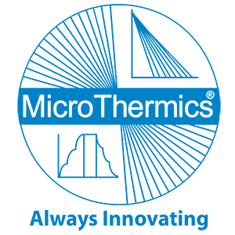

Optimize Your Operations with Expert Thermal Process Solutions
Thermal Process Solutions

Slide 2
About us
Micro Thermics stands at the forefront of thermal processing innovation, drawing on decades of industry leadership. We specialize in tailored solutions for UHT, HTST, and pasteurization processes, ensuring precision and efficiency. Our holistic services encompass process development, equipment selection, and beyond. At Micro Thermics, you're not just a client; you're a vital partner in advancing food and beverage processing. Trust in our unwavering commitment to excellence and explore how our thermal processing solutions can elevate your operations. Discover the Micro Thermics legacy – where precision converges with progress in thermal processing technology.

Slide 3

Elevate Your Operations with Cutting-Edge Thermal Process Solutions
Micro Thermics leads the industry in delivering customized thermal processing services, backed by decades of expertise. Whether it's UHT, HTST, or pasteurization, we guarantee precision and efficiency at every step. Our comprehensive services cover process development, equipment selection, and more. At Micro Thermics, you're not just a client; you're a valued partner in advancing food and beverage processing. Rely on our unwavering commitment to excellence and discover how our thermal processing solutions can enhance your operations. Experience the MicroThermics difference – where precision intersects with progress in thermal processing technology.

Slide 4
Innovative Thermal Process Development for Optimal Results
Micro Thermics excels in providing cutting-edge thermal process development services. With extensive industry knowledge, we specialize in UHT, HTST, and pasteurization processes, ensuring precision and efficiency. Our offerings encompass comprehensive process development, equipment selection, and more. At Micro Thermics, you're not just a client; you're an integral partner in revolutionizing food and beverage processing. Trust in our unwavering commitment to excellence and explore how our thermal process development solutions can optimize your operations. Immerse yourself in the Micro Thermics experience – where precision converges with progress in thermal processing technology.

Slide 5

Pioneering Thermal Processing Solutions for Industry Leaders
Micro Thermics leads the industry in delivering tailored thermal processing services. With decades of experience, we specialize in UHT, HTST, and pasteurization, ensuring precision and efficiency at every phase. Our comprehensive services include process development, equipment selection, and more. At Micro Thermics, you're not just a client; you're a valued partner in advancing food and beverage processing. Rely on our unwavering commitment to excellence and discover how our thermal processing solutions can enhance your operations. Experience the MicroThermics difference – where precision intersects with progress in thermal processing technology.

Slide 6

Contact Us
MicroThermics, Inc.
3216-102 Wellington Ct.
Raleigh, NC 27615
USA
Phone: +1 919 878 8045
Fax: +1 919 878 8032
Email: info@microthermics.com

