Slide 1

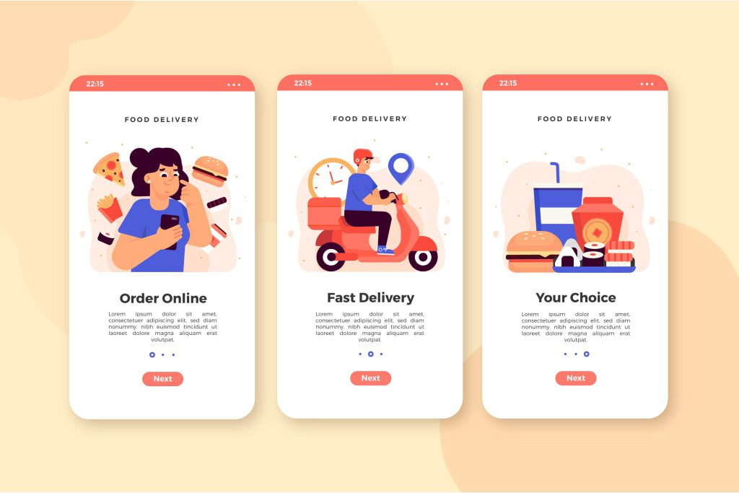
Quora Web Solution
Website Design and
Development
Company
Web Design & Web Development
Company in Bangalore, India
www.quorawebsolution.com
+91 9986 056 909
info@quorawebsolutions.com
24A, 1st Main Rd, Chandra Reddy
Layout, Koramangala 4th Block,
Koramangala, Bengaluru,
Karnataka 560034

Slide 2

From Concept to Launch: The Step-by-Step Process of Building a Stunning Website That Drives Traffic and Conversions
www.quorawebsolution.com

Slide 3
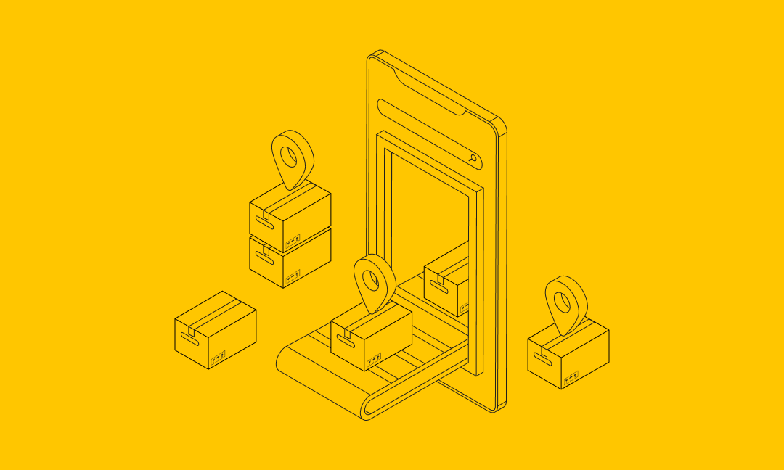
Building a website is a complex yet rewarding journey that requires a balance of creativity, strategy, and technical expertise.
www.quorawebsolution.com

Slide 4

From the initial concept to the final launch, every stage of development plays a crucial role in creating a stunning website that not only looks good but also drives traffic and generates conversions.
www.quorawebsolution.com

Slide 5

Here's a step-by-step guide to help you navigate the process.
www.quorawebsolution.com

Slide 6
1. Defining Goals and Objectives
Before you dive into design or development, it’s essential to define the goals of your website. What do you want to achieve? Whether it’s increasing sales, generating leads, or enhancing brand awareness, understanding the purpose of your website will guide every decision you make throughout the process. Set clear, measurable goals to ensure that your website aligns with your business objectives.
2. Research and Planning
This stage involves gathering insights about your target audience, competitors, and industry trends. By analyzing competitor websites, user behavior, and current web design trends, you can identify features and functionalities that will work best for your site. Creating a detailed sitemap will help you structure your website’s navigation and ensure a smooth user experience.
3. Wireframing and Prototyping
www.quorawebsolution.com

Slide 7
Wireframing is like the blueprint for your website. It involves creating a skeletal version of your website, mapping out the layout and functionality without any design elements. This step helps to organize content, prioritize features, and plan the user journey. Once wireframes are approved, a prototype may be created to demonstrate interactive elements and flows before actual development begins.
4. Designing the User Interface (UI)
With the wireframe and prototype in place, the design phase begins. A clean and visually appealing user interface (UI) is key to creating a memorable first impression. At this stage, color schemes, typography, imagery, and branding elements are added to the wireframe. It's essential to focus on design principles like consistency, simplicity, and visual hierarchy to ensure the website is aesthetically pleasing and functional.
5. Developing the Website
www.quorawebsolution.com

Slide 8
Website development is where the magic happens. Front-end development brings the design to life, turning static images and layouts into a fully functional website. Back-end development ensures that the site operates smoothly, handling server-side tasks, databases, and integrations. During this phase, developers implement key features, such as contact forms, shopping carts, and content management systems (CMS).
6. Optimizing for Performance and SEO
Once the website is developed, it's time to optimize it for speed and search engines. Site performance plays a crucial role in user experience, so optimizing load times by compressing images, minifying code, and enabling browser caching is vital. Additionally, SEO (Search Engine Optimization) techniques like keyword research, meta tags, and content optimization should be integrated into the site to help it rank higher on search engines and attract organic traffic.
www.quorawebsolution.com

Slide 9
7. Testing and Quality Assurance
Before launching the website, thorough testing is necessary to ensure everything functions as expected. This includes cross-browser testing to ensure compatibility across different browsers, mobile responsiveness testing for users on smartphones and tablets, and functionality testing for forms, buttons, and links. A quality assurance check ensures that all issues are identified and resolved before the site goes live.
8. Launch and Post-Launch Activities
Once testing is complete and all issues are resolved, it’s time to launch your website. Make sure everything is in place, including domain registration, hosting setup, and final backups. After launch, monitor website performance closely to address any bugs or issues that may arise. It’s also important to track metrics like traffic, bounce rates, and conversions to ensure your website is meeting its goals.
www.quorawebsolution.com

Slide 10
9. Ongoing Maintenance and Updates
A website is never truly "finished." Continuous monitoring, maintenance, and content updates are necessary to keep it fresh, secure, and relevant. Regular updates help improve user experience, enhance security, and stay up to date with industry changes.
Conclusion
The process of building a stunning website that drives traffic and conversions is both an art and a science. By following these steps, you can create a site that not only captures attention but also provides value to your users, leading to better business results. Whether you’re building your website in-house or partnering with a professional web design company, a well-executed plan will help you achieve long-term success online.
Innovative Web Design and Development Solutions: How a Custom Website Can Set Your Business Apart in a Competitive Market
www.quorawebsolution.com

Slide 11
In today’s digital landscape, having a professional, user-friendly website is essential for businesses looking to stand out. However, in a competitive market, a generic template website simply won’t cut it. To truly differentiate your brand and make a lasting impact, investing in a custom website design and development solution is the way forward. Here's how a tailored website can give your business a significant edge.
1. Reflecting Your Brand’s Unique Identity
A custom website design allows you to create a unique online presence that aligns with your brand’s voice, mission, and values. Unlike pre-made templates, which can make your site look similar to others, a custom design enables you to showcase your distinct style. From color schemes and typography to layout and imagery, every element can be tailored to create a visual identity that resonates with your target audience.
2. Improved User Experience (UX)
www.quorawebsolution.com

Slide 12
A well-designed custom website is built with your users in mind. By focusing on intuitive navigation, fast loading times, and mobile responsiveness, custom sites enhance the user experience (UX). Users will find it easier to engage with your content, products, or services, which can significantly increase conversion rates. A seamless experience also reduces bounce rates, ensuring visitors stay longer and explore more of what you offer.
3. Better Functionality and Custom Features
A custom website allows you to incorporate unique functionalities that are tailored to your specific business needs. Whether it's a custom e-commerce platform, a booking system, or advanced integrations with third-party tools, bespoke solutions can elevate your business operations. Custom development ensures that all features are built to work flawlessly together, providing a smooth and efficient user journey.
www.quorawebsolution.com

Slide 13
4. Scalability and Flexibility
As your business grows, so will your website needs. One of the biggest advantages of a custom website is its scalability. Unlike templates, which can become restrictive as your business evolves, a custom-built website offers the flexibility to add new features, pages, or integrations as needed. Whether you’re expanding your product offerings, entering new markets, or integrating new technologies, a custom website can grow alongside your business.
5. Search Engine Optimization (SEO) Advantage
A custom website offers more control over the implementation of SEO strategies. With a tailored design, you can ensure that your website is built with SEO best practices in mind, such as optimized URL structures, faster load times, mobile-friendly design, and user-friendly navigation.
www.quorawebsolution.com

Slide 14
This makes it easier to rank higher on search engines, increasing your visibility and attracting more organic traffic.
6. Competitive Edge in the Market
In a crowded market, businesses must do everything they can to stand out. A custom website not only enhances your brand’s uniqueness but also demonstrates professionalism and commitment to quality. It shows your customers that you’re invested in providing them with an exceptional experience, which can foster trust and loyalty. Custom websites also enable you to adapt to new trends and technologies faster, keeping you ahead of your competition.
7. Long-Term Cost-Effectiveness
While custom website design and development may come with a higher initial cost compared to using pre-designed templates, it often proves to be more cost-effective in the long run.
www.quorawebsolution.com

Slide 15
Custom websites are built to last, with fewer limitations and maintenance requirements. Additionally, they often result in higher conversion rates and customer satisfaction, ultimately driving more revenue for your business.
Conclusion
In a world where online presence is crucial to success, investing in a custom website design and development solution is one of the best decisions you can make for your business. A custom-built site not only sets you apart from competitors but also ensures that your website reflects your brand’s identity, meets the needs of your users, and grows alongside your business. With tailored functionality, improved user experience, and SEO advantages, a custom website can be the key to long-term success in today’s digital marketplace.
www.quorawebsolution.com

Slide 16
Quora Web Solution: Quora Web Solution is a trusted website development company based in Bangalore, India, offering a wide array of services to not only domestic but global clientele. Be it Website Design and Development, SEO services, Digital Marketing, Branding, App Development, Ecommerce Solution, and Logo Creation . Quora Web Solution has the best website developers offering top quality services and that is the reason why we are well known as one of the best Website Development Companies in Bangalore, India.
Visit Us - www.quorawebsolution.com
Call Us - +91 9986 056 909
Mail Us - info@quorawebsolutions.com
www.quorawebsolution.com

Slide 17

WORDPRESS DEVELOPMENT
ECOMMERCE DEVELOPMENT
PHP DEVELOPMENT
CMS DEVELOPMENT
DRUPAL DEVELOPMENT
WEBSITE SERVICES
WEBPORTAL DEVELOPMENT
MAGENTO DEVELOPMENT
WEBSITE DEVELOPMENT
JOOMLA DEVELOPMENT
SMALL BUSINESS DEVELOPMENT
CHEAP WEBSITE DEVELOPMENT
STATIC WEBSITE DEVELOPMENT
DYNAMIC WEBSITE DEVELOPMENT
WEBSITE DESIGN COMPANY
TOUR AND TRAVEL WEBSITE DEVELOPMENT
Services

