Slide 1
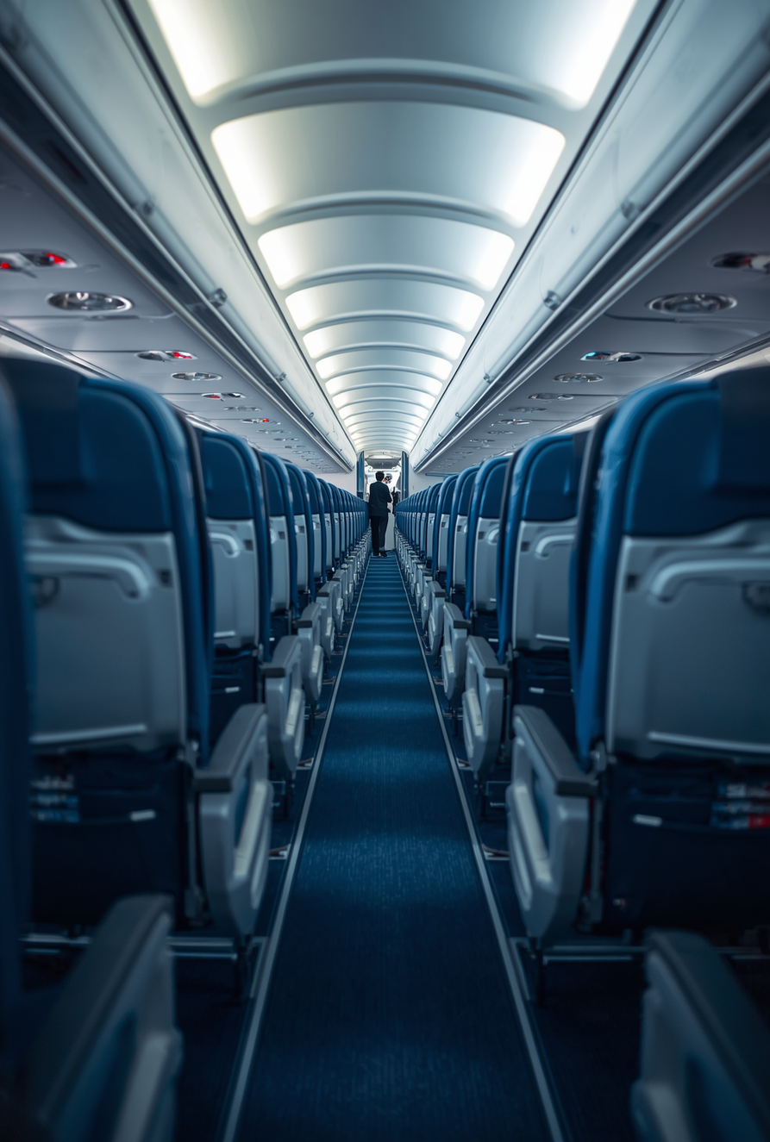




KLM AIRLINES SEAT SELECTION
www.klm.com
How to Choose Your Seat on KLM Flights
+1-888-212-0809

Slide 2




WHAT IS IT?
KLM Airlines seat selection allows passengers to choose their preferred seat on a KLM flight before check-in. Available via the KLM website or mobile app, this feature gives travelers greater control over their flying experience — from window to aisle, front to back.
Selecting your seat in advance offers key advantages: enjoy greater comfort tailored to your preferences, secure extra legroom seats for a more relaxed journey, and ensure you sit alongside your travel companions throughout the flight.
BENEFITS

Slide 3


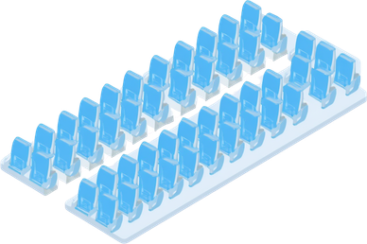

Step 1: Visit KLM Website or App
Go to the KLM website or mobile app. Enter your booking reference and last name to access your reservation.
HOW TO SELECT YOUR SEAT
Step 2: Access Your Booking
Navigate to the "Manage Booking" or "My Trip" section to view your flight details and available options.
Follow these simple steps to choose your preferred seat on KLM flights. Note: Seat selection is free for many fare types, but fees may apply for certain seats or classes.
Step 3: Choose & Confirm Your Seat
Select "Select your seat", browse the seat map, pick your preferred seat, and confirm your selection.

Slide 4




SEAT TYPES
Standard Seats: Free with most tickets, standard legroom and comfort for all passengers.
Economy Comfort: Extra legroom seats, ideal for taller passengers — may involve an additional fee depending on route and fare class.
Preferred Seats: Front cabin or exit rows, offering quicker boarding — sometimes paid.
Business Class: Fully included with business fare, premium comfort and service.
Fees vary based on seat type, route, and fare class booked.
COSTS & CLASS

Slide 5




Timing Your Selection
Select your seat early to get the best available options.
Changes are allowed up to 30 minutes before departure, subject to availability.
TIPS & POLICIES
Groups & Families
Families and groups can usually select seats together at the time of booking.
Some special seats (e.g., exit rows) require passengers to meet safety criteria.
KLM seat selection policies ensure passengers have options that suit their needs and comfort. Plan ahead for the best experience on your KLM flight.
Policies & Reminders
KLM seat selection policies ensure passengers have options that suit their needs.
Thank you for learning about KLM Airlines seat selection. Have a great flight!

Slide 6


THANK
YOU!
Have a great flight!

