Slide 1
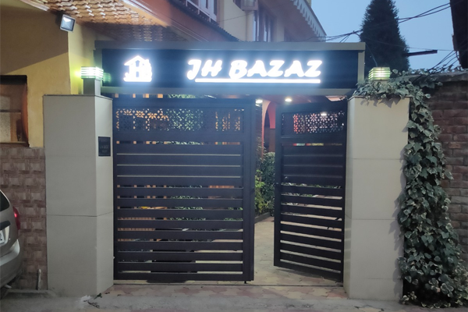


Hotel JH Bazaz
Your Comfortable Stay in Srinagar, Kashmir
A comfortable, affordable, and family-friendly stay for travelers exploring the beauty of Kashmir.
JHBAZAZ.COM

Slide 2
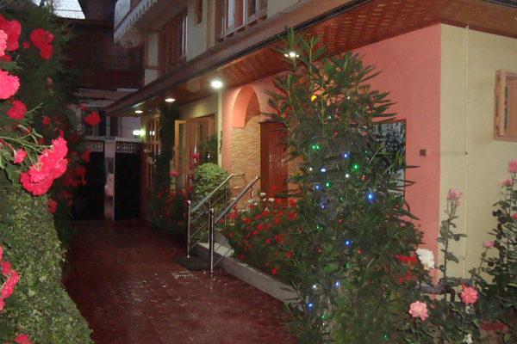
About Hotel JH Bazaz
Located in the Dalgate area of Srinagar, Hotel JH Bazaz is a welcoming hotel focused on making every guest feel at home.
Comfortable Stay
Cozy accommodation with essential modern facilities
Friendly Hospitality
Personalized, helpful service for every guest
Affordable Options
Budget-friendly rates without compromising comfort
Convenient Location
Close to Srinagar's top attractions and landmarks

Slide 3
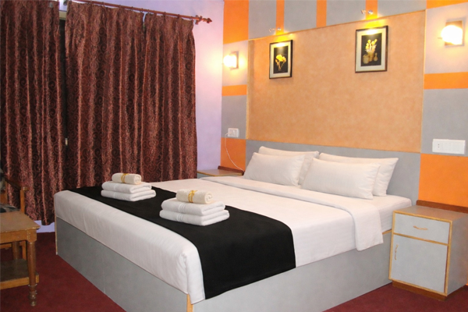


Why Choose Hotel JH Bazaz?
Comfort & Convenience
Budget-friendly accommodation with comfortable rooms
Personalized guest service and family-friendly environment
Safe and peaceful surroundings
Convenient access to Srinagar attractions
Hotel JH Bazaz aims to make every guest's Kashmir trip comfortable and memorable.

Slide 4
Room Options
Comfortable rooms for different needs and group sizes.
Room Type | Capacity | Per Night
AC Room | 2 Members | ₹1,750
Non-AC Room | 2 Members | ₹1,300
AC Room | 4 Members | ₹2,800
Non-AC Room | 4 Members | ₹2,400
Wi-Fi
Geyser
Locker
Parking
Rates may change; confirm current prices with the hotel.

Slide 5





Hotel Amenities
Facilities designed for a comfortable and convenient stay.
Connectivity
Comfort
Convenience
High-speed Wi-Fi and Smart TV in rooms
Geyser and 24/7 hot shower bath
Parking, pick & drop facility, and locker
Safety
Relaxation
CCTV surveillance and safe surroundings
Peaceful garden area for guests

Slide 6
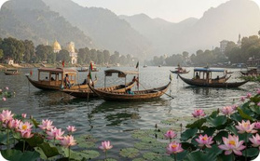
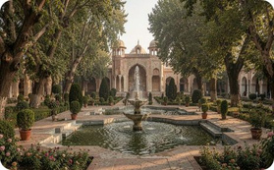
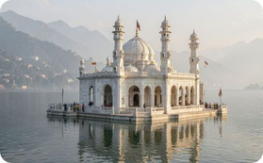

Explore Srinagar & Kashmir
Hotel JH Bazaz is a convenient base for discovering Kashmir's most beautiful attractions.
Dal Lake
Mughal Gardens
Hazratbal Shrine
Pari Mahal
Iconic lake with shikara rides and houseboats
Shalimar Bagh, Nishat Bagh & Chashme Shahi
Revered white marble shrine on the lake
Seven-terraced garden with panoramic views

Slide 7
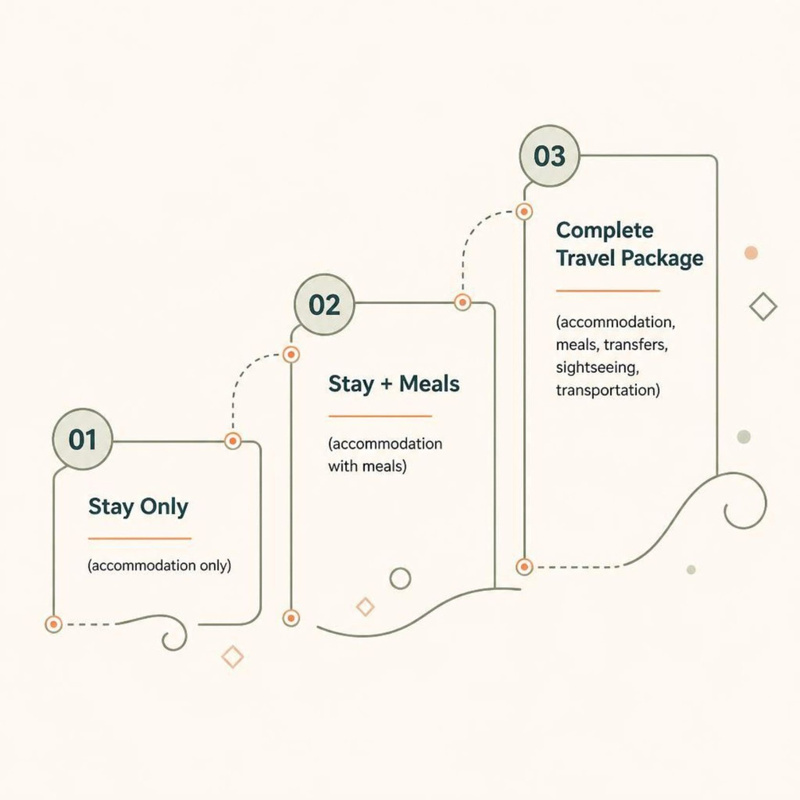

Kashmir Travel Packages
What's Included
Travel options include Innova, Etios, and Tempo Traveller vehicles for a seamless Kashmir experience.
Accommodation
Meals
Transfers & Transportation
Sightseeing

Slide 8
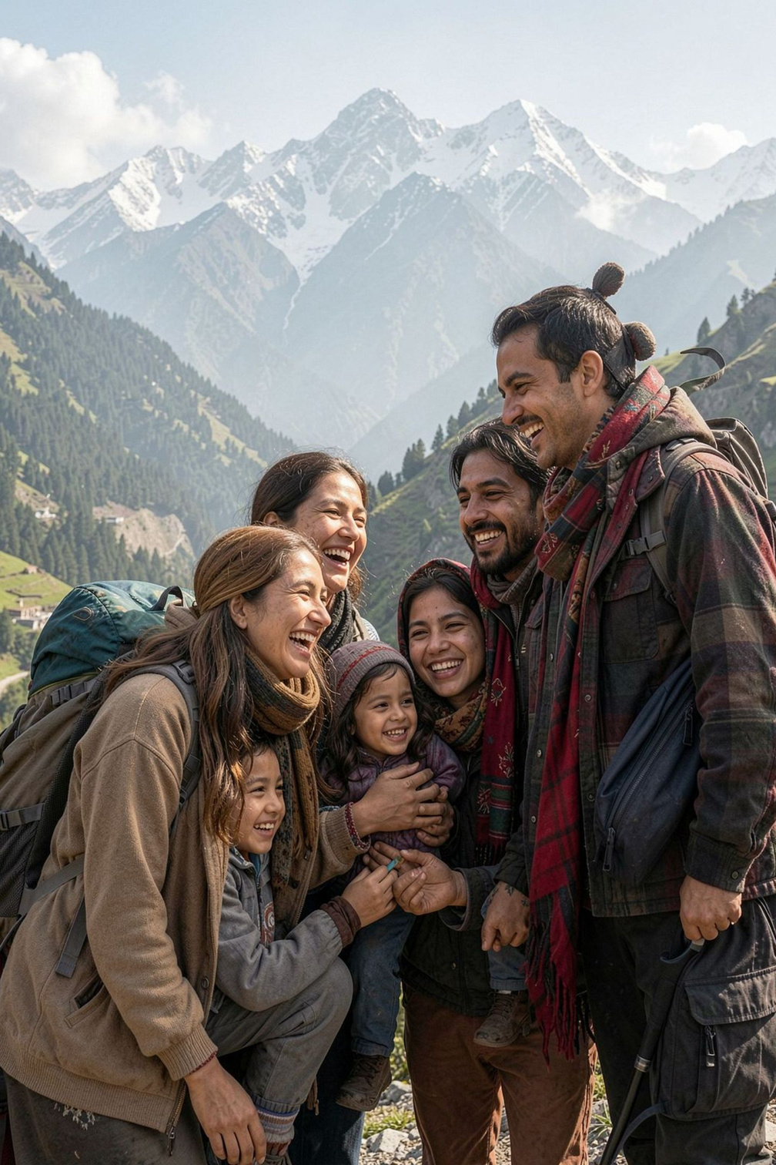
Ideal for Every Traveler
Families
Peaceful and convenient accommodation for family holidays
Couples
A comfortable base for exploring Srinagar and Kashmir
Budget Travelers
Affordable room options with all essential facilities
Travel Groups
Room and transportation options suited for group trips

Slide 9
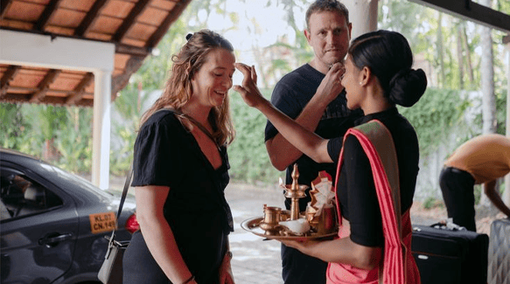
Our Commitment
COMFORT · SERVICE · VALUE
At Hotel JH Bazaz, we focus on creating a positive guest experience through thoughtful service and attention to detail.
Your Comfort Is Our Priority
Comfortable & Clean Accommodation
Helpful & Friendly Hospitality
Essential Modern Facilities
Safe & Value-for-Money Stays

Slide 10
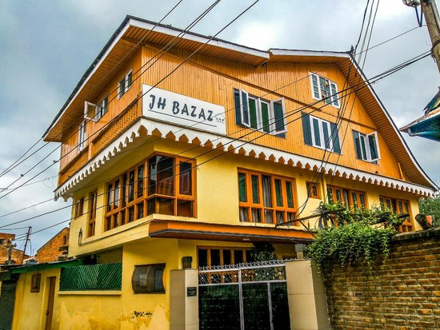
Plan Your Kashmir Stay Today
📍 Address
Ist Cross Lane, Boulevard Road, Buchwara, Dalgate, Srinagar – 190001
📞 Call Us
+91 9622424355
+91 9797822940
✉️ Email
hoteljhbazaz@gmail.com
🌐 Website
jhbazaz.com
Hotel JH Bazaz — A Home Away From Home in Srinagar, Kashmir

