Slide 1

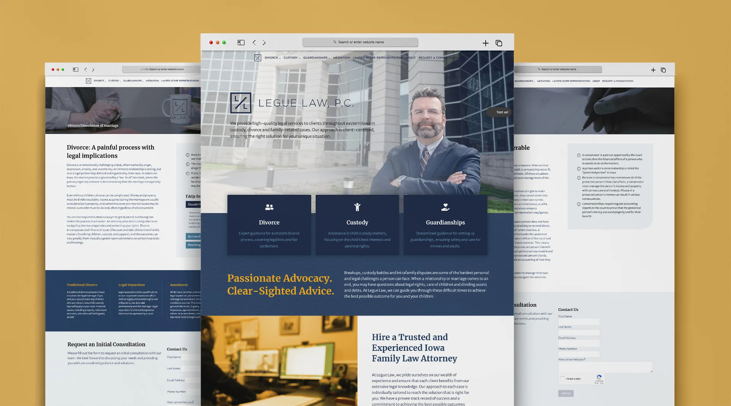
Quora Web Solution
Website Design and
Development
Company
Web Design & Web Development
Company in Bangalore, India
www.quorawebsolution.com
+91 9986 056 909
info@quorawebsolutions.com
24A, 1st Main Rd, Chandra Reddy
Layout, Koramangala 4th Block,
Koramangala, Bengaluru,
Karnataka 560034

Slide 2

How Website Design and Development Can Impact Your Conversion Rates and Customer Engagement
www.quorawebsolution.com

Slide 3
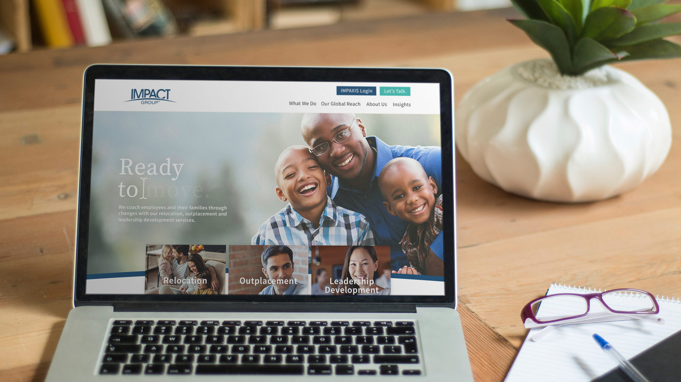
In today’s digital-first world, the design and development of your website can make or break your business’s online success.
www.quorawebsolution.com

Slide 4

Website design isn’t just about aesthetics; it’s about creating an intuitive, engaging experience that drives conversions.
www.quorawebsolution.com

Slide 5

But how exactly does website design and development influence conversion rates and customer engagement? Let’s dive in.
1. First Impressions Matter
www.quorawebsolution.com

Slide 6
Your website is often the first point of contact between your business and potential customers. A sleek, professional design can immediately establish trust, while a cluttered or outdated website can send visitors running. A well-designed site is crucial for conveying professionalism and reliability, both of which play into conversion rates.
2. User Experience (UX) is Key to Engagement
A positive user experience directly affects how visitors interact with your site. Intuitive navigation, fast loading times, and a mobile-optimized design all contribute to a seamless experience that keeps visitors engaged. When users can find what they’re looking for quickly and easily, they’re more likely to convert.
Easy Navigation: Visitors should never feel lost. Streamlined navigation and clear calls-to-action (CTAs) guide users toward completing their desired actions, whether that’s making a purchase, filling out a contact form, or signing up for a newsletter.
www.quorawebsolution.com

Slide 7
Mobile Optimization: With increasing numbers of users browsing from mobile devices, a responsive design ensures that users can engage with your content and complete actions on any device.
3. Loading Speed Affects Conversion Rates
In the fast-paced digital world, speed is everything. Studies show that even a one-second delay in loading time can result in significant decreases in conversion rates. Efficient website development ensures fast load times, reducing bounce rates and increasing the likelihood that users will stay on your site and follow through with desired actions.
4. Clear Calls to Action (CTAs)
The design of your website should include clear and compelling CTAs that guide users toward conversion. Whether you’re encouraging users to buy a product, book a service, or download a resource, strategically placed and well-designed CTAs are essential.
www.quorawebsolution.com

Slide 8
The design and placement of these buttons can significantly impact their visibility and user engagement.
5. Visual Appeal and Branding
Your website’s visual elements—colors, fonts, images, and overall layout—serve as a direct reflection of your brand. A visually appealing site that aligns with your brand’s identity can foster emotional connections with visitors, improving customer loyalty and engagement.
Consistency in Branding: Consistency between your website and other marketing materials (like social media, brochures, and ads) reinforces your brand’s credibility and trustworthiness.
Appealing Design: High-quality images and a clean, modern design can captivate users, keeping them on your site longer and encouraging them to explore further.
6. Trust-Building Features
www.quorawebsolution.com

Slide 9
Incorporating trust signals on your website, such as customer testimonials, security badges, and industry certifications, can greatly enhance conversion rates. Customers are more likely to engage with a website they feel secure on.
Security Features: Displaying trust seals and security icons (such as SSL certificates) reassures users that their personal information is safe, increasing their willingness to make a purchase or provide contact details.
7. Content is Still King
Even the most beautifully designed website won’t convert visitors if the content doesn’t speak to their needs. Your website’s content—whether it’s blog posts, product descriptions, or landing pages—should be clear, informative, and aligned with your audience’s interests.
Engaging Copywriting: Persuasive and well-written content guides users through the customer journey and helps them make decisions faster.
www.quorawebsolution.com

Slide 10
Relevant Content: Regularly updated content, such as blogs or case studies, can keep users engaged and encourage repeat visits, boosting customer loyalty.
8. Analyzing and Iterating for Improvement
Finally, ongoing analysis of website performance is crucial. Tools like Google Analytics can provide insights into how users interact with your site, where they drop off, and which pages lead to conversions. Use this data to fine-tune your website design and development, making iterative improvements to boost engagement and conversions over time.
Conclusion
Website design and development play a critical role in driving conversion rates and fostering customer engagement. A well-designed, user-friendly website that prioritizes speed, navigation, and trust can help convert visitors into loyal customers.
www.quorawebsolution.com

Slide 11
By investing in professional design and development, you’re not just improving aesthetics—you’re building a platform for success.
How to Choose the Right Website Design and Development Company to Create a Powerful Online Presence for Your Business
Choosing the right website design and development company is a critical decision for your business’s online success. A well-designed, functional website can set your brand apart, engage your customers, and help you achieve your business goals. Here’s a guide to help you select the best partner for creating a powerful online presence.
1. Understand Your Needs and Goals
Before you begin your search, it's important to have a clear understanding of what you need.
www.quorawebsolution.com

Slide 12
Are you looking for a simple informational website, or do you need an e-commerce platform with complex features? Knowing your goals will help you identify the right company that specializes in the services you require, whether it’s SEO optimization, custom development, or UX design.
2. Check Their Portfolio
A company’s portfolio is one of the best indicators of their skills and experience. Browse through their past projects to assess their design style, development expertise, and ability to meet business needs. Look for a variety of industries and website types in their portfolio to see if they can adapt to your specific requirements.
3. Read Client Reviews and Testimonials
Client feedback provides valuable insight into the company’s work ethic, reliability, and results. Look for testimonials on their website or third-party review platforms to get a sense of their reputation. Positive reviews and case studies can give you confidence that they can deliver on their promises.
4. Evaluate Their Design Process
www.quorawebsolution.com

Slide 13
Ask the company about their design process. Do they take time to understand your business and goals before diving into the design phase? A good company will work closely with you to develop a strategy that aligns with your vision and target audience. They should also involve you in key stages, such as wireframing, prototyping, and revisions.
5. Ensure They Are Technically Skilled
Web development goes beyond design. Your chosen company should have solid technical expertise, including experience with coding, web standards, and integrating with third-party tools. They should also be familiar with the latest technologies, such as responsive design, content management systems (CMS), and SEO practices, to ensure your website functions smoothly across all devices.
6. Check for SEO and Mobile-First Focus
In today’s digital landscape, a website’s performance is critical to its success.
www.quorawebsolution.com

Slide 14
Ensure the company prioritizes SEO-friendly design and development, as this will help your site rank higher in search engine results. Additionally, a mobile-first approach is essential, given the increasing number of mobile internet users. Make sure the company designs websites that are responsive and optimized for both desktop and mobile users.
7. Communication and Customer Support
Good communication is key throughout the project. Choose a company that listens to your needs, communicates effectively, and is responsive to your inquiries. They should also provide ongoing support after the website launch, addressing any issues that arise and helping with updates or changes as your business evolves.
8. Discuss Budget and Timelines
While quality should be a priority, it’s important to ensure the project fits within your budget. Ask for a detailed breakdown of costs, including any ongoing maintenance or updates.
www.quorawebsolution.com

Slide 15
Additionally, make sure the company can meet your timeline for launching the website. Delays can harm your business, so it's crucial to set clear expectations from the start.
9. Assess Their Creativity and Innovation
Your website is a reflection of your brand, and it should stand out in a competitive market. Look for a company that can offer creative, unique, and innovative solutions, rather than a one-size-fits-all approach. A good design company will offer fresh ideas and think outside the box to build a site that not only looks good but also engages your audience.
10. Ensure They Offer Ongoing Maintenance
A website is not a “set and forget” asset. After launch, you’ll need regular maintenance, updates, and troubleshooting.
www.quorawebsolution.com

Slide 16
Choose a company that offers ongoing support and maintenance services to ensure your site stays current, secure, and functional over time.
Conclusion
Choosing the right website design and development company is crucial for your business’s digital success. By carefully evaluating their portfolio, technical skills, process, and customer support, you can find a company that will help you create a powerful online presence that aligns with your goals and resonates with your audience. Make sure to choose a partner who understands your vision and can work with you to achieve it every step of the way.
www.quorawebsolution.com

Slide 17
Quora Web Solution: Quora Web Solution is a trusted website development company based in Bangalore, India, offering a wide array of services to not only domestic but global clientele. Be it Website Design and Development, SEO services, Digital Marketing, Branding, App Development, Ecommerce Solution, and Logo Creation . Quora Web Solution has the best website developers offering top quality services and that is the reason why we are well known as one of the best Website Development Companies in Bangalore, India.
Visit Us - www.quorawebsolution.com
Call Us - +91 9986 056 909
Mail Us - info@quorawebsolutions.com
www.quorawebsolution.com

Slide 18

WORDPRESS DEVELOPMENT
ECOMMERCE DEVELOPMENT
PHP DEVELOPMENT
CMS DEVELOPMENT
DRUPAL DEVELOPMENT
WEBSITE SERVICES
WEBPORTAL DEVELOPMENT
MAGENTO DEVELOPMENT
WEBSITE DEVELOPMENT
JOOMLA DEVELOPMENT
SMALL BUSINESS DEVELOPMENT
CHEAP WEBSITE DEVELOPMENT
STATIC WEBSITE DEVELOPMENT
DYNAMIC WEBSITE DEVELOPMENT
WEBSITE DESIGN COMPANY
TOUR AND TRAVEL WEBSITE DEVELOPMENT
Services

