Slide 1

Pet Policy Guide
How much is the American Airlines pet fee?
Your Complete Guide to Flying with Furry Companions
+1-888-212-0809

Slide 2


Impact Inc
Presentation
Introduction
Traveling with pets requires careful planning and a thorough understanding of airline regulations. The american airlines pet policy provides comprehensive guidelines for pet owners flying with their companions. Whether on domestic or international trips, knowing the requirements, fees, and restrictions ensures a smooth and stress-free experience.
This guide covers essential topics including documentation, weight limits, carrier requirements, and more — everything you need to prepare for worry-free travel with your pet. Understanding these rules helps avoid denied boarding and last-minute surprises at the airport.

Slide 3


Q: What documents are needed to fly with a pet?
A: Health cert, vaccination proof & carrier docs!
Flying with pets requires proper documentation for airline and government compliance. International flights under the American Airlines pet policy have stricter rules than domestic routes. Prepare all documents well ahead of travel to avoid last-minute issues at check-in.
Pet Travel
Documents
Required documents: Valid health certificate from a licensed vet • Proof of current rabies vaccination • Import permits for international destinations • Airline-approved carrier documentation • Government-issued ID matching reservation • Country-specific veterinary certificates for international travel.

Slide 4
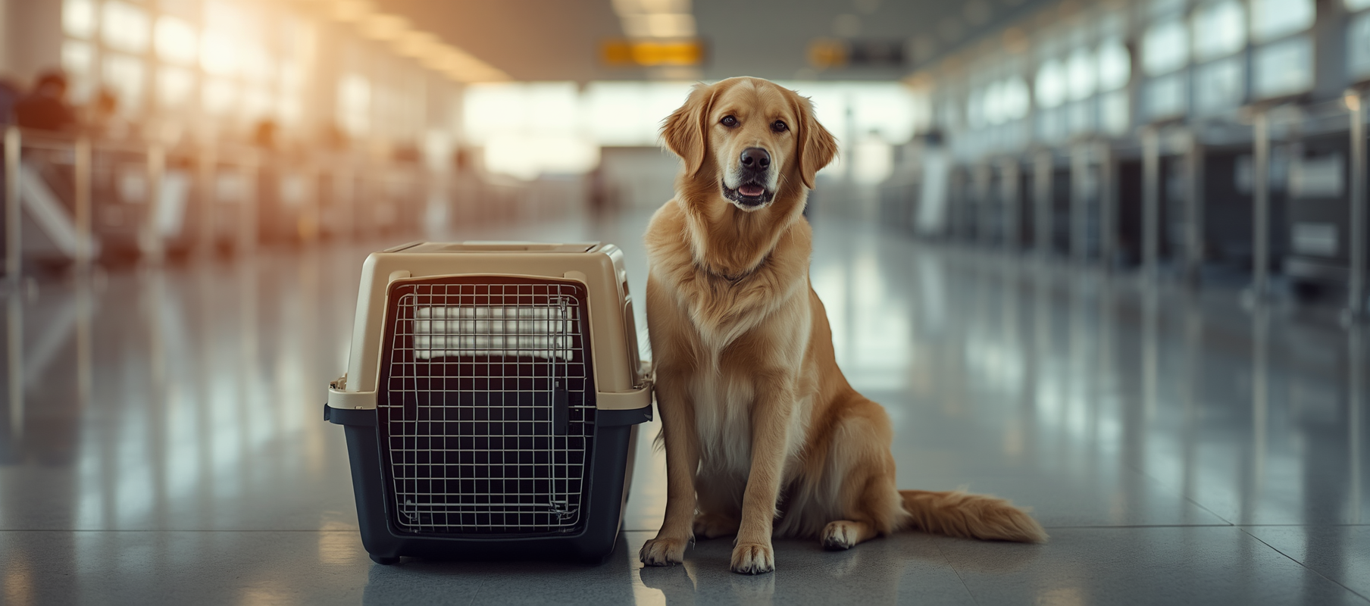
Can I Buy My 50 lb Dog a Seat on a Plane?
Q: Can large dogs fly in the cabin?
A: Cargo only
• Cabin travel limited to small pets in carriers fitting under seat
• Large dogs travel as checked pets or cargo only
• Combined pet and carrier weight determines eligibility
• Cargo compartments are temperature-controlled and pressurized
• Advance booking required for pet cargo services
• Breed restrictions may apply for cargo travel

Slide 5
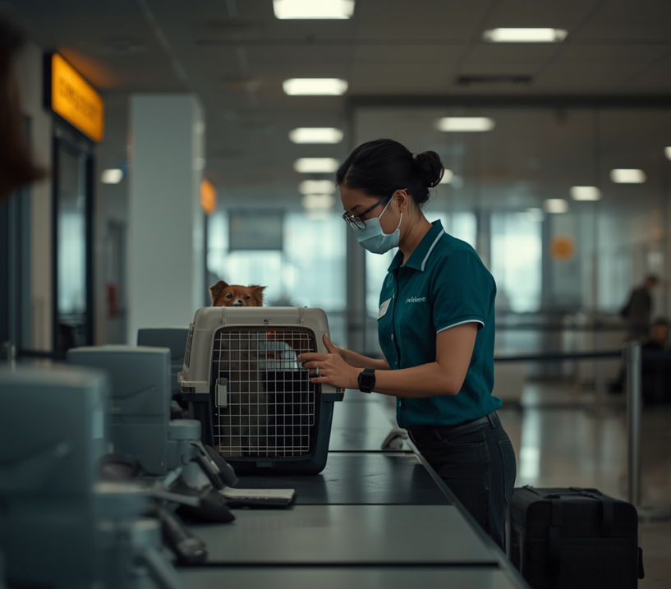
Q: How strict are American Airlines with pets?
A: Very strict — rules are enforced at check-in and boarding!
American Airlines enforces firm standards to ensure safety and comfort during pet travel. The american airlines pet policy on domestic flights is consistently applied at check-in and boarding. Being aware of these strict rules helps avoid denied boarding or travel disruptions.
Policy
Strictness
• Carrier dimensions strictly measured at check-in
• Pet must remain in carrier throughout flight
• Only one pet carrier allowed per passenger
• Service animals have different requirements than pets
• Staff may refuse boarding if pet appears distressed or ill
• All documentation thoroughly reviewed before acceptance

Slide 6

Health Certificate Requirements
Q: Does my pet need a health certificate?
A: Yes, always
Health certificates are essential for pet travel on American Airlines. Required for all pets, issued within 10 days of travel by a licensed veterinarian. The certificate confirms your pet is fit for air travel. International flights may require additional certifications. Keep original documents accessible throughout your journey.

Slide 7

WEIGHT LIMIT
DIMENSIONS
COMFORT
Weight Limits & Carrier Rules
Combined weight of pet and carrier must not exceed 20 lbs for cabin travel. Larger pets must travel as checked pets or cargo. Weight is verified at check-in.
Carrier must fit under the seat in front of you. Max size: 19" x 13" x 9". Hard-sided or soft-sided carriers accepted if airline-approved. Ventilation required on at least two sides.

Slide 8

Special Provisions for Military Personnel
FEE WAIVERS
BAGGAGE & ORDERS
COORDINATION
Active duty military may receive fee waivers on certain routes. American Airlines pet policy military provisions provide special flexibility and accommodations for service members traveling with pets under official orders.
Additional baggage allowances apply for pet carriers. PCS orders must be presented at check-in. Same health and safety requirements apply to all military pet travelers as standard passengers.
Advance coordination with your military travel office is strongly recommended. Contact the airline early to confirm current military benefits and ensure all pet documentation is prepared before travel day.
Learn More
Learn More
Learn More

Slide 9

Impact Inc
Presentation
Conclusion
Understanding the american airlines pet policy is essential for smooth pet travel. Documentation, weight limits, and health certificates all play vital roles in ensuring compliance and comfort for your pet.
The American Airlines carry-on pet policy provides clear cabin travel guidelines, while larger pets can use cargo services designed for safety and comfort. Preparing properly ensures a stress-free journey for you and your pet. Always verify current policies before booking as regulations may change.

Slide 10
AirFlyPolicy.com
Presentation
Still Have Questions? Let's Chat!
Get expert assistance with your pet travel planning. Our specialists are ready to help you navigate American Airlines pet policies, fees, and documentation requirements for a stress-free journey with your furry companion.
+1-888-212-0809
www.airflypolicy.com

