Slide 1


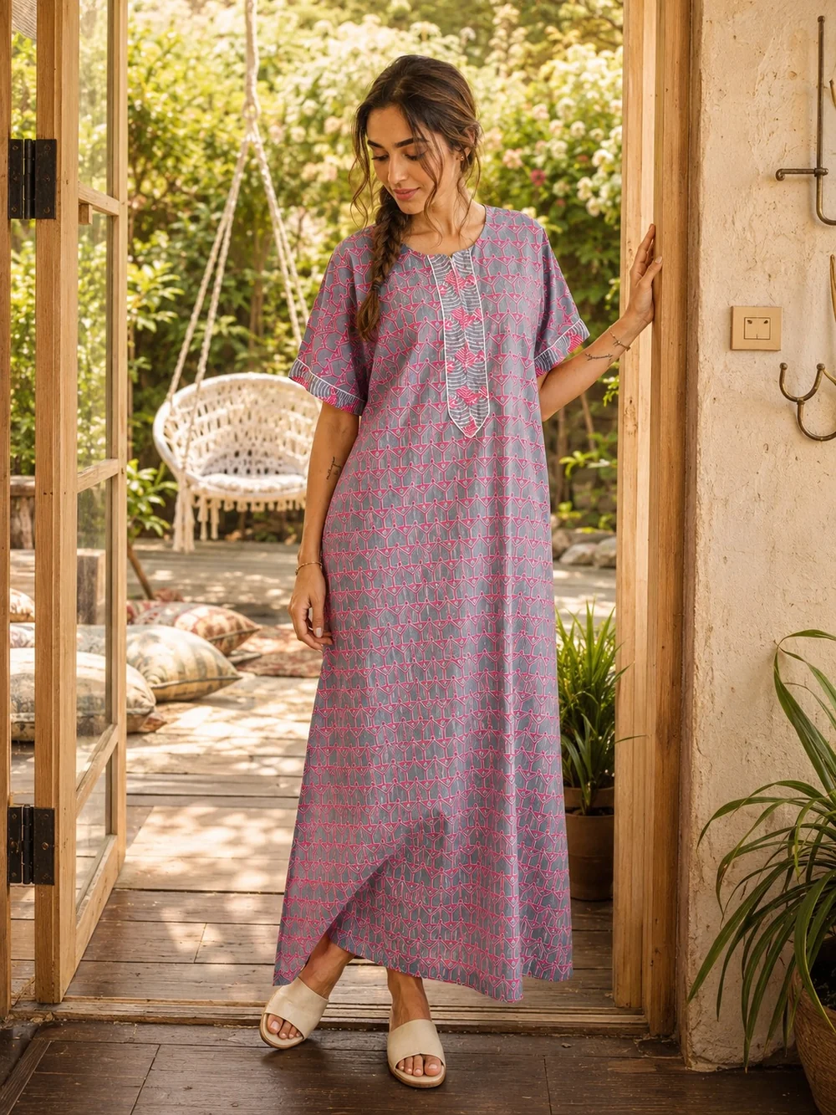

Cotton Nighty for Women
Where Comfort Meets Everyday Style
Soft. Breathable. Beautiful.
Discover thoughtfully designed cotton nightwear by Yellow Bloom, created for relaxed evenings, peaceful nights, slow mornings, and comfortable everyday living.
Yellow Bloom Where Comfort Meets Confidence in Every Stitch
Notes:
1

Slide 2
What Is a Cotton Nighty for Women?
A Cotton Nighty for Women is more than just sleepwear.
It is an everyday essential designed to offer:
Breathable comfort
Softness against the skin
Easy movement
Relaxed silhouettes
Effortless everyday style
Comfort from morning to night
At Yellow Bloom, cotton nightwear is designed to transition naturally between sleepwear, homewear, lounging, and relaxed everyday dressing.
Notes:
2

Slide 3
Why Choose Cotton Nightwear?
Comfort Begins with the Fabric
Cotton is a natural choice for women who want comfortable everyday clothing.
100% Cotton
  ✓ Soft and lightweight
  ✓ Breathable and comfortable
  ✓ Easy to wear for extended hours
  ✓ Suitable for relaxed homewear
  ✓ Perfect for warm-weather comfort
  ✓ Easy to incorporate into everyday routines
Yellow Bloom's website highlights 100% premium cotton as a core part of its product philosophy.
Notes:
3

Slide 4






Cotton Nighty for Women by Yellow Bloom
Comfort Meets Confidence
Yellow Bloom believes women shouldn't have to choose between comfort and style.
Its nightwear collection brings together:
Premium cotton
Nature-inspired prints
Original designs
Relaxed silhouettes
Thoughtful detailing
Everyday versatility
The result is nightwear that feels comfortable while still looking beautiful.
Notes:
4

Slide 5
Designed for More Than Sleep
One Nighty. Many Moments.
A Yellow Bloom cotton nighty can be worn for:
Sleep
Relax comfortably at bedtime.
Lounging
Enjoy slow mornings and peaceful evenings.
Work From Home
Stay comfortable during long hours at home.
Everyday Homewear
Move through your daily routine with ease.
Travel & Relaxation
Ideal for relaxed holidays and resort-style lounging.
Several Yellow Bloom designs are specifically positioned for homewear, sleepwear, lounging and relaxed daytime dressing.
Notes:
5

Slide 6





Styles You'll Love
Explore Different Cotton Nighty Styles
Yellow Bloom's collection includes a variety of silhouettes and design details.
Floral Prints
Block & Handmade Details
Fresh, feminine patterns inspired by nature.
Craft-inspired touches that give every piece character.
Full-Length Silhouettes
Relaxed Sleeves
Comfortable coverage with an elegant flow.
Designed for ease of movement.
Statement Yokes
Functional Pockets
Patchwork and detailed necklines add a distinctive touch.
Practical details for everyday convenience.
Examples across Yellow Bloom's collection include floral prints, patchwork yokes, relaxed sleeves, ankle-length silhouettes and functional pockets.
Notes:
6

Slide 7
Featured Styles
Discover Yellow Bloom's Signature Nightwear
BLOSSOM RADIANCE
GARDEN BLOOM
SKY BLOOM
Pure Cotton Nighty for Women
Floral Pure Cotton Nighty with Ruffled Yoke
Pure Cotton Nighty with a relaxed V-neck silhouette
POPPY MEADOW
SUNNY PETAL MEDLEY
Floral Cotton Nighty with an artisanal patchwork yoke
Cotton Nighty with Patchwork Yoke & Lace Accents
These products demonstrate Yellow Bloom's focus on pure cotton, floral-inspired prints, relaxed silhouettes and distinctive detailing.
Notes:
7

Slide 8
What Makes Yellow Bloom Different?
More Than Nightwear
Yellow Bloom was created around the belief that comfort should never come at the expense of style.
The brand focuses on:
Premium Cotton
100% cotton is central to many of its nightwear designs.
Original Prints
Designs are developed with a distinctive Yellow Bloom aesthetic.
Thoughtful Craftsmanship
Yokes, patchwork, borders, lace and print details add character.
Versatility
Pieces are designed to work across homewear, sleepwear and relaxed everyday dressing.
Confidence
Clothing designed to help women feel comfortable, confident and beautiful.
Notes:
8

Slide 9






Finding the Right Cotton Nighty for Women
What Should You Look For?
Fabric
Fit
Choose breathable, comfortable cotton.
Look for a relaxed silhouette that allows natural movement.
Length
Sleeves
Select a length that suits your lifestyle and comfort.
Choose short, relaxed or flowy sleeves depending on your preference.
Neckline
Details
V-neck, round neck and detailed yokes offer different looks.
Pockets, borders, patchwork and prints can make everyday nightwear more functional and stylish.
Notes:
9

Slide 10







Cotton Nighty for Every Body & Every Routine
Comfort Should Feel Effortless
A good Cotton Nighty for Women should allow you to move, relax and feel comfortable without constantly adjusting your clothes.
Yellow Bloom's relaxed designs are made for:
Everyday homewear
Bedtime routines
Relaxed mornings
Leisure at home
Work-from-home days
Travel and holidays
Maternity-friendly comfort in selected styles
Some Yellow Bloom designs explicitly describe their relaxed silhouettes as suitable for maternity-friendly wear as well as homewear and sleepwear.
Notes:
10

