Slide 1

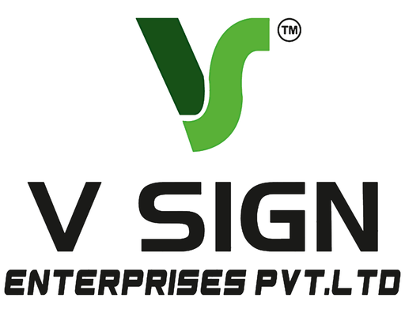



V Sign Enterprises Pvt. Ltd.
Transforming Businesses with Premium Signage Solutions
We Design • We Manufacture • We Install

Slide 2

Who We Are
V Sign Enterprises Pvt. Ltd. is one of Hyderabad's trusted signage companies, delivering innovative branding solutions for businesses of every size. Our experienced team combines creativity, quality materials, and precision craftsmanship to manufacture signage that strengthens brand visibility.

Slide 3
Our Services
  SS Letter Sign Boards
  Terrace LED Signage
  Indoor & Outdoor Signage
  Corporate Branding
  Custom Signage Solutions
  LED Sign Boards
  ACP LED Sign Boards
  Glow Sign Boards
  Acrylic Sign Boards
  3D Letter Signage

Slide 4

Why Choose V Sign?
  Experienced Professionals
  Premium Materials
  Modern Manufacturing
  Creative Designs
  Competitive Pricing
  On-Time Delivery
  Professional Installation
  Excellent Customer Support

Slide 5

Industries We Serve
  Retail Stores
  Shopping Malls
  Restaurants
  Cafés
  Hotels
  Hospitals
  Corporate Offices
  Educational Institutions
  Jewellery Stores
  Showrooms
  Commercial Buildings
  Residential Projects

Slide 6

Why LED Sign Boards?
Benefits
  High Brand Visibility
  Energy Efficient
  Weather Resistant
  Attractive Appearance
  Long Life Span
  Low Maintenance
  Premium Finish
  Better Customer Attention
  Custom Sizes Available
  Suitable for Indoor & Outdoor Use

Slide 7

Contact Information
Get in Touch
V Sign Enterprises Pvt. Ltd.
📞 Phone
099087 06363
🌐 Website
www.vsignpvtltd.com
📧 Email
vsign.pvtlt@gmail.com
Samathapuri, Kothapet, Hyderabad,
Telangana 500102

Slide 8

Thank You
V Sign Enterprises Pvt. Ltd.
Your Trusted Partner for Premium Signage Solutions
Premium Quality
Creative Designs
Timely Delivery
Professional Installation
Affordable Pricing
🌐 www.vsignpvtltd.com

