Slide 1

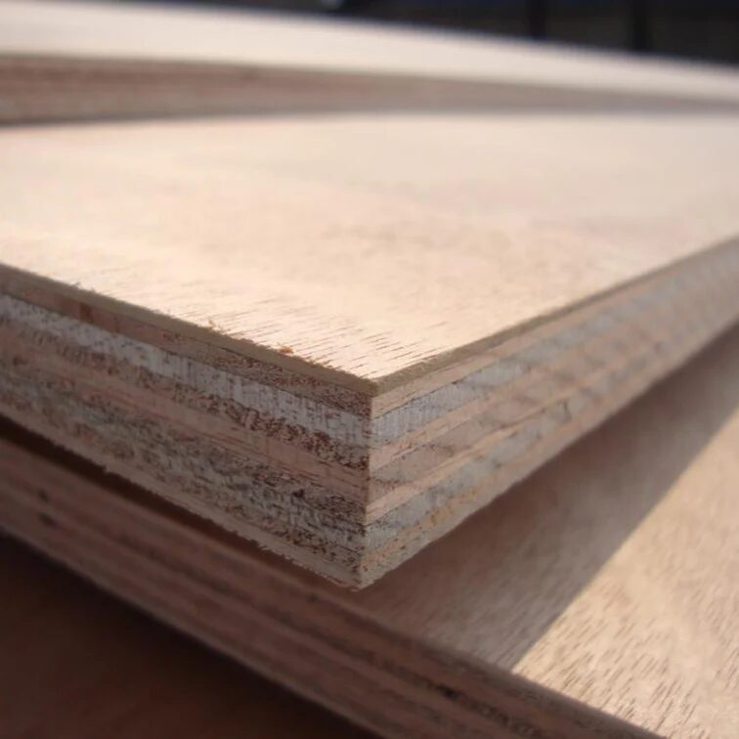
How to Find Reliable Timber Suppliers in Five Dock for Your Project

Slide 2

When it comes to starting a building or renovation project, one important decision is always to choose the right supplier. We’ve learned how the quality of materials can affect timelines, artistry and long-term outcomes. It is important to consider more than just prices when looking for Timber Suppliers in Five Dock consistency, product variety, and service are key factors to consider.
We know that builders and homeowners must have reliable materials on time for their most critical needs at Advanced Timber & Hardware.
Why Supplier Reliability Matters
A timber supplier plays a significant role in keeping a project on track. Delayed deliveries or inconsistent stock can create unnecessary setbacks.
When comparing Timber Suppliers in Five Dock, consider whether they offer:
Consistent stock availability
Quality timber that meets Australian standards
Knowledgeable customer support
Delivery options across Sydney
Products suitable for residential and commercial projects
These factors often make a noticeable difference throughout the construction process.

Slide 3
Look for a Wide Product Selection
Every project has unique requirements. Working with suppliers that stock multiple timber categories saves time and reduces sourcing challenges.
Products Worth Checking
Structural timber
H2 treated pine
H3 outdoor timber
LVL beams
Decking materials
Sheet products and plywood
Many experienced contractors prefer Timber Suppliers in Five Dock, which can provide most materials from one location rather than sourcing from several businesses.
Assess Their Industry Experience
In many cases, experience is a reflection of the supplier’s understanding of the construction requirements. Familiarity with the product and a supply network is usually stronger among suppliers who have a long history in the industry.

Slide 4
It is always advisable to see how long a business has been established and if they have frequently served tradespeople, carpenters and builders.
This is also useful when considering Timber Suppliers in Kogarah, and local experience can be useful to ensure the correct product is recommended for the application.
Delivery and Customer Support Make a Difference
Reliable service extends beyond supplying timber.
A quality supplier should provide:
Flexible delivery scheduling
Clear communication
Assistance with product selection
Support for bulk and ongoing orders
These practical services help projects move forward with fewer interruptions.
Compare Reputation and Product Quality
Consider customer reviews and the reputation of suppliers before making a choice. Five Dock’s trusted timber suppliers regularly find themselves getting repeat orders because of their reliable service and materials.

Slide 5
This is the same when evaluating Timber Suppliers in Kogarah, customer satisfaction can be a sign of longevity.
Choosing a Supplier with Confidence
Finding dependable Timber Suppliers in Five Dock requires careful consideration of quality, service, and experience. By focusing on suppliers with strong stock availability, practical support, and a proven reputation, projects can proceed with greater confidence. Advanced Timber & Hardware continues to support Sydney builders and homeowners with quality timber products, reliable deliveries, and professional service. For those comparing Timber Suppliers Kogarah, these same qualities remain essential when selecting a trusted supplier.

Slide 6

For More Details Contact Us :
Name: Advanced Timber & Hardware
Address: 2 Madeline St, Strathfield South NSW 2136
Telephone: 296423000
Email id: Sales@advancedtimber.com.au
Website: http://www.advancedtimber.com.au/

