Slide 1


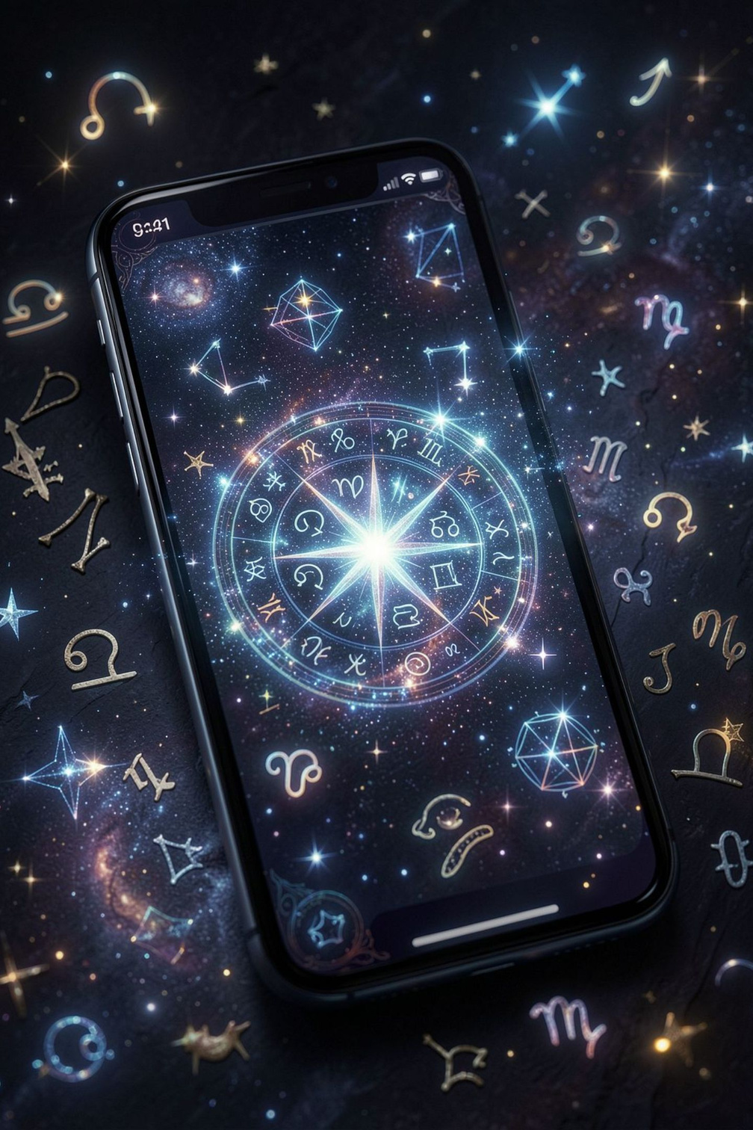

Vaidik Talk
Your Trusted Astrologer App
Discover astrology in a simple and modern way. Explore Kundli, Horoscope, Tarot, Vedic, Jyotish, Numerology, Birth Chart and Panchang — and connect with an astrologer through chat and calls.

Slide 2
About Vaidik Talk
Vaidik Talk brings traditional astrology and modern technology together — a complete digital astrology experience on your smartphone.
Personalized Guidance
Kundli & Birth Chart
Tailored astrology insights for your life
Explore planetary positions and houses
Daily Horoscope
Tarot & Numerology
Stay connected with daily insights
Two popular spiritual guidance systems
Panchang & Vedic
Astrology Chat
Traditional calendar and Vedic tools
Connect with expert astrologers

Slide 3


Astrologer Consultation
Connect with an experienced astrologer for personalized guidance — available through convenient chat and call options.
Relationship & Compatibility
Career & Business
Questions about love and partnerships
Guidance on professional paths
Kundli & Birth Chart
Vedic & Jyotish
Interpretation and analysis
Traditional consultation expertise

Slide 4
Kundli & Birth Chart
Your Kundli and Birth Chart help you explore traditional Vedic astrology — understand planetary positions, houses, and signs.
Planetary Positions
Compatibility
Career Insights
Understand planets and houses in your chart
Explore relationship compatibility through Kundli
Career-related questions and guidance
Personal Growth
Expert Discussion
Insights for self-discovery and growth
Discuss your chart with an astrologer

Slide 5
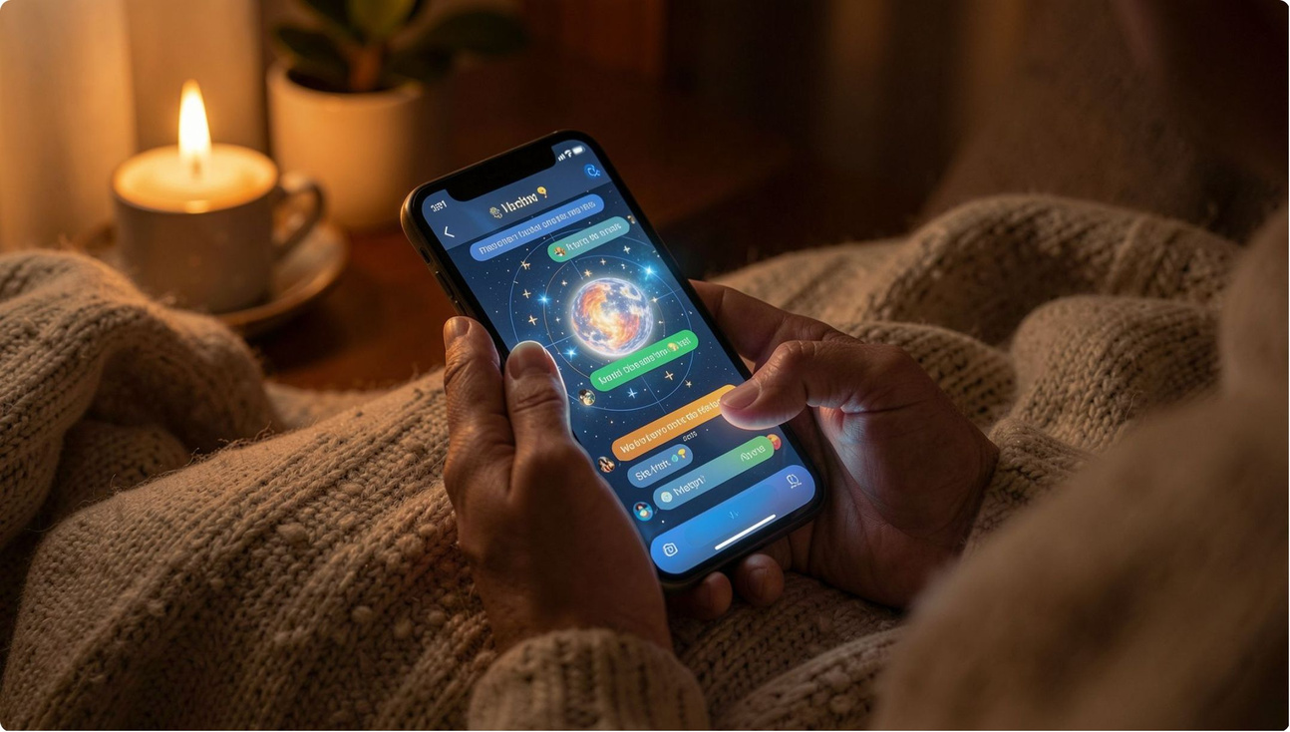

Horoscope & Astrology Chat
Daily Horoscope
Stay connected with astrology through daily horoscope insights delivered to your smartphone.
Personalized Questions
AI Astrology Experience
Relationship & Career
Ask astrology questions tailored to your life
AI-powered astrology insights
Discussions on love and professional life

Slide 6
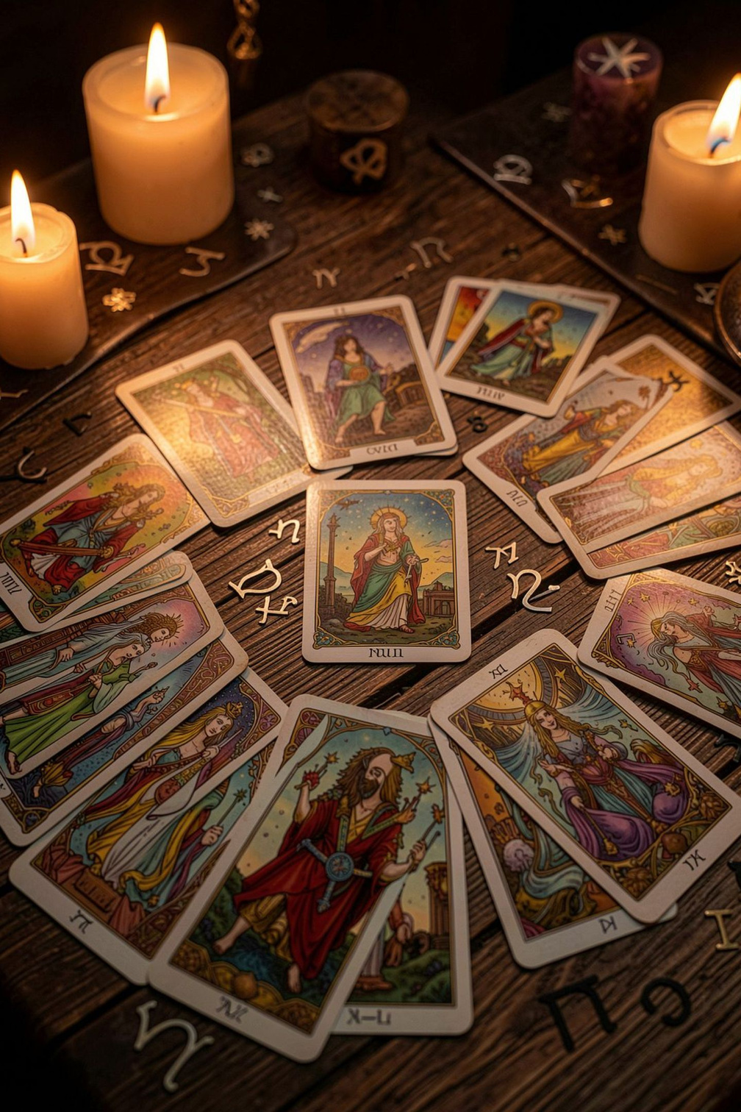
Tarot & Numerology
Explore two popular spiritual guidance systems in Vaidik Talk.
🃏 Tarot
🔢 Numerology
  Symbolic card-based guidance
  Relationship questions
  Career reflection
  Personal growth
  Name-based insights
  Birth-date numerology
  Compatibility exploration
  Personal reflection

Slide 7





Vedic Astrology & Jyotish
Discover traditional Vedic Astrology and Jyotish — explore planets, houses, and traditional astrology concepts.
Planets & Houses
Explore planetary positions and houses
Traditional Concepts
Understand Vedic astrology principles
Timing Themes
Explore timing-related themes in your chart
Jyotish Practitioner
Connect with a Jyotish expert for personalized guidance

Slide 8

Panchang & Muhurat
Panchang brings traditional calendar information to your smartphone — daily Tithi, Nakshatra, Moon Sign, Muhurat, and auspicious timing.
Daily Panchang
Moon Sign
Muhurat
Festivals
Tithi & Nakshatra info
Daily lunar guidance
Auspicious timing exploration
Traditional calendar events

Slide 9






Why Choose Vaidik Talk?
Vaidik Talk brings multiple astrology services together in one convenient app.
Astrologer & Chat
Kundli & Birth Chart
Expert consultations via chat and call
Planetary positions and chart analysis
Daily Horoscope
Tarot & Numerology
Personalized daily insights
Card and number-based guidance
Vedic & Jyotish
Panchang & AI
Traditional astrology and Jyotish
Traditional calendar and AI-powered features

